Slide 1
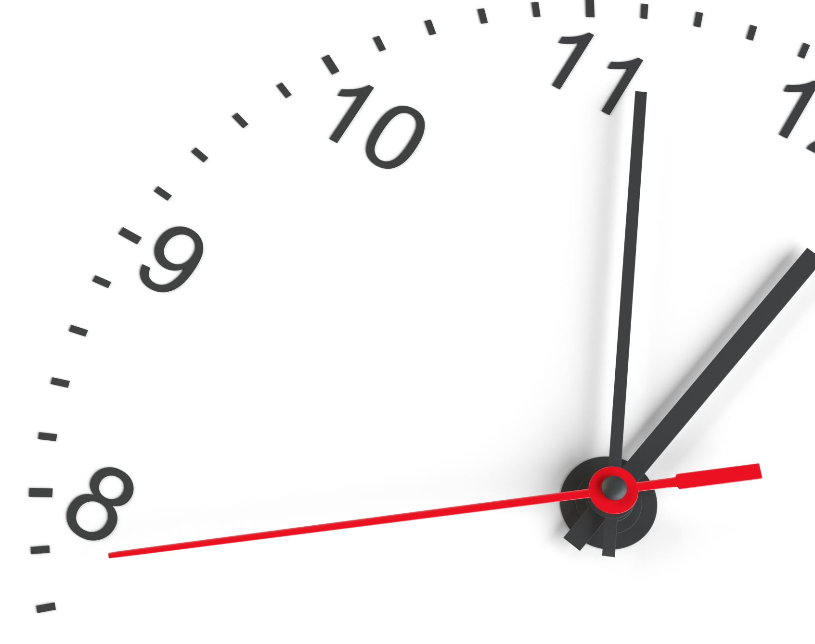
200 minutes
The key purpose of this process is to instil effective study habits from week one in Year 12 and give you material to study in your independent study periods.
We believe that this will allow you to properly utilise your study periods and begin to create a culture of study.

Slide 2
Scouse baby
Baby babbles in perfect Scouse accent | ITV News Granada

Slide 3
What is the ‘200 minutes’ project?
Subject staff have set up an academic Project based around their subject.
The Project has been designed to encourage independent study
Year 12s are still getting to grips with their subjects in the first 2 weeks and have not been taught much content yet. We would like you to fill your study periods straight away with meaningful work that supports your curriculum, develops independence and sets the tone for the rest of the year.
Each Project will take about 200 minutes (3-4 hours)
The deadline for this will be set for the middle of the 4th week (24th September)

Slide 4
How does it work?
Most of you will be studying 3 x A levels so you would pick 3 'projects' from the provision from your 3 subjects.
6th Form Tutors will help you to plan your projects (carefully breaking down the tasks, allocating study periods to these tasks etc.) Essentially, instilling independent habits.
Subject teachers may also set aside time in their lessons for you to present - it would be a shame for such work to not be showcased.
Failure to complete this will alert the sixth form leadership team to potential transition issues

Slide 5

Next steps
Some examples may include:
  A book review and presentation
  A literature review and presentation
  Research project gathering primary data
  Extended essay
  Creative task
The key purpose of this process is to instil effective study habits from the 'off’, including reading around the subject. It will also begin to normalize study in your study periods.

