Slide 1
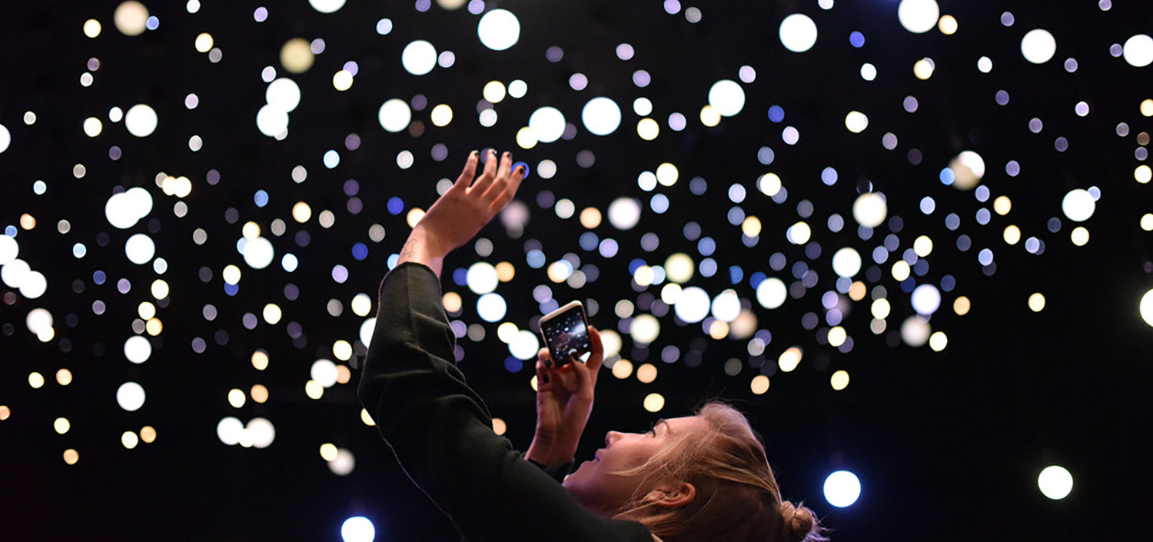

The Stellar programme -Ad astra (to the stars)

Slide 2
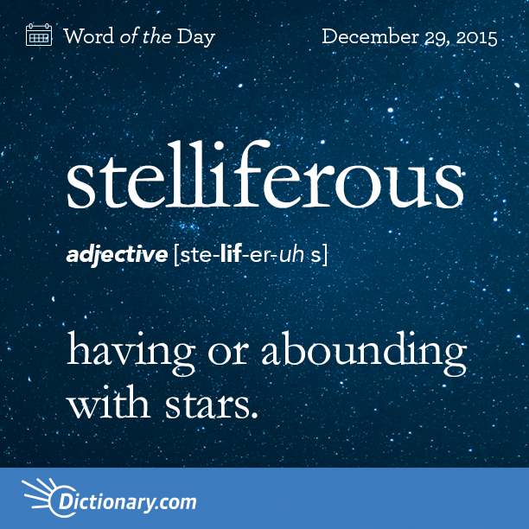

Slide 3
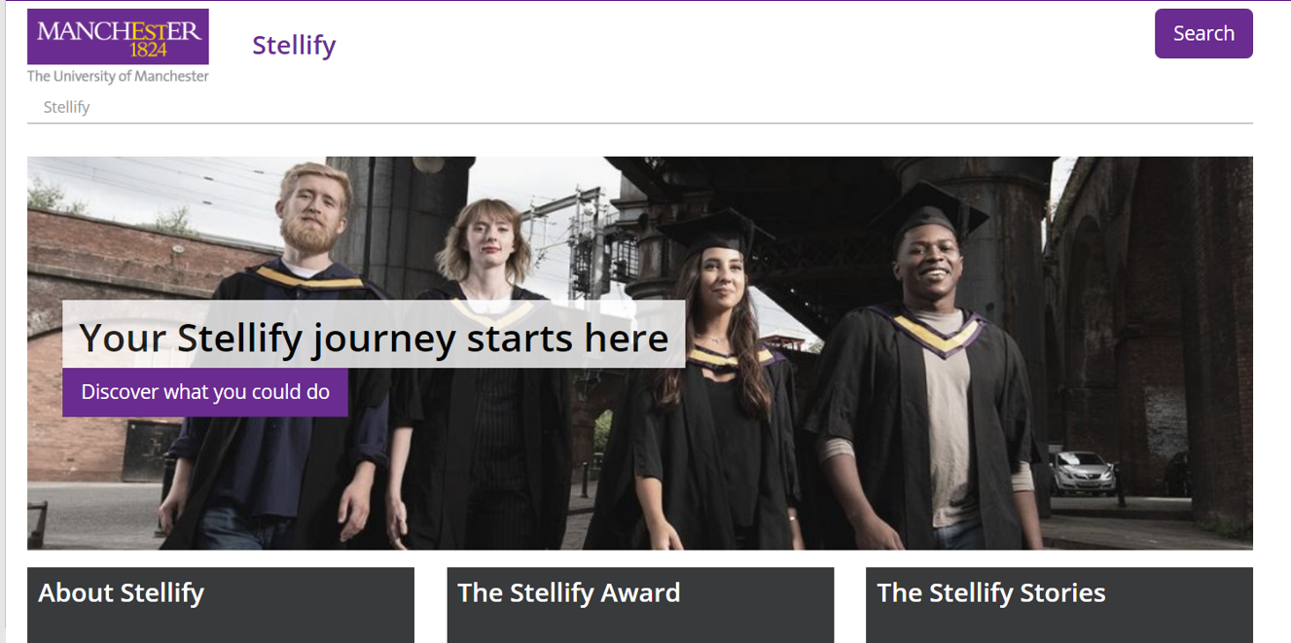
https://www.youtube.com/watch?v=Z2xzSVYT7hU&t=6s

Slide 4

14 sections, 3 levels, 2 years
Gold - 10 sections including all 9 highlighted
Silver - 7 including the one silver
Bronze - 5 including 3 highlighted

Slide 5
Super curricular
Personal Growth
Volunteer in School
Work Experience Placement
Attendance
Enrichment
Community Engagement
Charity
Student Leadership
The Stellar Programme
Cultural Events
Sixth Form Trip
Mentoring
HE / Careers
Sport

Slide 6
Bronze complete any 5 (at least 3 bronze)
Silver complete any 7 (at least 3 bronze and 1 silver)
Gold complete all 9 pyramid challenges
The Stellar Programme

Slide 7
Personal Growth
Enrichment
D of E / Young Enterprise
3 book reading challenge
get better sleep with a mindfulness project
take part in an environmental project,
learn a new skill (cooking, instrument, ICT)
Performing Arts – music, dance or drama
school club or society
debating

Slide 8
Volunteer in school
Work Experience Placement
Help at Open Evening / speak to students in other year groups / do student tours
Gain at least one week of valuable, aspirational work experience or career insight.
This could be virtual.
Buddy Reader / subject mentor
Promote clubs, societies and events
Facilitate PSHE discussions and debates

Slide 9
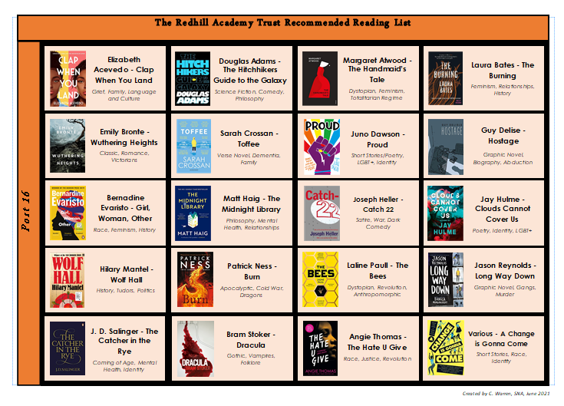

Slide 10
Attendance
98% challenge
Where circumstances prevent this, manage your studies effectively to accommodate your needs.
achieve 98% attendance over 2 years

Slide 11
Student Leadership
Charity
Taking a role in raising money / awareness for a chosen charity.
Community Engagement
Sixth Form Student Union
Form / Subject Rep
Taking a lead role in National charity events within school e.g. Comic Relief, poppy sales, Holocaust Remembrance
Helping to run youth groups e.g. Brownies / Cubs, church groups, environmental campaigning
Dog walking for the RSPCA / shopping for an elderly neighbour
Leading assembly, a club or society

Slide 12
Super Curricular
(Complete 3)
Attending university Summer School
Complete MOOCs in a subject that interests you
Take part in a curriculum trip beyond your course requirements
Attending taster lectures
Attending HE+ events

Slide 13
Mentoring
Sport
Play for a team, regular commitment e.g. yoga, help out with lower school team / training / refereeing
Peer / buddy mentoring, lower school mentoring, role models, lesson support
Sixth Form Trip
HE / Careers Encounters
Cultural Events (attend 2)
Theatre, music, art exhibitions, museum, online gallery tour, cultural lecture, TEDtalk
Independently visit universities, careers fairs, apprenticeship talks, careers talks, create a CV
Take part in a curriculum trip e.g. theatre, field trip

