Slide 3
Operation stage | Potential hazards | Controls in place
Purchase of food | Food may not be fresh due to bacterial growth Temperature of the food may be above 5°C | Delivery is not accepted due to the appearance and temperature of the food Temperature of the delivery van should be checked (print out provided)
Storage of food | High risk foods may be stored above 5°C High risk frozen food not be stored between -18°C to -22°C Dry foods may be contaminated | Fridge and freezer temperatures regularly checked and recorded Dry goods stored in well ventilated and pest proof containers
Food preparation | Food may NOT be prepared and cooked soon after preparation this will encourage bacterial growth High risk food may be prepared near/with low risk foods | Prepare high risk food and cover and put in the fridge (0°C to 5°C) Raw fish/meat must be stored away from cooked food – red chopping board to avoid cross contamination
Cooking of food | Food may not be cooked all the way through so bacteria will not be destroyed | Use a food probe to ensure the centre of the fish reaches 72°C for 2 minutes
Serving of food | Cross contamination from food handlers to the food | Use metal tongs not hands to avoid cross contamination
Washing up and cleaning | Food residue on plates and cutlery – bacteria growth | All equipment washed at a minimum of 82°C in a dishwasher to kill bacteria
Disposal of waste | Food scraps attract pests – source of bacteria | Secure bin lids to avoid pest contamination
Care of the kitchen | Dirt and food waste collect in corners and under work stations – attracts pests and bacteria growth | Kitchen deep cleaned every 6 months
There is a very high chance that there will be a question on HACCP
Notes:
There is a very high chance that there will be a question on HACCP

Slide 4
Operation stage | Potential hazards | Controls in place
Purchase of food | Food may not be fresh due to bacterial growth Temperature of the food may be above 5°C | Delivery is not accepted due to the appearance and temperature of the food Temperature of the delivery van should be checked (print out provided)
Storage of food | High risk foods may be stored above 5°C High risk frozen food not be stored between -18°C to -22°C Dry foods may be contaminated | Fridge and freezer temperatures regularly checked and recorded Dry goods stored in well ventilated and pest proof containers
Food preparation | Food may NOT be prepared and cooked soon after preparation this will encourage bacterial growth High risk food may be prepared near/with low risk foods | Prepare high risk food and cover and put in the fridge (0°C to 5°C) Raw fish/meat must be stored away from cooked food – red chopping board to avoid cross contamination
Cooking of food | Food may not be cooked all the way through so bacteria will not be destroyed | Use a food probe to ensure the centre of the fish reaches 72°C for 2 minutes
Serving of food | Cross contamination from food handlers to the food | Use metal tongs not hands to avoid cross contamination
Washing up and cleaning | Food residue on plates and cutlery – bacteria growth | All equipment washed at a minimum of 82°C in a dishwasher to kill bacteria
Disposal of waste | Food scraps attract pests – source of bacteria | Secure bin lids to avoid pest contamination
Care of the kitchen | Dirt and food waste collect in corners and under work stations – attracts pests and bacteria growth | Kitchen deep cleaned every 6 months
Notes:
There is a very high chance that there will be a question on HACCP

Slide 5
HACCP Exam Questions

Slide 6
HACCP
Hazards (salmonella food poisoning)
–Out of date/broken shells
–Uncooked
–Cross contamination
CCP’s
–Check dates/condition
–Check temperatures
–Keep raw/cooked seperate

Slide 7
Health and safety

Slide 8
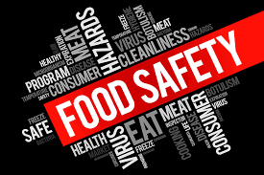
Food Safety Act
This ensures that food is safe to eat
It also checks that information on a product given to customer is correct (contains nuts)
Makes sure that the quality and composition of the food is based on what the customer expects (special claims like ‘made with 70% cocoa solids’ – ensuring this is true)
How would you ensure food is safe to eat?
Colour coded chopping boards – reduce cross contamination
PPE – aprons, hair nets – to avoid cross contamination
Food storage to slow bacteria growth
Cooking above 72⁰ C
Fridge 0 to 5⁰C
Freezer -18 ⁰C

Slide 9
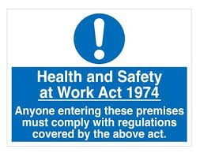
Health and Safety at Work Act
This aims to protect employees at work
It gives rules for employers to follow
–Workplace should be well lit
–It shouldn’t be too hot or cold
–Workers must be properly trained (in relevant health and safety)
–Equipment is safe to use
–Suitable measures are in place to stop dangerous equipment from harming staff (oven gloves)
–The fire and first aid policy is in place

Slide 10
Technology

Slide 11
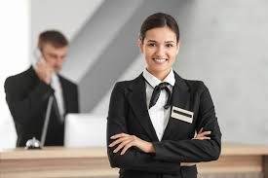
Uniform
All staff, in order for customers to identify them, should wear name badges and logos on uniform. Uniform should comfortable and breathable for employees to work in
What are the advantages of a uniform to employers and employees?

Slide 12
Diabetes Gluten/Coeliac Lactose Low salt Low fat Phenylketonuria (PKU/medical) MSG free Vegetarian Vegan Lacto-vegetarian Lacto-ove-vegetarian Pescatarian Paleo Kosher (religious) Religious beliefs Muslims Hindus Sikhs Jewish Rastafaria
Indicative content: Wheat/cereal Gluten free Nuts Seeds (sesame, pumpkin, poppy etc.) Molluscs Crustaceans (lobster, prawns etc.) eggs Dairy/milk free/lactose Mustard Sulphites Fish Fruits and vegetables Lupin Soya Beans (kidney beans, soya
Campylobacter • Salmonella • E-coli • Clostridium perfringents • Listeria • Bacillius cereus • Staphylococcus aureu

Slide 13
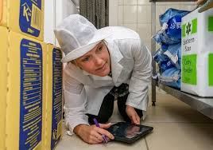
Roles | Responsibilities
Inspect business for food safety standards Follow up complaints Follow up outbreaks of food poisoning Collect samples for testing Giving evidence in prosecutions Maintaining evidence Submitting reports. Can close dirty premises Can impose fines of £20,000 or six months imprisonment Can take legal action for manslaughter | carrying out routine or unplanned visits and inspections to ensure compliance with health and safety legislation visit premises and make recommendations offer training enter premises without warning will check premises are hygienic check pest control check the temperature of the fridge, freezers, and hot holding check labelling of foods taking photos removing samples and conducting interviews as part of the inspection process

Slide 14
Trish has opened up a new café and is due a visit from the Environmental Health Officer (EHO). Describe the evidence an Environmental Health Officer will want to see in the following areas: (a) Preparation of food.
Different colour chopping boards • Raw meat prepared away from cooked to prevent cross contamination • Different colour coded knifes. • Food handler’s hygiene. • Food handlers appropriately dressed • No piercing visible, • hair up in a net (good hygiene practice) • washing hands • Correct handling of foods • Washing hands correctly • Food has been stored at correct temperature | Food handler hygiene certificate • Preparation of food quickly and is cooked and served in a safe time. • Separate areas for high-risk foods • Separate areas for raw meat and ready to eat. • Washing up • Waste disposal

Slide 15
Trish has opened up a new café and is due a visit from the Environmental Health Officer (EHO). Describe the evidence an Environmental Health Officer will want to see in the following areas: (a) cooking the food.
• Use of food probe Temperatures included: • Hot holding 63°C • Core temperature minimum temperature of 70° for 2 minutes. • Different coloured chopping boards• mell | Cooked at correct temperature • Cooking for correct amount of time • Different equipment maybe colour coded • Different areas for foods to prevent cross contamination. • Checking dates • Visual checks of texture/appearance/s

Slide 16
A HACCP form has been written for the café, however the EHO has advised that it has missed out the food storage section.
Fill in the HACCP on storage of food.

Slide 17
What are the advantages/ disadvantages of cafeteria service?
Customers are served ready-made food from a counter.
Advantages are:
Don’t need many staff, or skilled staff
Can serve a huge amount of people very quickly
Cost effective for business and cheap for customers
Disadvantages are:
–Food needs to be kept hot which is expensive and can cause food to deteriorate, spoil and be thrown away.
–Customers have to queue
–The display area can become very untidy and needs constant cleaning/replenishing.

Slide 18
Fast food – advantages and disadvantages
In a fast-food outlet, food is being cooked all the time. Customers order at a a counter and are given their food straight away.
Advantages
–They don’t need skilled staff
–They can serve a lot of customers quickly
–Easy for customers to grab something quickly if they are out and about
Disadvantages
–Lots of very specialist equipment like fryers which need to be on all the time (expensive running costs)
–Expensive rent for high-street outlets
–Limited menu options

Slide 19
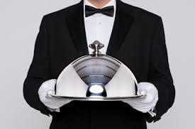
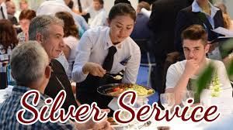
Silver service – advantages and disadvantages
Silver service is where waiters serve most of the foods at the table and where each item is placed based on the customers request (eg number of potatoes, types of veg). It is done with silver spoons and platters.
Advantages
–Highly entertaining, high level of personalised service so people will pay more for their meal
–Creates a sense of occasion and raises the profile of the establishment
Disadvantages
–Staff are highly skilled and therefore cost more to employ
–Unskilled staff attempting silver service may make mistakes like dropping food on customers.

Slide 20
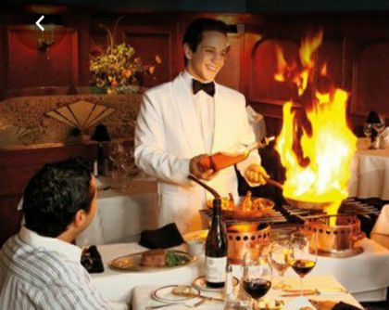
Gueridon – advantages and disadvantages
In Gueridon service, the chef finishes some element of the meal at the table. This may be carving, serving and even sometimes cooking the later stages in front of the customer
Advantages
–This is a highly entertaining form of service which means business can charge a premium price for their dishes
Disadvantages
–It is highly skilled and therefore is very expensive to employ and train people to this standard
–If not done by experienced professionals can cause health and safety problems.

Slide 21
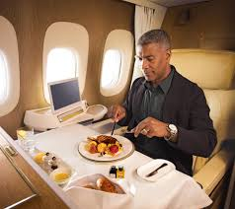
In flight service – advantages and disadvantages
In flight catering takes place on planes. Food is cooked elsewhere and then reheated ‘in-flight’.
Advantages
–Customers with special dietary requirements can pre-order their meals
–Less or no food is wasted as everyone knows exactly what they are having
Disadvantages
–Customers have limited choice
–Cooking facilities are limited which limits the range of foods that can be reheated.

Slide 22
A la carte
Individually priced items, large selection.
Cooked to order, freshly produced.
Minimum cutlery and crockery is laid, additional items are laid depending on choice of dish e.g. prawn cocktail, soup or pate.
Greater choice leads to high customer satisfaction.
More difficult for chefs. Usually more expensive as greater skills needed.

Slide 23
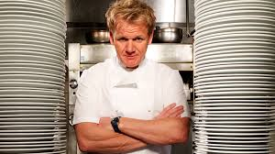
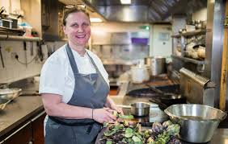
Head chef responsibilities
Manage the pass
Test the food and assure quality before leaving the kitchen
Organise the kitchen
Compile the menu’s
Order the foodstuffs
Show the required profit
Engage the staff
Supervise the kitchen
Advise on purchase for equipment
Be responsible for health, hygiene and safety
Gordon Ramsay
Angela Hartnett

Slide 24
Sous chef responsibilities
The sous chef will be responsible for a section of work within the kitchen
They are 2nd in charge so will take over from the head chef when they are way
They will support the head chef in other managerial roles eg training, supervising etc

Slide 25
Chef de partie (section chef)responsibilities
The chefs de partie are each in charge of a section of the work in the kitchen
Pastry chef (le patissier)
Roast chef (le rotisseur)
Fish chef (le poissonier)
Vegetable chef (l’entremetties)
Soup chef (le potager)
Grill chef (le grillardin).

Slide 26
What are the qualities you would expect from a commis (assistant) chef or a trainee?
Willing to learn
Punctual
Clean and tidy
Good listener
Able to take on advice
Basic cooking skills only (prep of veg etc)
What are the qualities needed for:
Receptionist
Waiter
Chambermaid
Etc etc?

Slide 27
What is the role of a restaurant manager?
Responsible for organising and supervising all the work in the restaurant.
Be flexible so that they can cover people who are ill.
Multitask and multi-skill so that they can do a wide range of jobs and cover a wide range of staff if needed.
Hire and fire staff.
Communicate with customers.
Co-ordinate the efforts of the staff.
Ensure high standards of practise and hygiene within the restaurant.
Train, develop and motivate a team of people less experienced/skilled than him/herself.
Be a leader, and lead by example.

Slide 28
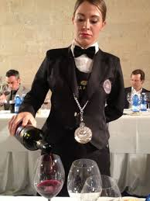
What does a Sommelie do?
A Sommelie is a wine waiter who advises on drinks eg which wine would go best with a certain chicken dish.
They are not just a bar person as they would be responsible for sourcing the wine for the restaurant/hotel and not just serving it.
The choice of wine with a meal is very important as it can enhance the outcome of the food.

Slide 29
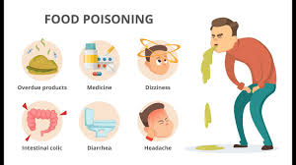
Name the symptoms of food poisoning?
Nausea
Vomiting
Diarrhoea
Fever
Stomach ache
These will usually last for 2-3 days

Slide 31
How is ICT used within the catering industry?
EPOS: Electronic Point of Sale systems are computerised tills that track a customers order. They communicate via a touch screen key information about the order to a kitchen which then produces the food. It also will keep track of stock and tell the waiter when that food has run out.
Stock control systems: These monitor stock levels. Any new orders are added to the system and when food is used, it is taken off. This way, a manager will know when to purchase new foods. Sometimes this system will work automatically and email suppliers by itself.
Publishing software: Can be used to make menu’s and advertising flyers for a business
Internet: Can be used to advertise the business and provide a means by which people can contact you and make bookings

Slide 32
You will need to know food provisions!!

Slide 33
When you read the question highlight the key points as you will need to refer to them in the next question!!
Theme park
Teenagers/adults
Accommodation
Budgets
Easy and cheap
There is a very high chance that this style question will be on the paper!!

Slide 34
Review your suggestions for the types of accommodation and justify, which one is most suitable to meet the needs of the customers and the owners of Zero Fear. [8]
You MUST refer to the following points in the case study
Theme park
Teenagers/adults
Accommodation
Budgets
Easy and cheap
Sample 7-8 marks
I have looked at my suggestions and I think the best one for the
customers and business owners would be a caravan park. Caravan parks need less staff than a hotel, which would make running it cheaper and easier than any other option. The start-up price would be a lot lower than a hotel and this would meet the needs of the business owners.
The caravan park could have a number of different caravans to facilitate different budgets of the Zero Fear customers, which are teenagers and adults. I could have chosen a hotel, however there is planning permission required, full time staff needed and costly overheads for the business owners because the main customers would only stay for a few days a caravan park would be ideal, as they wouldn’t have a lot of luggage with them. They
could get food at the park and use the caravan as self-catering, which could cut down the cost of accommodation. Overtime Jan and Mark could add more areas to the caravan park like café, restaurants and bar in order to make more money.
Why has this response achieved full marks?

Slide 35
Over the past few years Cupton, a borough in London, has seen an increase in house prices and a number of new businesses have opened.
A recent national news blogger revealed Cupton as “Currently the most up and coming neighbourhood in London”.
What are the key words you need to highlight?
Trendy retired people who are buying in Cupton, these are people who have money to spend! Many of the retired neighbourhood are well off and love to socialise with friends & family. They are always on the “look out” for the next trendy establishment and hangout. Don’t make the mistake that these retired people are ready for a slow life! Businesses opened in Cupton. Fast food outlets have popped up, however, these are not popular with the retired people of Cupton. A chained budget hotel has also been built;this is the only hotel in Cupton. It is popular but there’s no competition at the moment. A small coffee shop has also opened.

Slide 36
Over the past few years Cupton, a borough in London, has seen an increase in house prices and a number of new businesses have opened.
A recent national news blogger revealed Cupton as “Currently the most up and coming neighbourhood in London”.
What are the key words you need to highlight?
Trendy retired people who are buying in Cupton, these are people who have money to spend! Many of the retired neighbourhood are well off and love to socialise with friends & family. They are always on the “look out” for the next and hangout. Don’t make the mistake that these trendy establishment retired people are ready for a slow life! Businesses opened in Cupton. Fast food outlets have popped up, however, these are not popular with the retired people of Cupton. A chained budget hotel has also been built; this is the only hotel in Cupton. It is popular but there’s no competition at the moment. A small coffee shop has also opened.

Slide 37
Indicative content
• Luxury hotel
• B&B/guest house
• Boutique hotel
• Pop up restaurant
• Café
• Fine dining restaurant
• Public house
• Wine bar
• Private club/golf club
• Night club
• Spa hotel
• Main stream catering restaurant
• Play centre with café
• Holiday camp
• Chinese/Indian/Chip shop take away

Slide 38
Sample 3
(3 marks)
For the young people of Cupton I have suggested a night club, this is because there isn’t anywhere available for them to go and hang out. This will be place they can go to, drink, dance and socialise with all their friends. Somewhere in the evening that appeals to the young people. (3 marks)
I have chosen a café as its less formal than a restaurant and somewhere the retired residents of Cupton can arrange to meet up or pop into without having to book. It’s somewhere they can socialise and chat without time restrictions. There are already fast-food outlets however according to the report these are not popular in this area. (3 marks)
For the parents with young children the best idea, would be a café with a play area attached. This means there would be a safe and secure environment for the children to play whilst their parents have a coffee, cake and catch up with social groups or use the free wifi to look at social media. (3 marks)
Why has this response achieved full marks?

