Slide 1
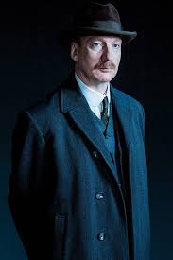
An Inspector Calls Lit Paper 2
Key context:
Written in 1945; first performed 1946.
Post war era; sense of need for change.
Introduction of the welfare state.
Labour government just elected.
Written about 1912 society.
Pre-war optimism of wealthy.
Huge inequalities in social classes.
Time of political unrest in Europe but also amongst workers – labour strikes.
Suffragettes – women’s rights.
Act 1:
Engagement party – Sheila and Gerald. Birling’s engagement speech p6/7
Arrival of inspector, lighting change p11
Interrogation of Birling for sacking Eva Smith p13-18 (Sheila and Mrs B absent)
Sheila re-enters and is told of the death.
Sheila’s interrogation – getting Eva Smith sacked from Milwards p20-25 (Birling / Mrs B absent)
Inspector mentions change of name to Daisy Renton. Argument between Gerald and Sheila (other characters absent).
Act 2:
Inspector re-enters to question Gerald. Mrs Birling enters – out of step with situation.
Gerald’s interrogation of his actions towards Daisy Renton and affair p34-40 (Eric absent) Sheila hands back ring. Gerald leaves.
Mrs Birling’s interrogation of her behaviour as part of the Brumley Women’s Charity Organization p42-48 (Eric and Gerald absent) Mrs Birling says the father should be blamed. Sheila realises that Eric is involved. Eric enters.
Act 3:
Eric’s interrogation of his behaviour towards the girl and theft p50-55
Inspector’s final speech p55-56
Birling family left to blame themselves. Sheila questions who the inspector was. Gerald returns and tells them he was a fake. They get proof by calling Colonel Roberts. Further arguments between them.
Gerald calls the infirmary for further proof – no girl has died.
Phone call – Birling answers – girl has died; police inspector is on his way.
The question:
You will be given a choice of 2 questions; you answer one. You will have 45 minutes.
Questions will be on character / theme / Priestley’s message and stagecraft.
Possible question focus:
Characters: Mr Birling, Mrs Birling, Sheila, Eric, Gerald, Eva Smith, Inspector Goole
Character groups or comparisons: older vs younger generation / males / females / rich / poor
Themes: responsibility / age / social class / attitudes / morality / society / Socialism vs Capitalism
Priestley’s message / stagecraft: how he uses the characters / moral message / how tension is created.
Priestley’s socialist message:
‘We don’t live alone. We are members of one body. We are responsible for each other.’
Dramatic devices:
Dramatic irony
Lighting changes
Entrances and exits
Stage directions
Eva – absent character / construct
Inspector – voice of Priestley
Structure of play – morality play
Key terms:
Socialism = society focused on equality
Capitalism = society built on profit
Bourgeoisie = rich capitalists
Proletariat = working class

Slide 2
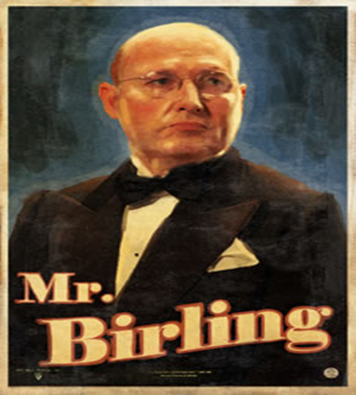
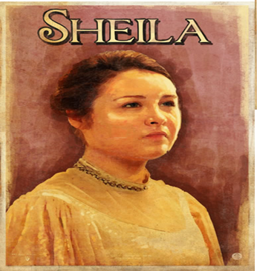
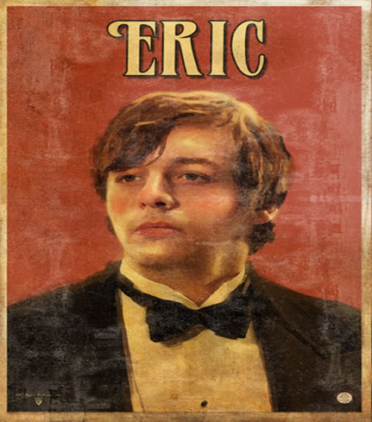
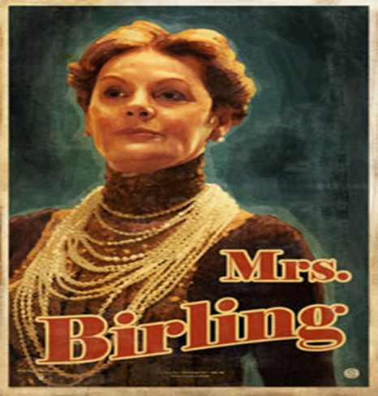
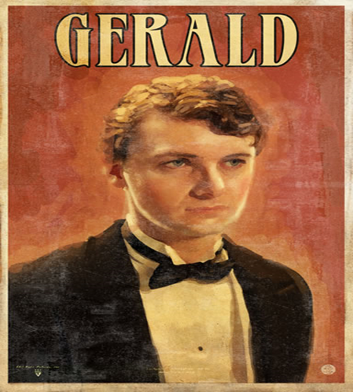
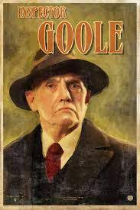
Mr Arthur Birling:
‘a hard-headed business man’
‘silly little war scares’
‘just a knighthood of course’
‘It’s my duty to keep labour costs down’
‘If you don’t come down sharply on some of these people, they’d soon be asking for the earth.’
‘The girl had been causing trouble in the works. I was quite justified.’
‘Look inspector, I’d give thousands’
How does Priestley use him?
Illustrates the faults with capitalist attitudes. Someone to mock / ridicule to remind us not to return to the past.
Sheila:
‘very pleased with life’
‘Look – Mummy – isn’t it a beauty?’
‘But these girls aren’t cheap labour – they’re people’
‘If she’d been some miserable plain little creature, I don’t suppose I’d have done it’
‘I’ll never, never do it again to anybody’
‘It frightens me the way you talk’
How does Priestley use her?
Portrays privileged, naive rich brought up with superficial, materialistic attitudes and values but shown to be capable of change – hope for future.
Eric:
‘half shy, half assertive’
‘squiffy’
‘I was in that state when a chap easily turns nasty - and I threatened to make a row’
‘You’re trouble is you’ve been spoilt’
‘Just used her for the end of a stupid drunken evening, as if she were an animal, a thing, not a person.’
‘He was our police inspector all right’
How does Priestley use him?
Illustrates what a privileged upbringing can create – immoral behaviour – but realizes his mistakes and says he will change.
Mrs Birling:
‘her husband’s social superior’
‘a rather cold woman’
‘she’d impertinently made use of our name’
‘I consider I did my duty’
‘girls of that class’
‘I was the only one of you who didn’t give in to him’
How does Priestley use her?
Illustrates the hypocrisy of the wealthy – charity involvement all about her own social standing and ego. A dislikeable character used to show the faults with the class system.
Gerald:
‘the easy, well-bred young man about the town’
‘the wonderful Fairy Prince’
‘I didn’t ask for anything in return’
‘it wasn’t disgusting’
‘We’ve been had.’
‘Everything’s alright now, Sheila’
How does Priestley use him?
A more complex character since some of his actions appear socialist and considerate but shows how rich can take advantage of others. Is shown to have not learnt from his actions when he finds out it’s a hoax.
Eva / Daisy:
‘a lively, good looking girl’
‘A good worker too.’
‘no relatives to help her, few friends, lonely, half-starved, she was feeling desperate.’
‘a pretty, lively sort of girl who never did anybody any harm’
‘She was very gallant about it’
‘she refused to take anymore’ (money)
How does Priestley use her?
Absent character / construct. Face of the poor – creates sympathy for the working class and is presented as the moral victim of the sins of the rich.
Inspector Goole:
‘I don’t play golf’
‘massiveness, solidity and purposefulness’
‘one person and one line of inquiry’
‘It’s better to ask for the earth than to take it’
‘She was here alone, friendless, almost penniless, desperate… you slammed the door in her face’
‘We are members of one body. We are responsible for each other.’
How does Priestley use him?
Priestley’s voice / mouthpiece. Exposes the faults of the other characters and presents Eva as victim through his emotive language. Structures the play.
Alderman Meggarty:
‘Old Joe Meggarty, half-drunk and goggle-eyed, had wedged her into a corner with that obscene fat carcass of his’
‘surely you don’t mean Alderman Meggarty?’
‘He’s a notorious womanizer as well as being one of the worst sots and rogues in Brumley’
‘everybody knows about that horrible old Meggarty… A girl I know… only escaped with a torn blouse’
How does Priestley use him?
Further illustration of the corruption of the rich capitalists. His abuse of women is shown to be accepted, even typical. Hypocrisy of those with status and power being people who behave immorally.

