Slide 1
Total revenue
(sales revenue or turnover):
The income that a firm receives from selling its goods or services. Selling price per unit x Number of units sold

Slide 2
Total
variable costs:
The total costs that change in relation to output
Variable cost per unit × Number of units sold

Slide 3
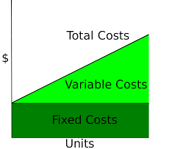
All of the fixed costs and variable costs of running a business. Fixed costs + Variable costs
TOTAL COSTS:

Slide 4
Profit:
The amount by which a business’s revenue from all its sales exceeds its costs. Calculated by taking costs away from revenue
Total revenue – Total costs

Slide 5
Interest:
The monetary charge for borrowing money —generally expressed as a percentage, such as an annual percentage rate (APR).
The reward you earn for saving money in a bank account
(Total repayment – Borrowed amount)
Borrowed amount × 100

Slide 6
BREAK EVEN
OUTPUT:
The level of output at which Total Revenue equals Total Costs.
On a break-even chart the level of profit at a given level of output is the vertical distance between the Total Revenue line and the Total Cost line. _______________Fixed costs______________
Selling price per unit – Variable cost per unit

Slide 7
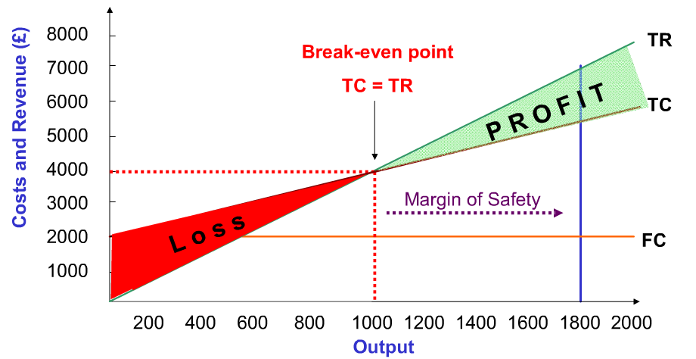
MARGIN OF
SAFETY:
Actual level of output – Breakeven level of output

Slide 8
GROSS PROFIT
MARGIN (%):
Gross profit x 100
Sales revenue

Slide 9
Net profit
margin (%):
__Net profit___ x 100
Sales revenue

Slide 10
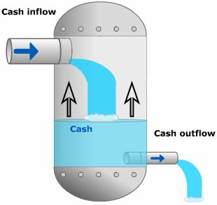
Net cash
flow:
Total inflows – Total outflows
Or
Total receipts – Total payments

Slide 11
Closing balance:
Opening balance + Net cash flow
Closing balance becomes the opening balance for the next month

Slide 12
Lead time:
The amount of time that passes between placing an order for new stock with a supplier and the goods arriving in the business
Delivery date – Date stock re-ordered

Slide 13
Gross Profit:
Sales Revenue – Cost of Sales This figure does not yet have overheads taken away from it

Slide 14
Net Profit:
Gross profit – Operating expenses

Slide 15
Average rate
of return (%):
Net return from project (£)/ number of years Initial cost of project (£) x 100
Where net return from project =
Total income from project over its lifetime – Total costs of project over its lifetime,
including the initial cost of the project.

Slide 16
Percentage
change:
New figure – Original figure
Original figure x 100

Slide 17
Average:
Total of all the individual values
The number of values in the set

