Slide 1
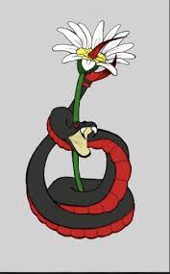
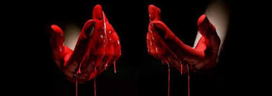
Macbeth 2025 Lit Paper 1
The question:
Short extract provided from one part of the play.
Starting with this extract, how does Shakespeare present…
Character or theme based questions. Could also be about stagecraft. WHAT? HOW? WHY? essay response needed.
Key context to refer to:
King James was an insecure king. The gunpowder plot was in 1605. Equivocation was a key issue at the time.
People believed in the supernatural and were fearful.
They believed in divine rule – king chosen by God – and the great chain of being – an order that kept balance in the world.
It was a patriarchal society – men in charge, women subservient.
Scene overview:
1.1 Witches meet on heath
1.2 Captain’s report
1.3 Prophecies
1.4 Macbeth is honoured
1.5 Lady Macbeth introduced
1.6 King Duncan arrives
1.7 Second thoughts / manipulation
2.1 Floating dagger
2.2 After the murder of Duncan
2.3 Porter / Duncan found
2.4 Macduff won’t go to watch him crowned
3.1 Plotting murder of Banquo
3.2 Macbeth admits fears to LM
3.3. Murder of Banquo
3.4. Banquet / ghost of Banquo
3.5 Hecate
3.6. Lennox says Macduff has gone to England
4.1 Second prophecies
4.2 Lady Macduff murder
4.3 Macduff meets Malcolm – distrust
5.1 Lady Macbeth sleepwalking
5.2 Rebels meet
5.3 Macbeth abusive to servants
5.4 Soldiers plan attack (branches)
5.5 Lady Macbeth’s death
5.6 Malcolm attacks
5.7 Macbeth kills Young Siward
5.8 Macduff kills Macbeth
5.9 Malcolm becomes king
50 mins – one compulsory essay question (30 + 4 marks)
5 mins to check SPAG
You must: ATM
Answer the question(say where it comes from and why it is important)
Analyse the extract and the language Shakespeare uses.
Then make links to at least 2 other scenes in the play.
Add in comments about the context of the play when analysing.
Q focus: key characters:
Macbeth
Lady Macbeth
Banquo
Witches
Duncan / Malcolm (kings)
Macduff
Key dramatic terms to use:
Soliloquy (one speaker on stage, speaking thoughts to audience)
Tension / suspense
Dramatic irony Iambic pentameter
Aside Trochaic tetrameter
Q focus: key themes:
Ambition
Violence / tyranny
Supernatural
Betrayal / deception
Loyalty / trust
Love
Gender / manliness
Fate
Appearance vs reality
Kingship
Key elements of tragedy to bring in:
Protagonist / antagonist
Hubris (excessive pride)
Hamartia (fatal error)
Catharsis (sense of resolution)
Anagnorisis (moment tragic hero realises his errors)
Tragic downfall
Machiavel (villain who manipulates)
Plan first:
Read the extract carefully and look at the info provided (what is happening)
Highlight at least 3 quotes from the extract that you can use to answer the question.
Around the outside of the extract, write down any key quotes from other parts of the play that you can remember that you could link to. Remember 3 big ideas.
Jot down key words about context that you could include.
Motifs: (symbols running through the play)

