Slide 1
Y11 GCSE PE November Mock Exam Revision

Slide 2
Timetable and guidance…
Topic | Topic
1 | Skeletal System and Joints
2 | Movement Analysis
3 | Muscles and muscle fibre types
4 | CV System
5 | Health and PES
6 | COFS and Fitness Testing MOTS and POTS
7 | PEDS
8 | Factors Affecting Participation in Sport
9 | Sporting Behaviour
10 | Sports Psychology: Skill Classification/Practice/Guidance and Feedback
Take each topic and then split the 4 tasks into 2 sessions…no more than 15 mins each.
Part 1
Task 1 Complete the revision clock adding AO1 AO2 AO3 content from memory
Task 2 Now use you revision guide/notes and green pen your revision clock using your notes/revision guide…this is the content you now need to re learn/go over.
Part 2
Task 1 Ever Learner topic test. 80% required!
Task 2 Past Paper: work through the exam questions and check your answers
Once completed…be proud and get busy doing something else before hitting the next topic!

Slide 3
GCSE PE revision Clocks
Suggested revision activities
Task 1 Use the AO1 prompt to get you thinking…now add any key words that sprint o mind
Task 2 can you add an example e.g. AO2 (the cranium is a flat bone and protects the brain from injury from impact as in football)
Task 3 Can you add AO3 e.g. impact of this on performance (cranium will allow the striker to head the ball again and again without injuring the brain)
Task 3 Highlight any of the prompts/key terms around the clock that DO NOT ring any bells in your memory…these are what needs to be revised…so open up your revision guide and make some notes.
REMEMBER what is the impact on any topic on PERFORMANCE in sport

Slide 4
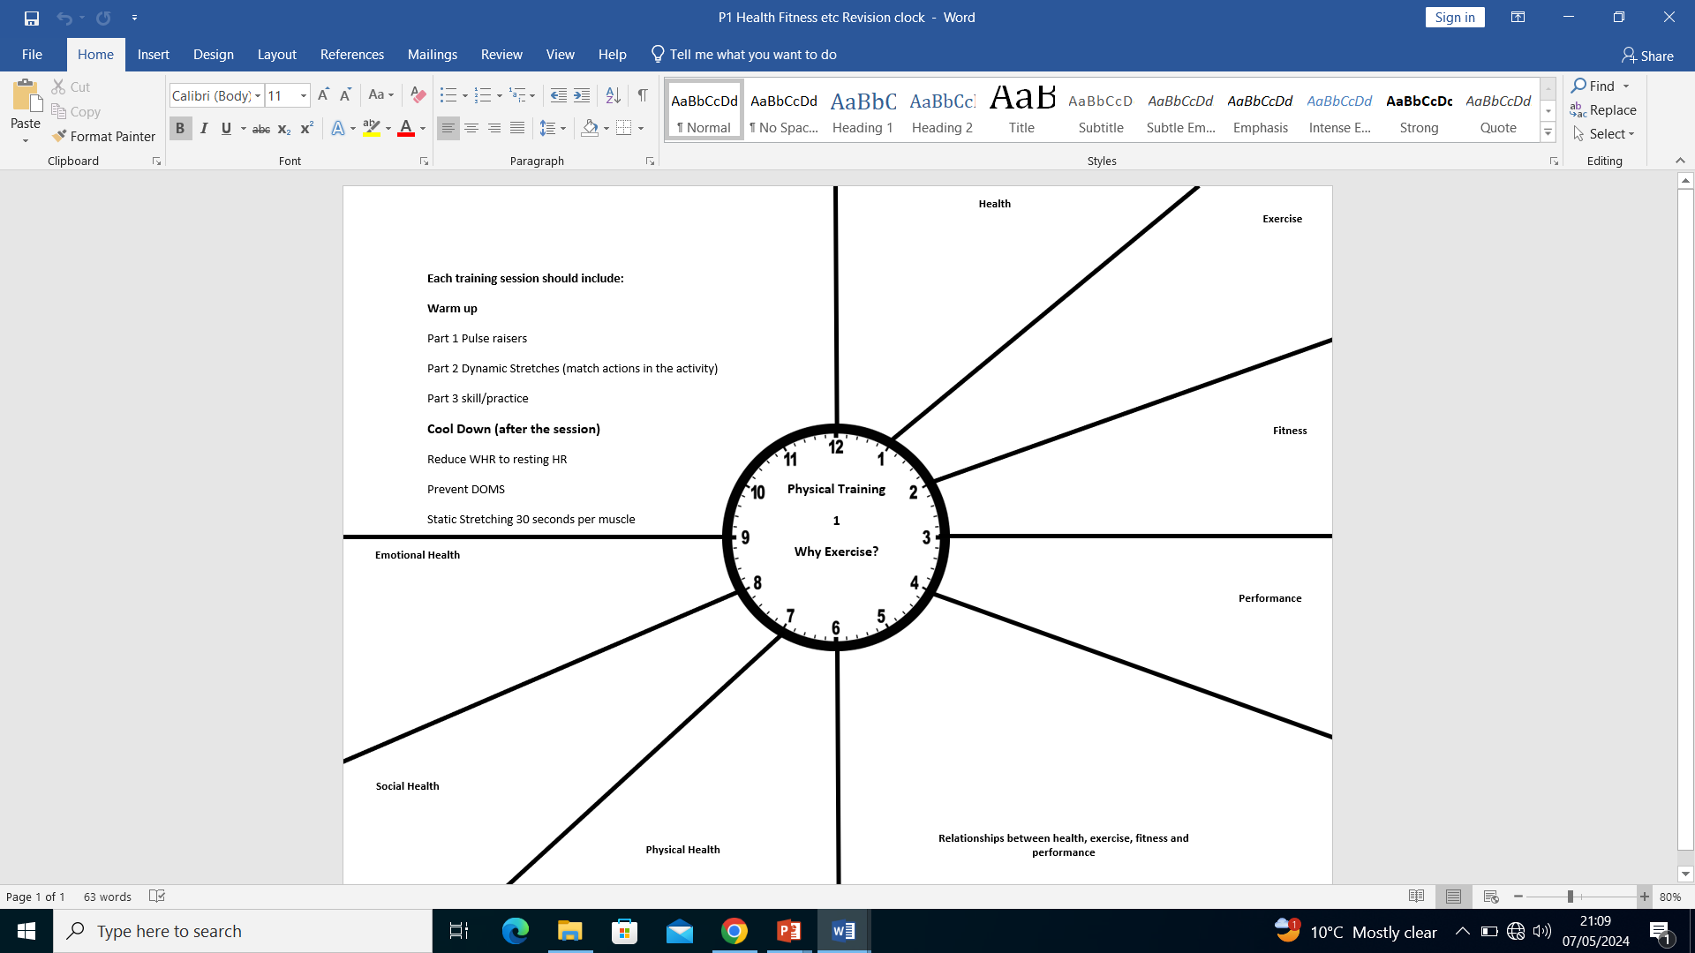

Slide 5
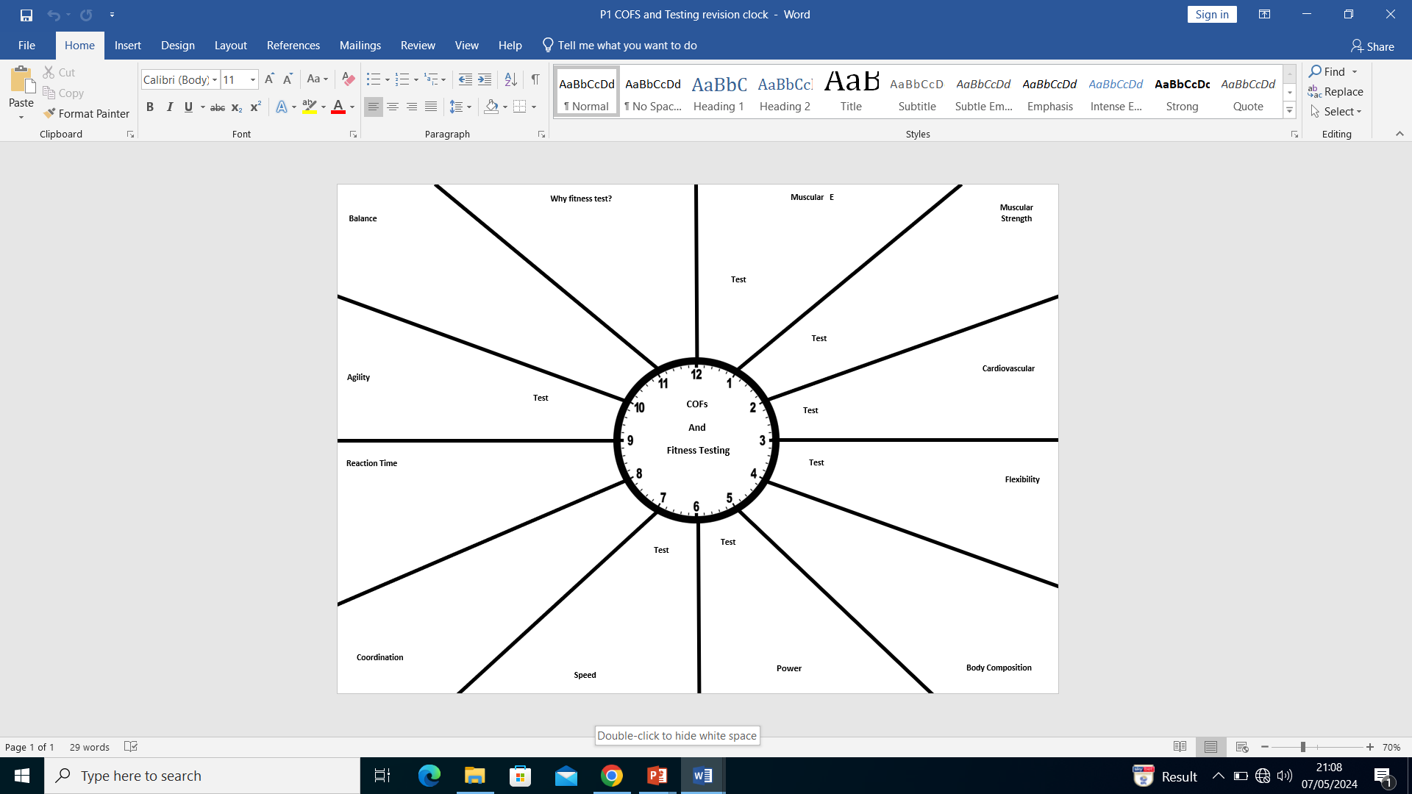

Slide 6
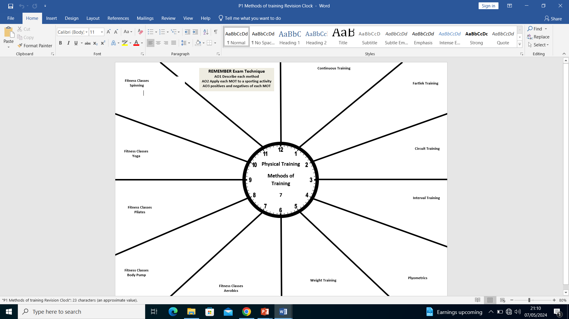

Slide 7
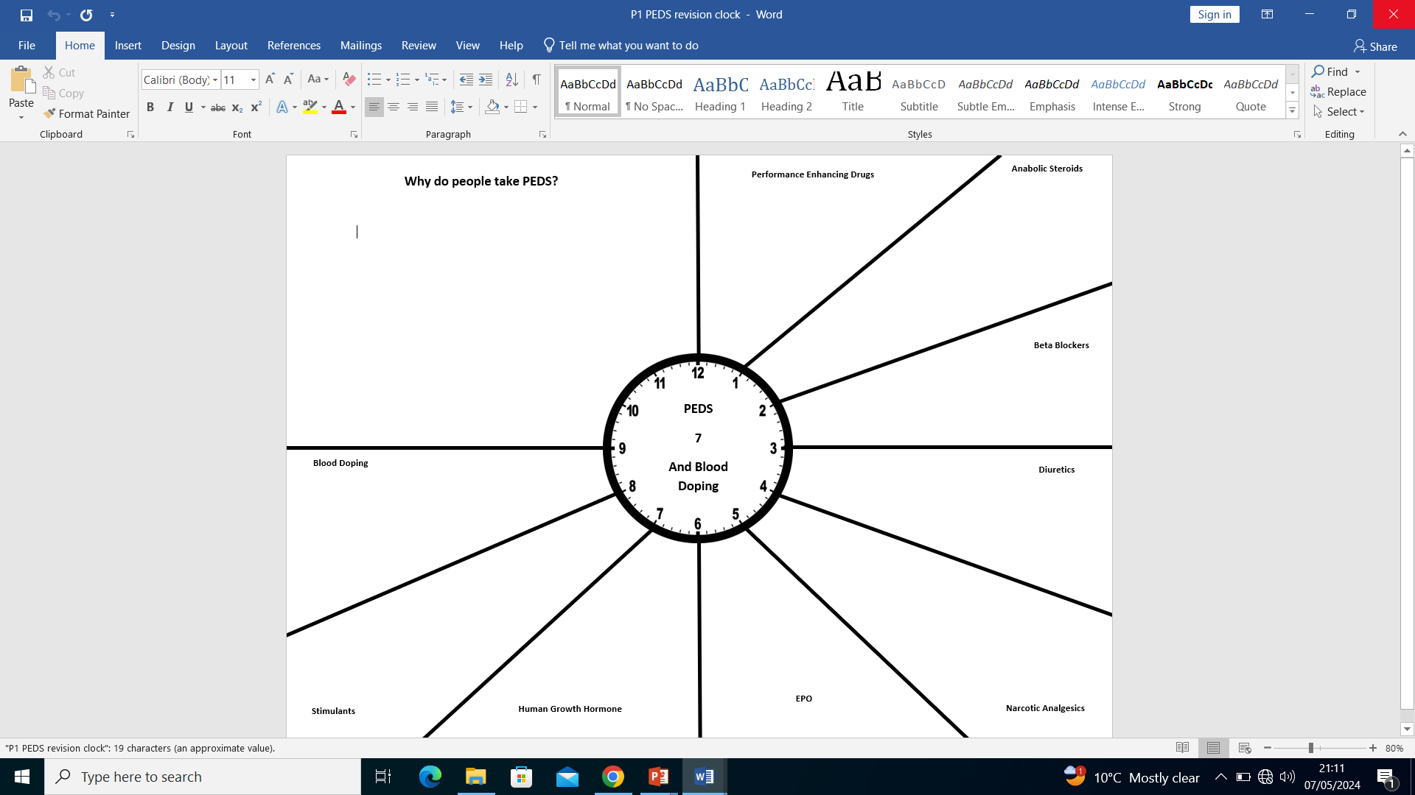

Slide 8
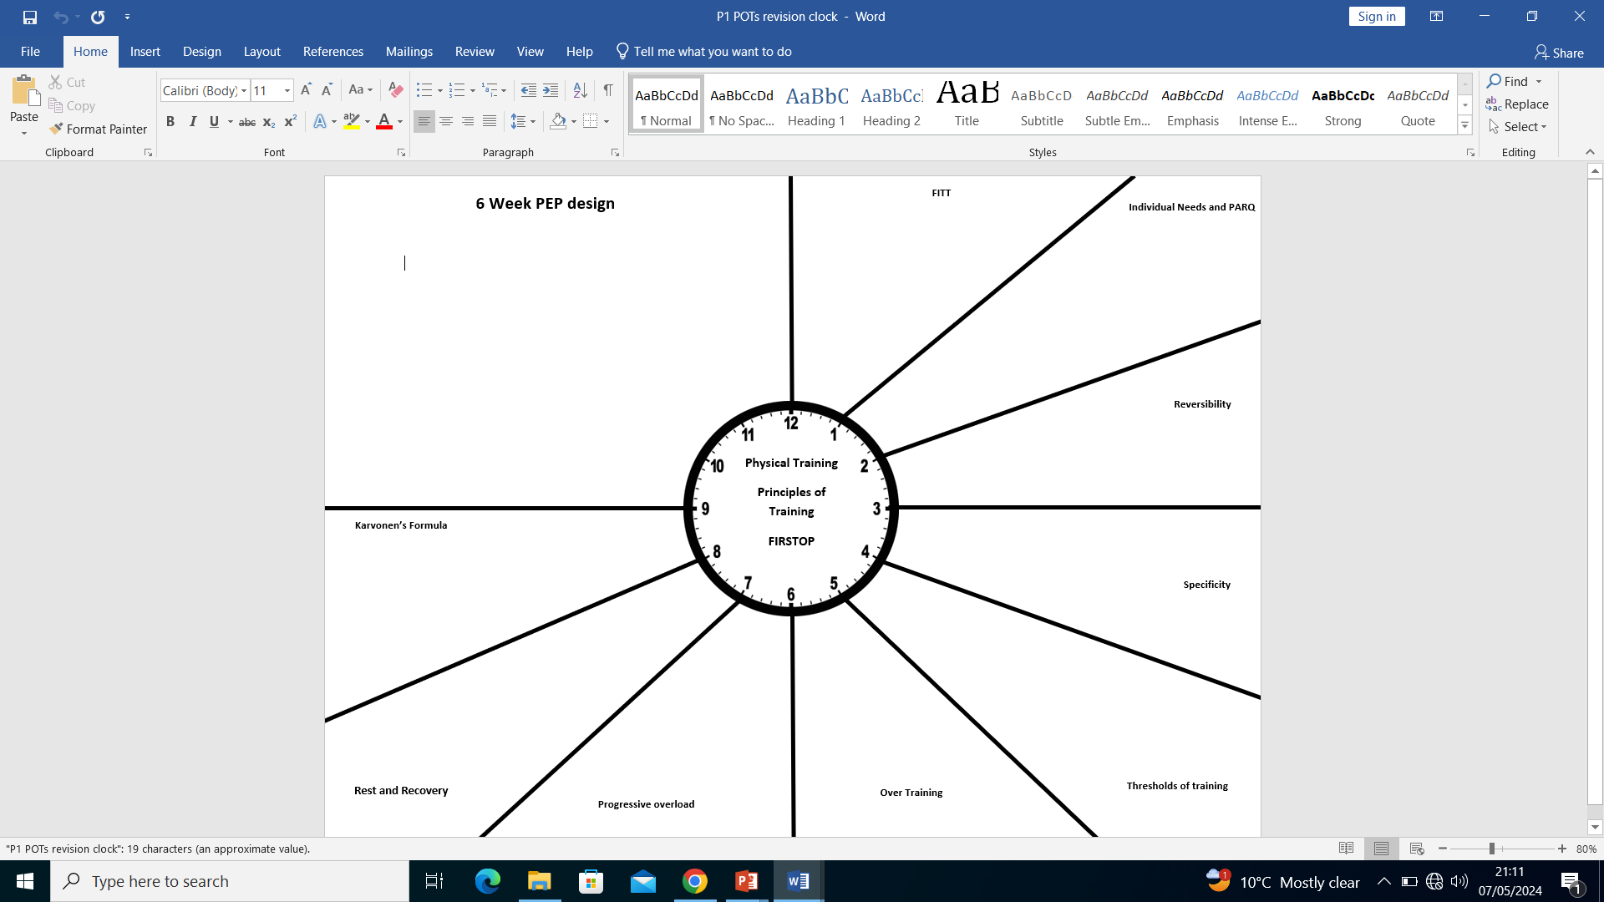

Slide 9
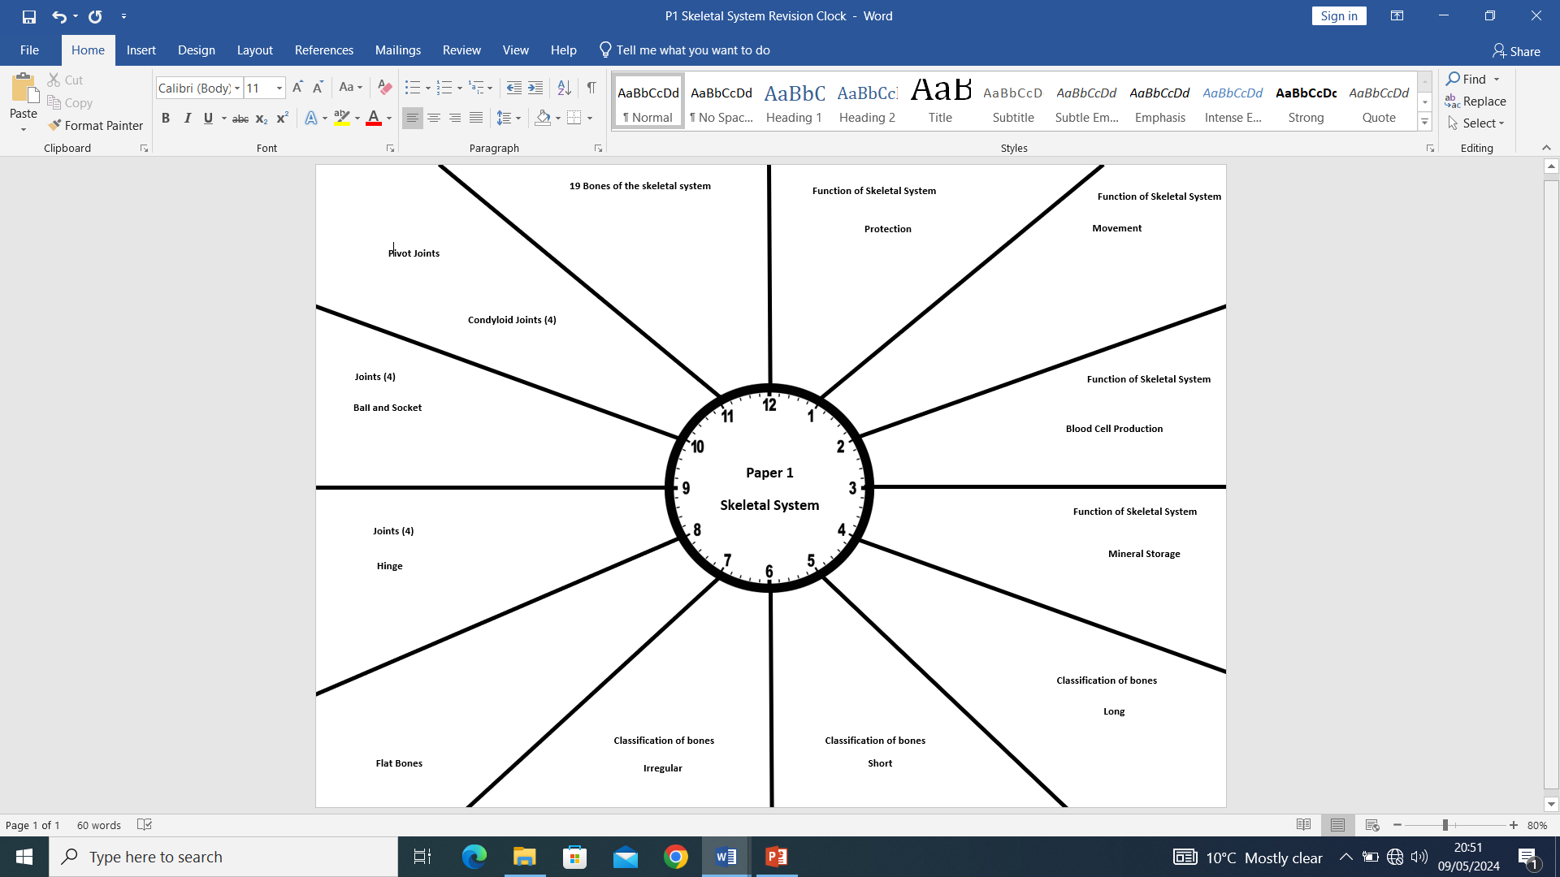

Slide 10
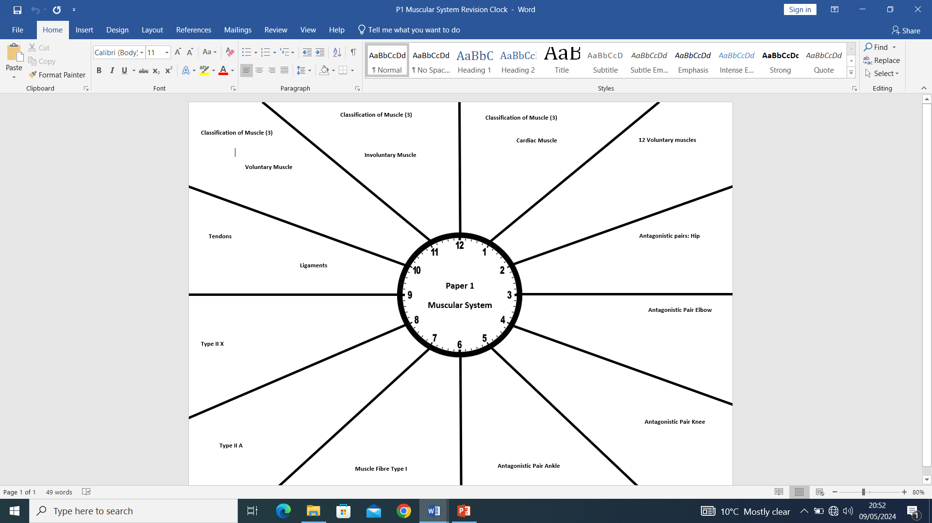

Slide 11
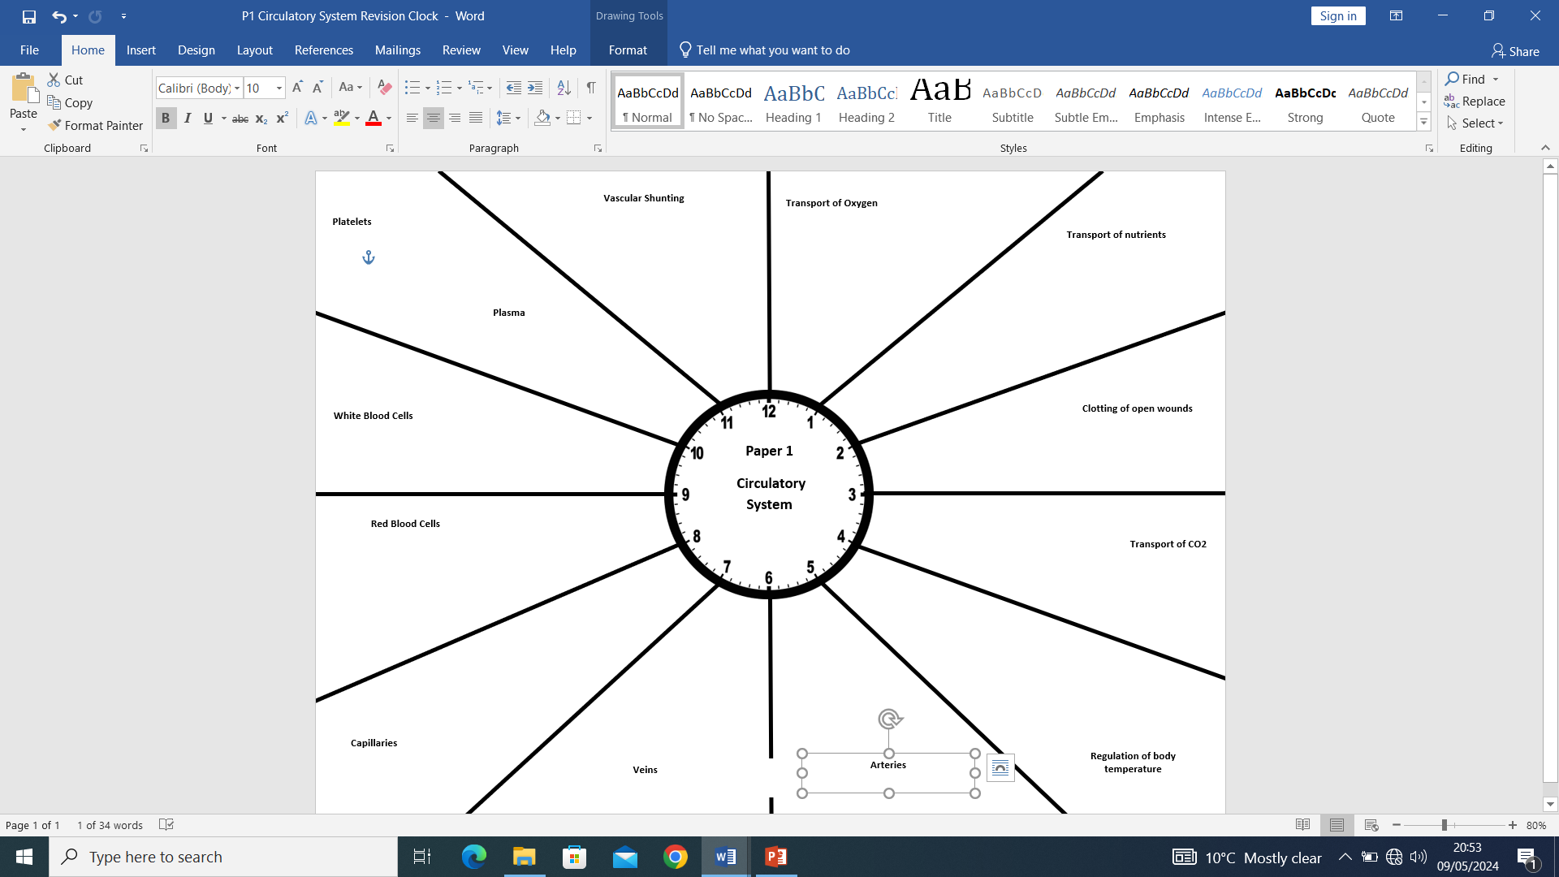

Slide 12


Slide 13
Paper 2
Factors Affecting Participation
Sporting Behaviour

Slide 14
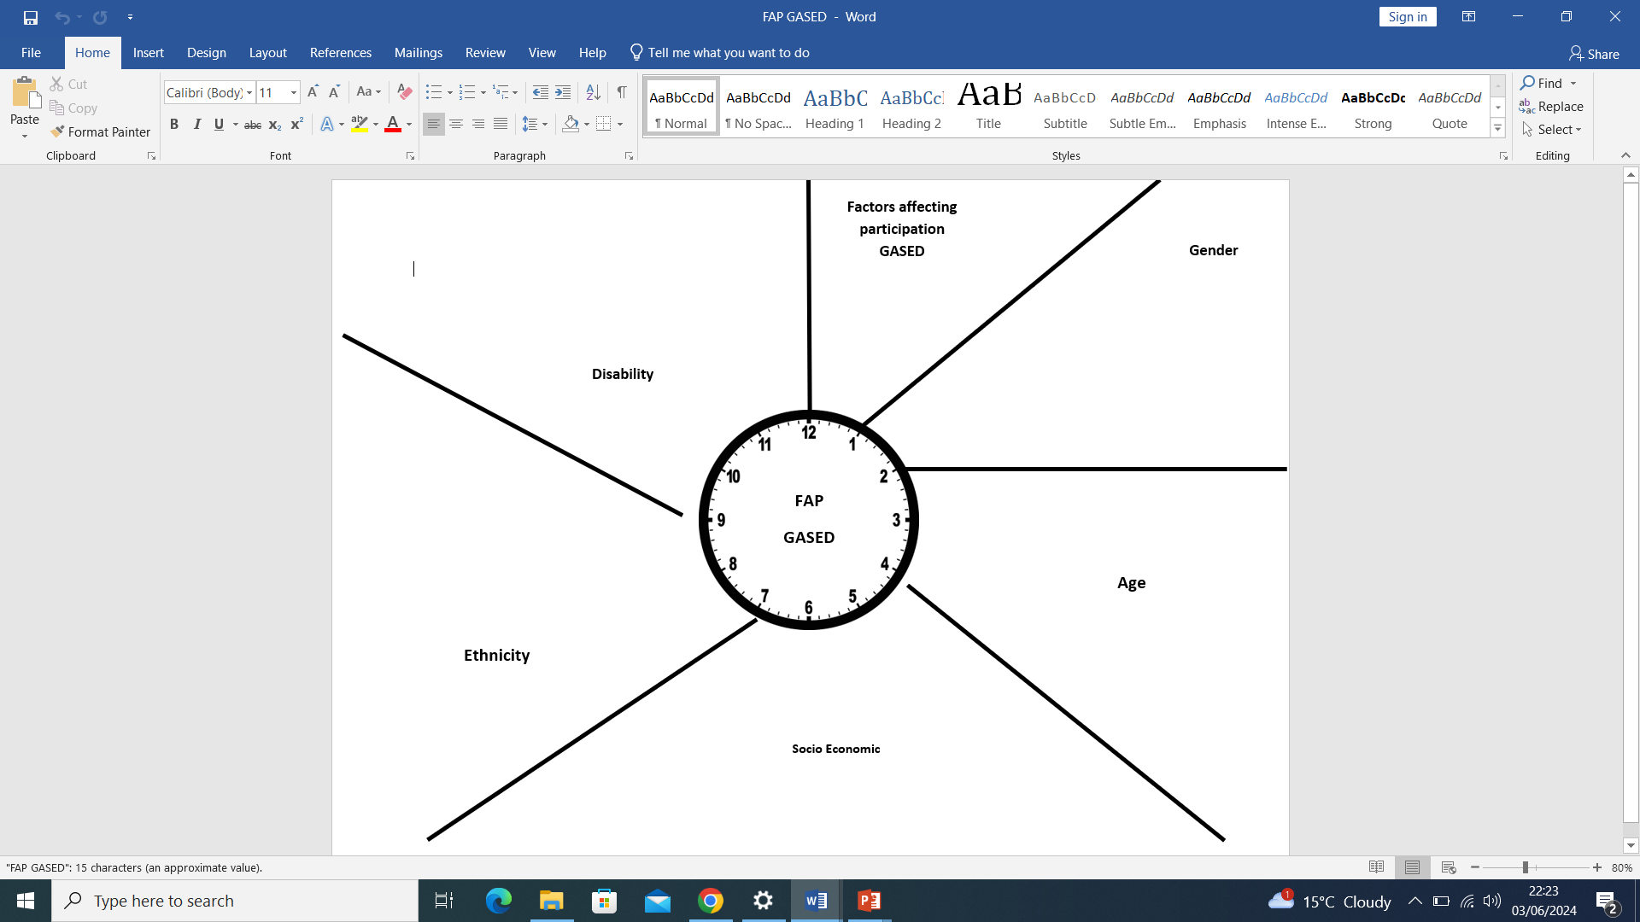

Slide 15
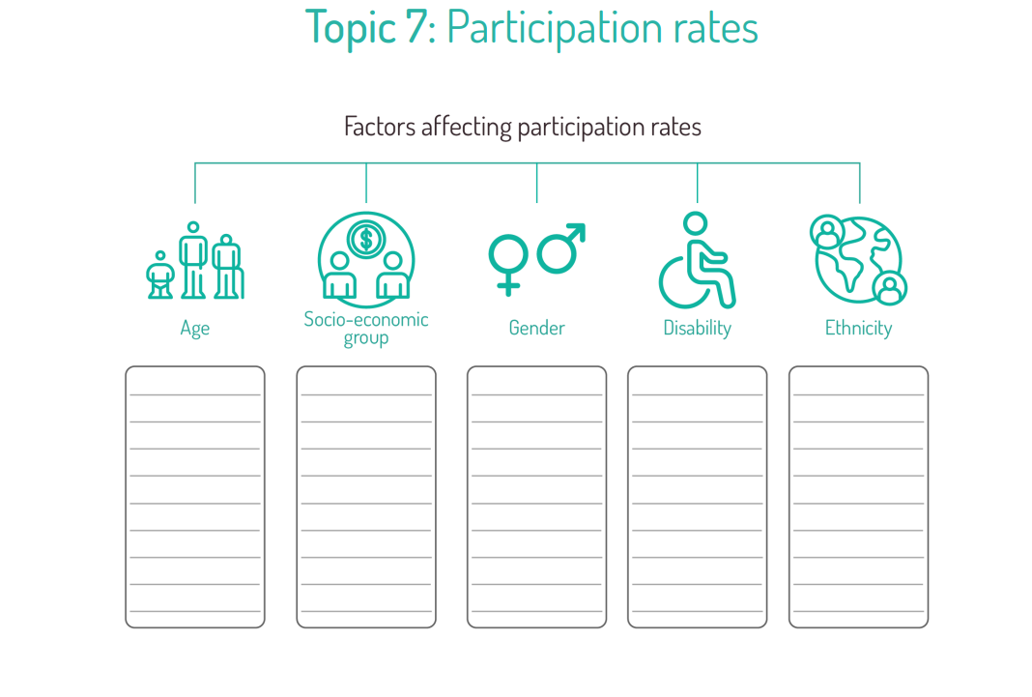

Slide 16
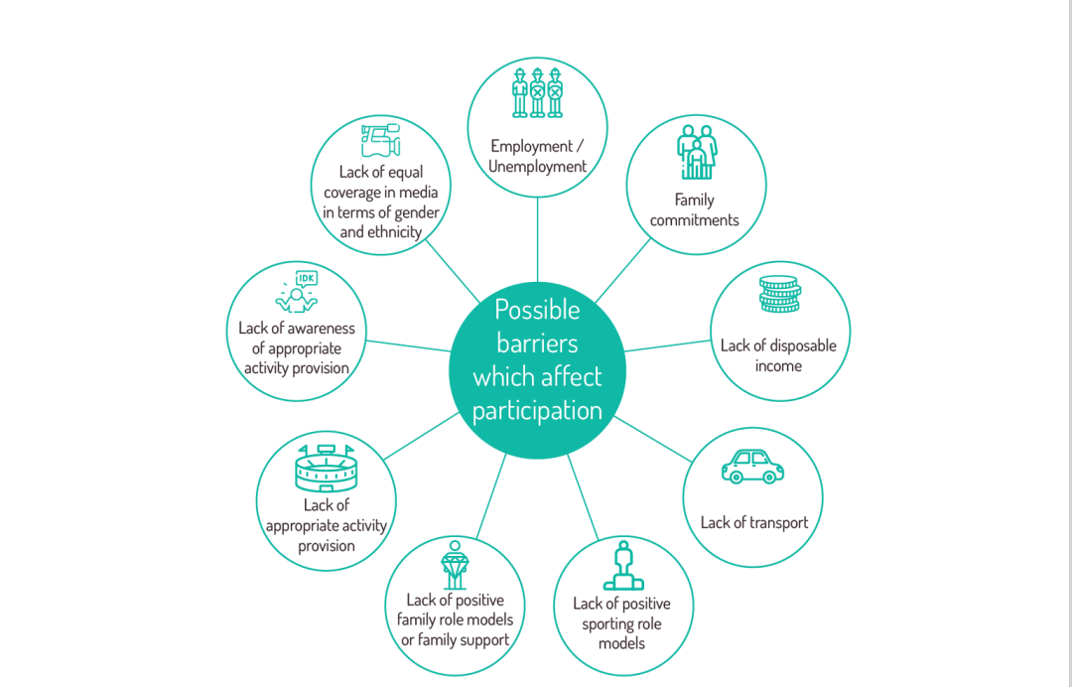

Slide 17
Factors Affecting Participation Examples answers
A01 (Factor) | AO2 (example) | AO3 (Impact)
Gender | dance has the ‘image’ of being stereotypically for females | More women are seen dancing therefore men are less likely to engage in it
Age | Type of activity….Contact sports e.g. rugby are not suited to older people | Older people more likely to engage in low impact sport e.g. bowls
Socio-economic | Professional people have access to more disposable income | More likely to be able to afford gold club membership or activities like skiing
Ethnicity | You are more likely to participate in sports that fit your culture e.g. area, family and friends | You are more likely to ski if you live in the Alps in France versus Kenya
Disability | Disability will influence what sports can be participated in…as they may required adapted equipment/facilities | Increased funding via commercialisation (media/image on TV) may increase options to engage in sport and also the interest in getting involved in it e.g. wheelchair basketball

Slide 18
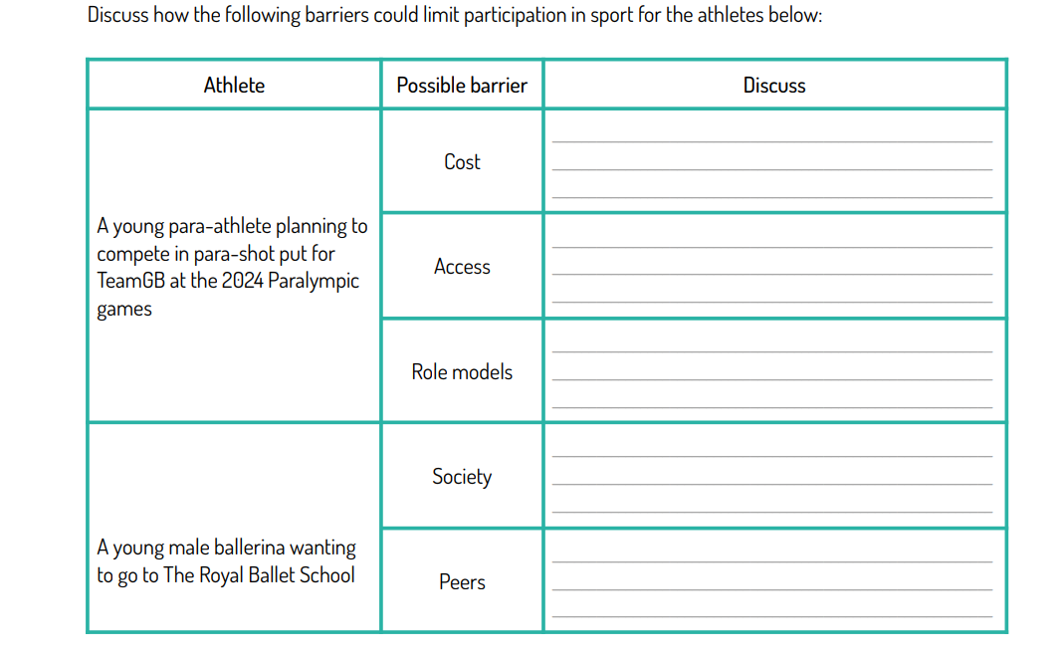

Slide 19
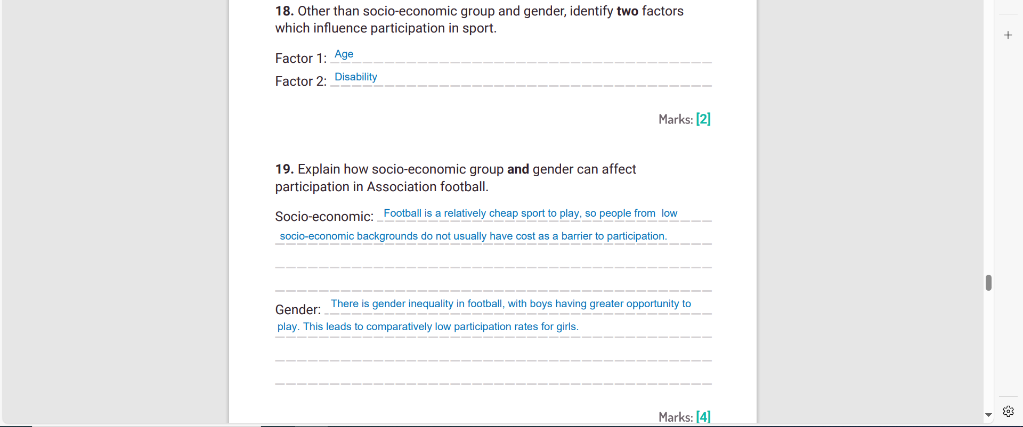

Slide 20
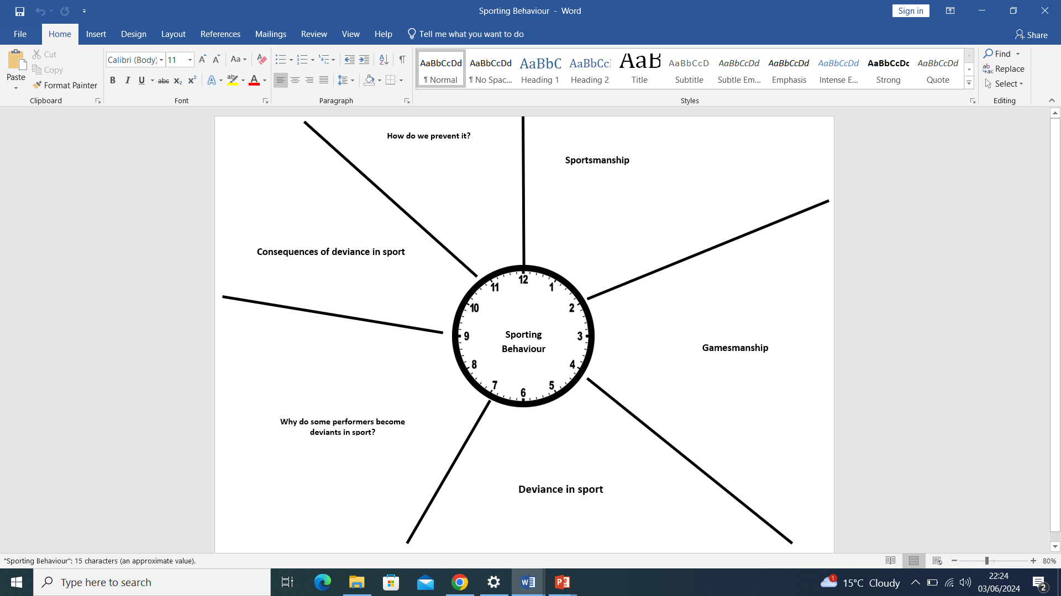

Slide 21
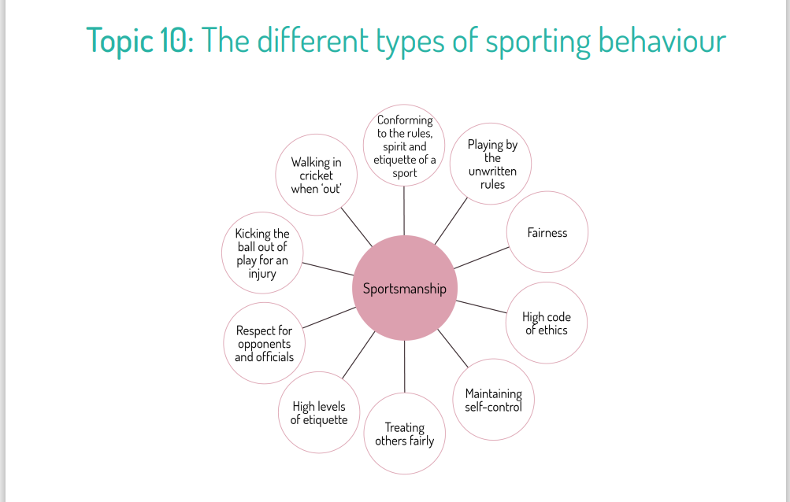

Slide 22
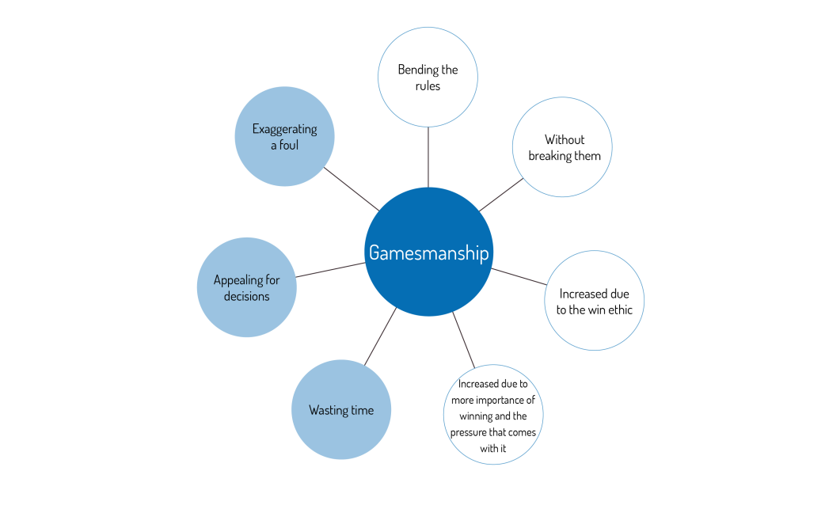

Slide 23
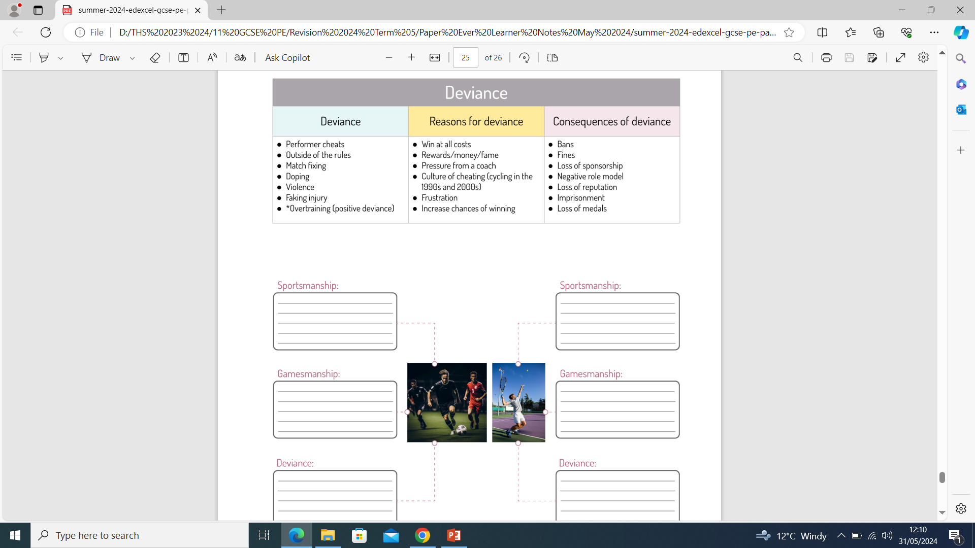

Slide 24
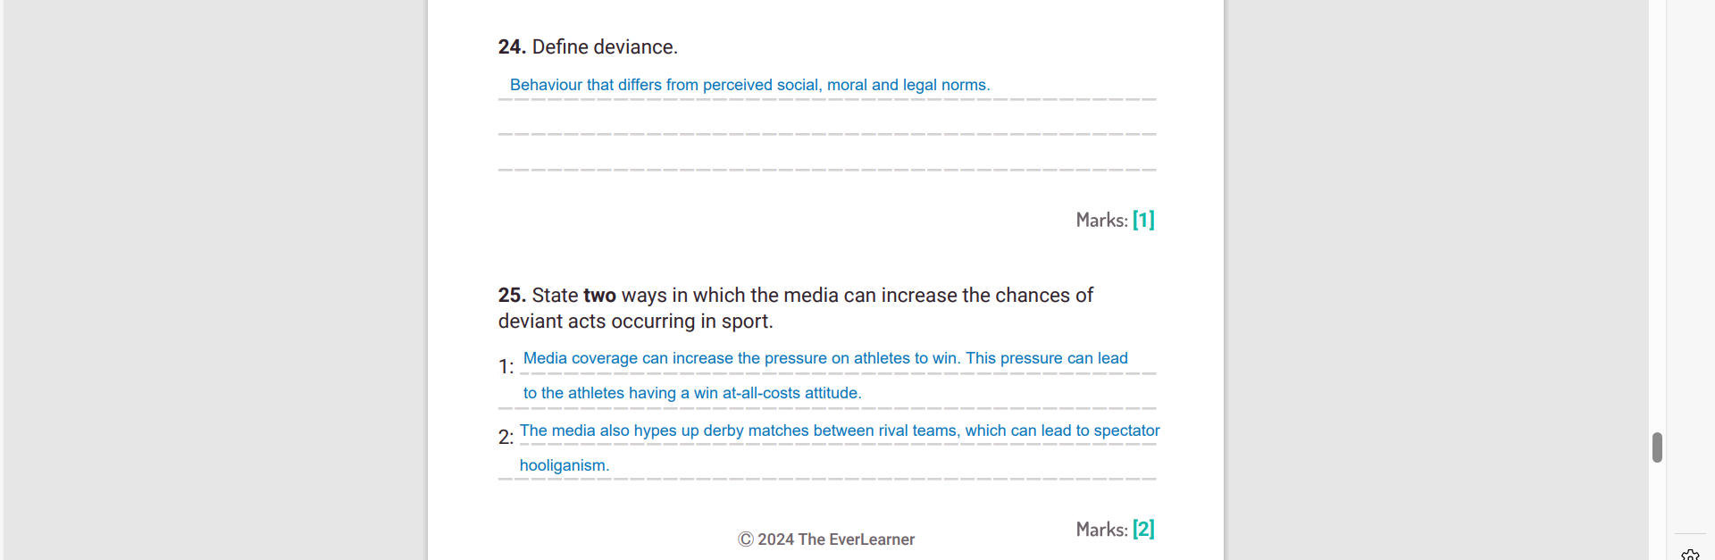

Slide 25
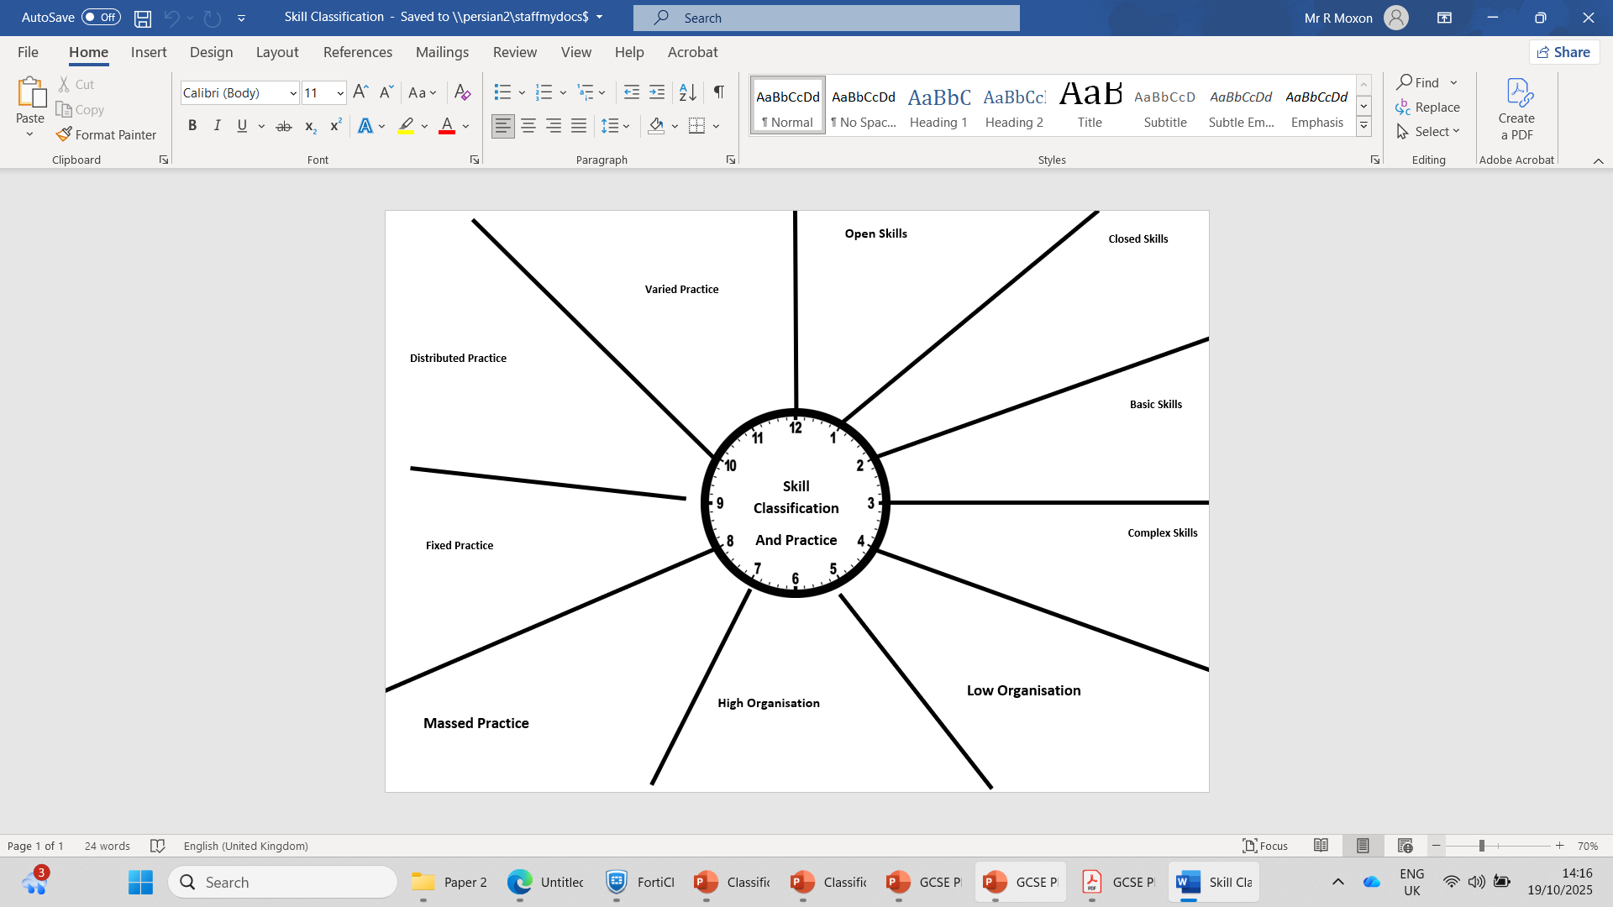

Slide 26
Massed | Distributed | Fixed | Varied
AO1 Points practice of the same skill repeatedly without rest or breaks | AO1 practice with breaks e.g. rest, feedback and guidance | AO1 Practice of same skill in the same situation Grooving or learning the skill | AO1 Same skill rehearsed in different situations
AO2 Examples when used Experienced performers Highly motivated performer as this can be boring practice Closed skills, basic, low organisation e.g. set shot basketball Not dangerous skills | AO2 skill is hard to do Skills that are physically demanding Tiring Dangerous Suited to Beginners and those performers that are not fit Complex/High organisation/Open/Dangerous | AO2 Performer that are learning a skill Badminton service (do 10 serves and then get feedback) Shot put Suited to: Closed skills Basic skills | AO2 Matched to open skills so games like football and netball e.g. unpredictable situations Keep ball activities in football/netball e.g. 4 v 2
AO3 Advantages and disadvantages Lots of practice in short period of time Boring/Tiring Only suited to more able performers not beginners | AO3 The performer doesn’t get too tired It prevents boredom/maintains motivation Allows for feedback and guidance The performer may not gain the skill in the time allowed therefore taking longer to learn the skill Less practice is completed | AO3 Skill is grooved/learned developing muscle memory …becomes automatic Can be boring | AO3 Performer experiences changing situations The level of difficulty can be matched to the ability of the performer e.g. 4 v 1 to then 3 v 2 the focus will be the same skill though e.g. keeping the ball

Slide 27
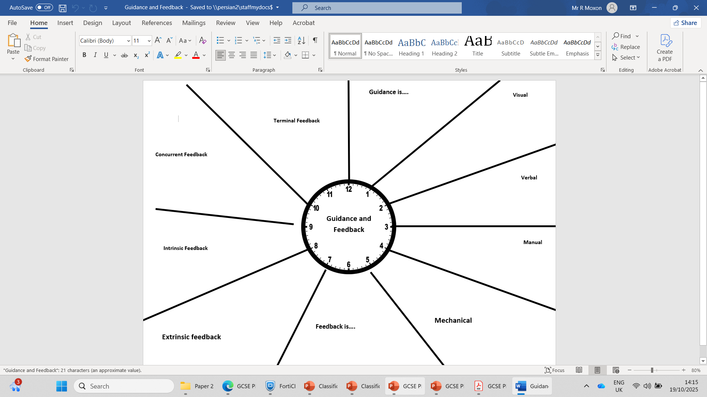

Slide 28
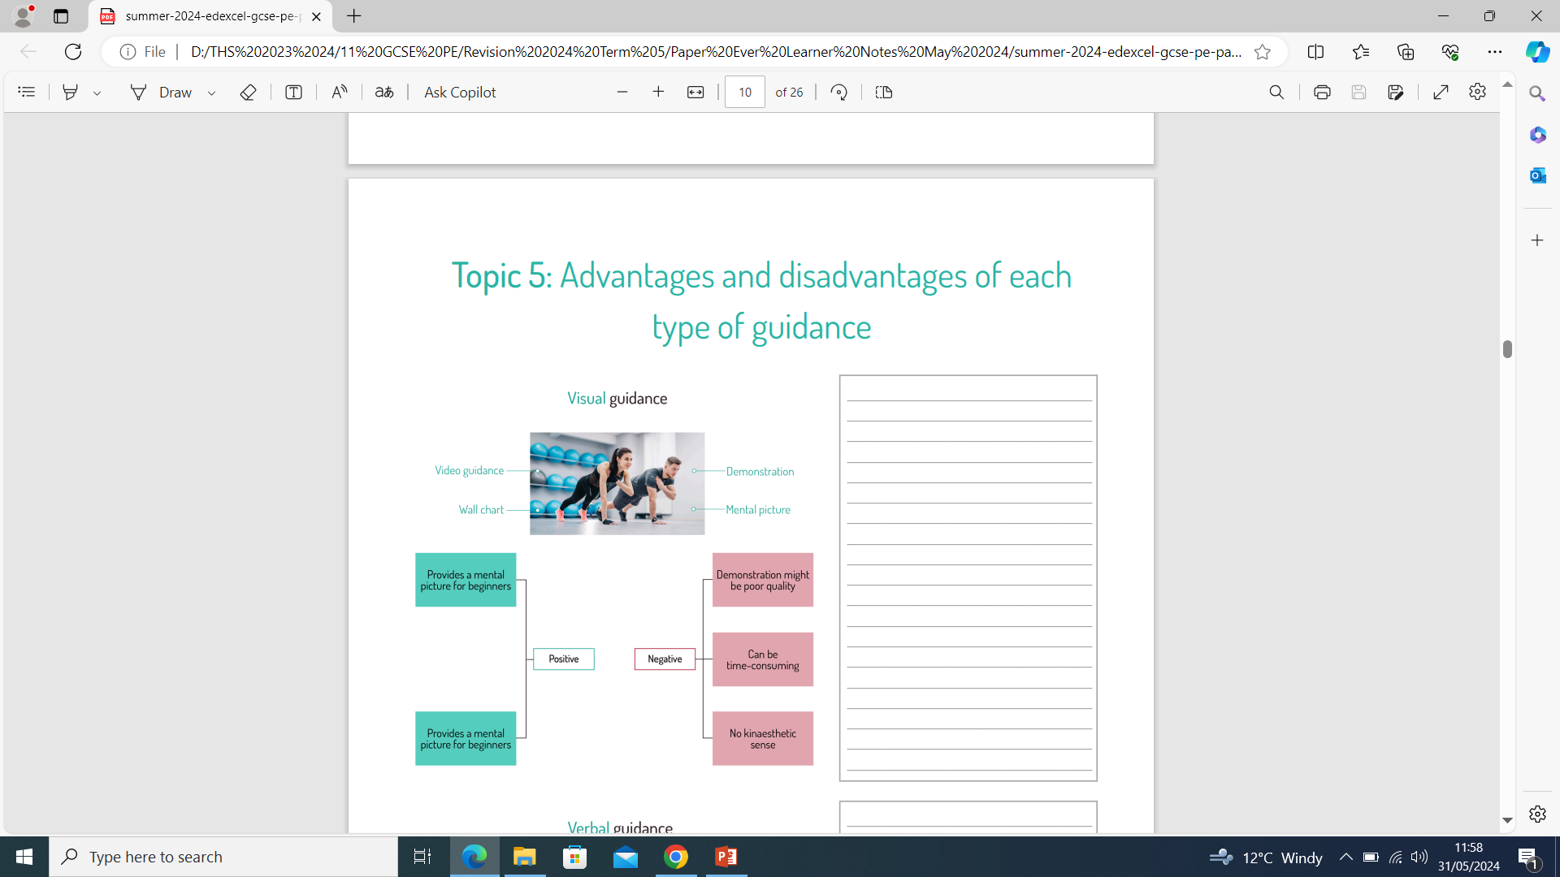
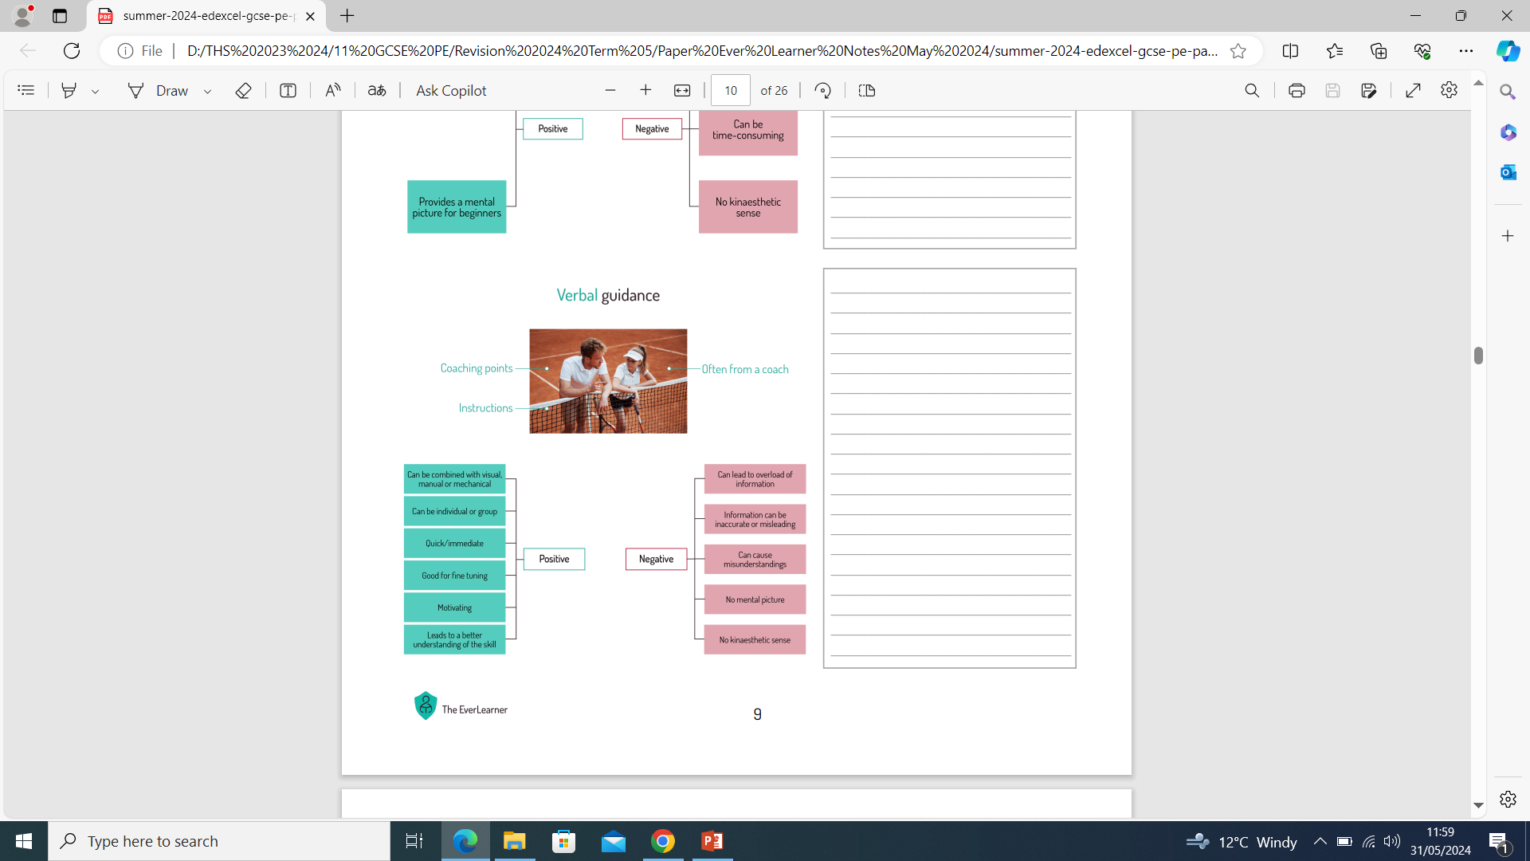

Slide 29
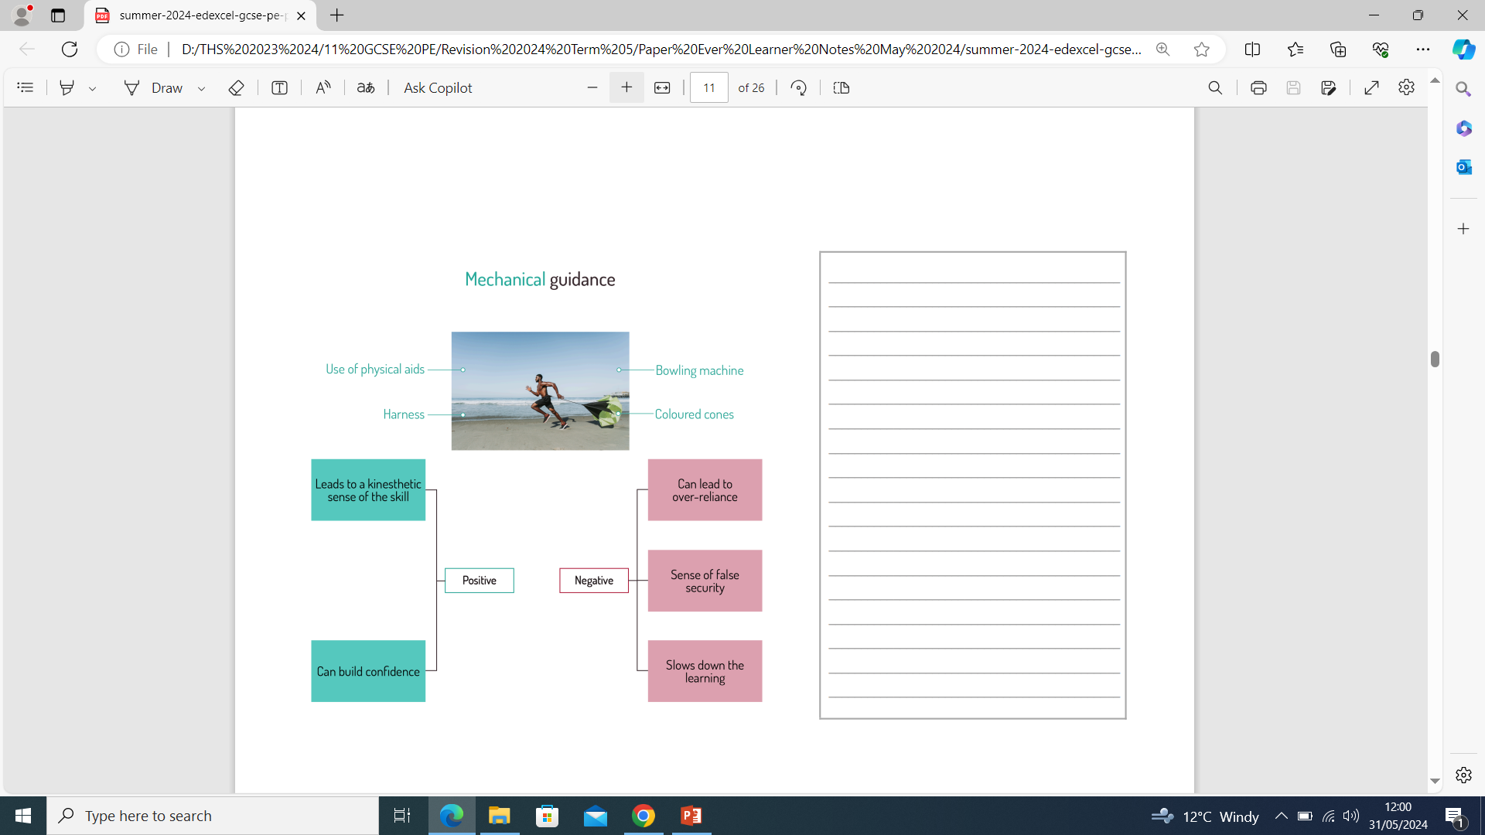
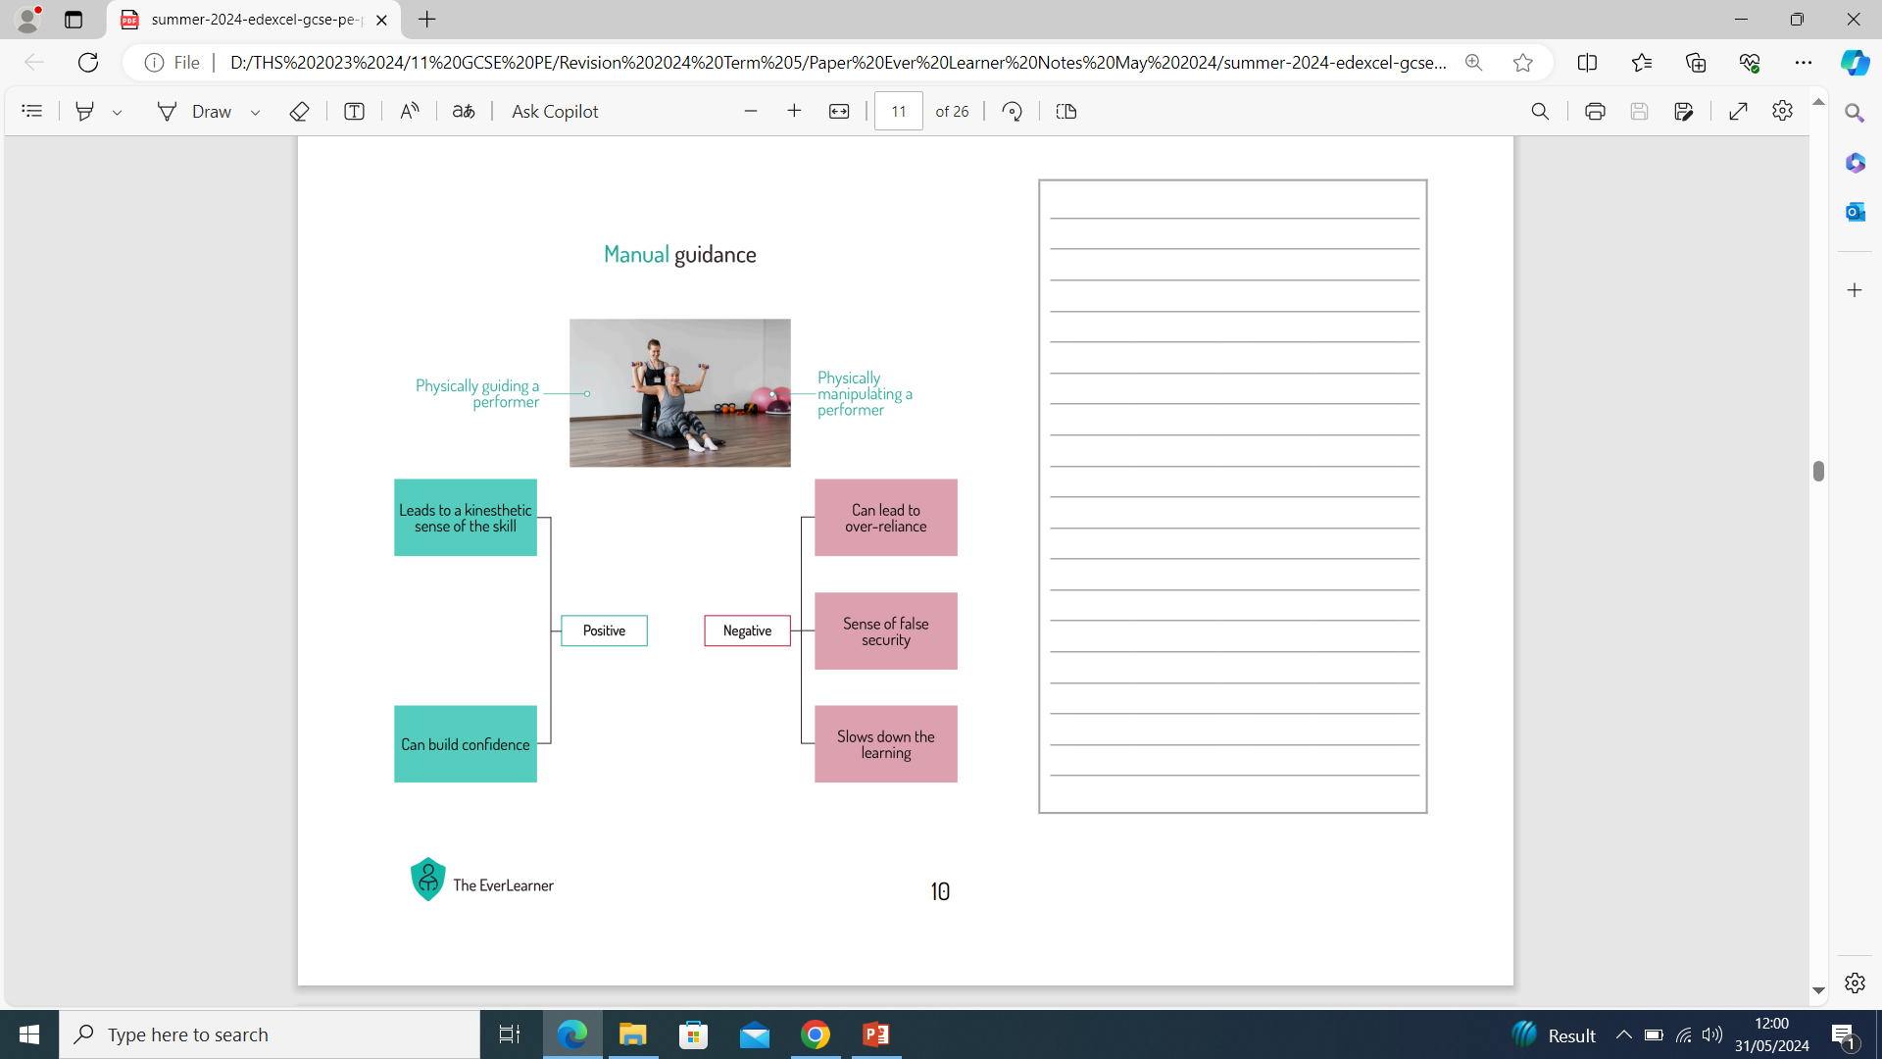

Slide 30
Guidance: example answers
Visual Guidance
AO1 | Shown the skill
AO2 | Demo/image or clip
AO3 | P Good for beginners to create mental image N incorrect image can lead to learning wrong technique
Verbal Guidance
AO1 | Coach telling the learner how to…
AO2 | Being told to how to hold the racket
AO3 | P quick and leads to immediate action N cognitive overload for beginners…
Manual Guidance
AO1 | Coach physically moving performer into position
AO2 | A gymnast being supported in performing a handstand
AO3 | P reduce risk/increase confidence N performer becomes reliant on the support
Mechanical Guidance
AO1 | Coach using equipment to support a performer
AO2 | Floats in swimming
AO3 | P reduce risk/increase confidence N performer becomes reliant on the support

