Slide 1
OCR Cambridge National
Sports Science
Knowledge Organiser
R180 Reducing the risk of injuries.

Slide 2
OCR Sports Science Knowledge Organiser R180 TA1Different Factors which influence the risk and severity of injuries.
Extrinsic Factors
1.Types of sports activity Contact sports such as rugby and Gaelic Football have an increased risk of bruising through tackling and collisions between players. Non- contact sports such as gymnastics, performers may land poorly or fall from the apparatus causing dislocations or sprains. Combat sports such as boxing and martial arts involve opponents trying to strike each other of knock their opponent out. This can result in serious head injuries such as concussion. High risk: More severe injuries can occur in sports such as Skiing, gliding and F1 . 2. Coaching, Instructing and Leading KNOWLEDGE OF TECHNIQUES RULES AND REGULATIONS: Understand and deliver correct coaching techniques. Know the rules and regulations of the sport. EXPERIENCE Be aware of factors that cause injury Deliver safe training sessions Be aware of safety protocols and up to date training methods COMMUNICATION: Deliver instructions clearly and concisely Clearly describe techniques, tactics and drills SUPERVISION Continually watch performers to ensure they follow instructions and use correct techniques. Carry out safety checks and the environment if danger is seen. Ethical Standards of behaviour Act in a honest and truthful way. Show fairness in decision making Treat everyone equally. (E.G Age, gender, culture.)
Extrinsic Factors Continued
3. Environment: Weather and temperature conditions FOG: Can reduce visibility therefore increasing the risk of collisions with equipment or other participants. E.g. A footballer running into the goal posts. WIND, RAIN and COLD WEATHER: Can cause both injury and medical conditions such as HYPOTHERMIA (where the body temperature drops.) E.g. A hill walker has more chance of falling in wet and windy conditions. HOT WEATHER: In bright sunshine or when the temperature is hot and humid athletes have an increased risk of dehydration and heat exhaustion. E.g. Marathon runner collapsing during a race. Playing surface AND THE SURROUNDING AREA. Natural turf (grass): Football, rugby, cricket, Pitches need to be well maintained as E.G. uneven surfaces or poor drainage can result in slippery conditions with players at risk of falling and spraining an ankle. Artificial playing surface (All weather sports pitches): 4g, netball courts and athletics tracks provide a better, safe environment as it is flat with better drainage. ALL surfaces should be checked for hazards such as debris, pot holes and animal waste. Advertising boards, fencing and barriers can also increase the risk of injury as there is a chance that players can collide with them.

Slide 3
OCR Sports Science Knowledge Organiser R180 TA1Different Factors which influence the risk and severity of injuries.
Extrinsic Factors Continued
3. Environment: Human Interaction Other participants: May collide with other performers causing injury. May injure someone through physical contact e.g. fair tackle. May act aggressively e.g. deliberate foul. Or May help to calm down own team members. Officials such as referees and umpires: Check performers follow the rules of the sport. Discipline players for illegal and dangerous tackles. SPECTATORS: Verbal abuse of performers, officials and rival fans may lead to frustration and aggression. Football hooliganism (violence between rival fans, officials or performers) Throwing missiles such as coins or invading the playing area may put performers, officials or other spectators at risk.
Extrinsic Factors Continued
4. EQUIPment: Protective equipment Helmets in cycling: show jumping and motor sports. Shin pads in hockey or football.( Protect the tibia and fibula in case of contact with another performers stick, the ball or studded boots.) Swimming Goggles. (Protects the eyes from chemicals and bacteria in swimming and freshwater pools.) Performance Equipment Performance equipment such as hockey and lacrosse sticks can cause injury by coming into contact with performers. A cricket player struck directly by a fast ball may suffer an injury. javelin requires the use of performance equipment that could lead to serious injury if care is not taken. Clothing Ski Jackets are well insulated to give maximum protection from wintery weather conditions. (Reduces the risk of hypothermia. People who are jogging or cycling should wear high visibility clothing so that they can be clearly seen by motorists. Footwear Studded football boots: ensure that performers have a good grip and reduce the risk of tripping and slipping. Road running shoes: have cushioned soles to absorb repeated impact on the ground. Basketball and boxing boots: have high ankle support have extra ankle-high support and protection to reduce the risk of going over on their ankles.

Slide 4
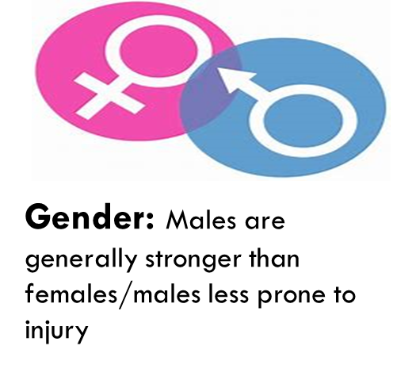
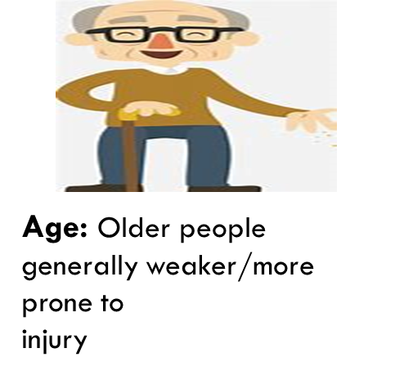
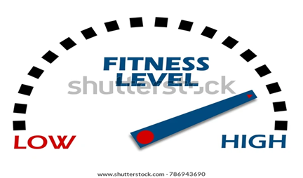
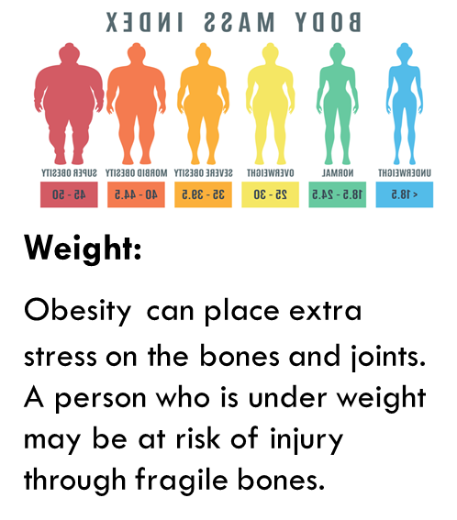
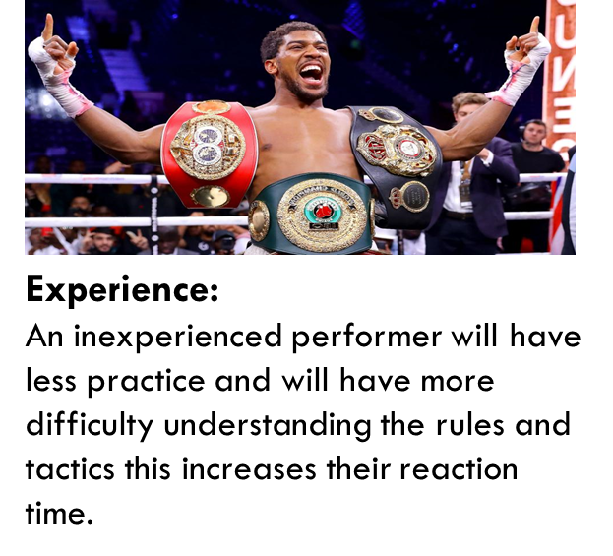
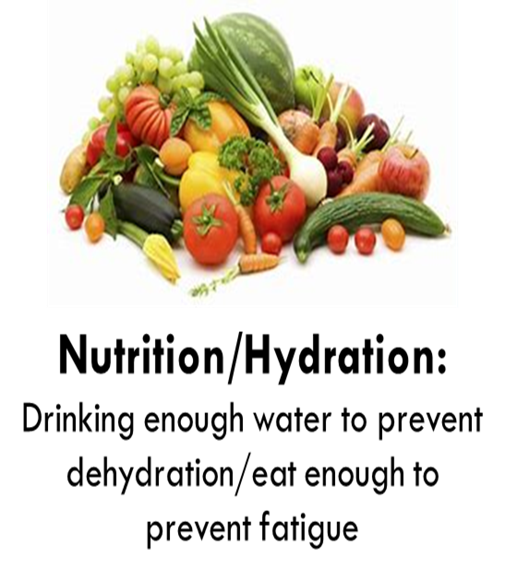
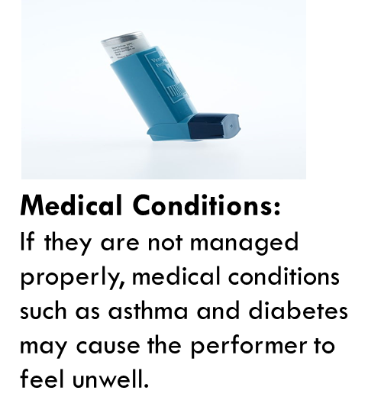
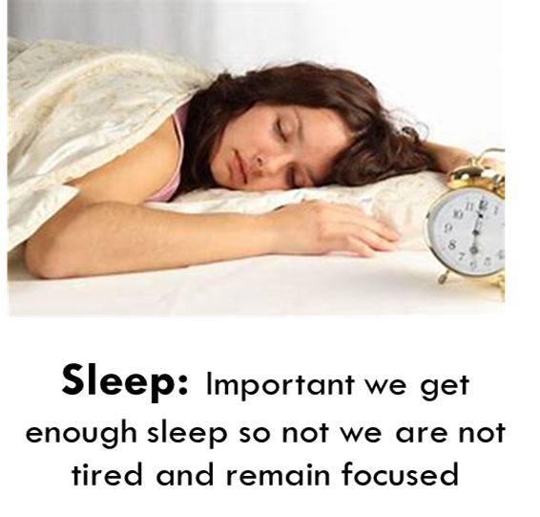
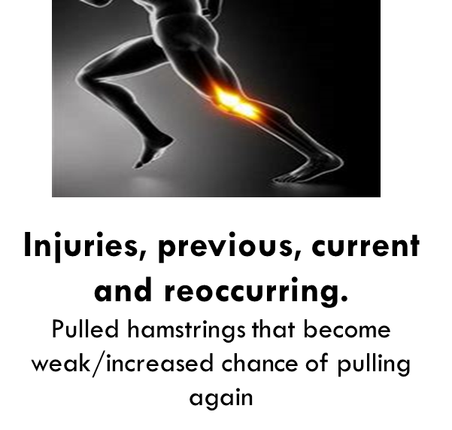
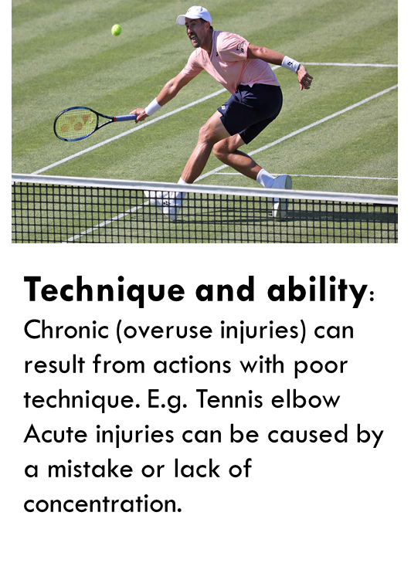
OCR Sports Science Knowledge Organiser R180 TA1Different Factors which influence the risk and severity of injuries.
Intrinsic Factors Continued
Fitness Levels:
A performer with low fitness levels is likely to tire easily and make errors.

Slide 5
OCR Sports Science Knowledge Organiser: R180 TA1Different Factors which influence the risk and severity of injuries.
Psychological Factors
Motivation: Having the drive to succeed Being over- motivated may result in a football player performing reckless tackles that could result in injury. Being undermotivated- may cause a rugby player to not commit themselves in a tackle and pull out. 2. Arousal: Feeling excited or alert in a sporting context. High arousal can lead to higher levels of excitement which could cause a gymnast to perform a vault that is too complex. Low levels of arousal may cause a canoeist to make a poor decision that causes their canoe to capsize. 3. Anxiety: Feeling of unease such as worry or fear. An American football player who is anxious about getting hurt during a game may react slower when being charged at. 4. Stress: Feeling unable to cope with pressure. A dancer who feels high levels of pressure before a performance may stumble and or trip when linking parts of their routine. 5. Confidence: A person's self- belief in their ability and that they can succeed. A batter in cricket may not have the confidence to face a fast bowler may have slower reaction times and get hit by the ball. 6. Aggression: (Direct and Channeled) : The deliberate intention to harm an opponent. Channelled involves playing within the rules but with the aim of harming performers on the opposing team. Direct Aggression: A basketball player deliberately punching another player may result in injury. Channelled aggression: An ice hockey may try to win the puck in a hard check against the boards in the hope that the opposing player will become injured.
Reasons for aggression
1. Level of performance - A performer may become frustrated if they are performing poorly while others are performing well - The frustration may build up leading to an act of aggression. E.g. A footballer may commit a two footed tackle. 2. Retaliation - If a performer has been fouled in a game they may seek revenge by committing a foul against another player. E.g. A basketballer may push or trip an opponent who had previously fouled them. 3. Pressure to win - There are many pressures to do well in sport and this can sometimes result in aggression which leads to foul play. E.g. A tennis player hitting the ball away aggressively as a result of losing a point. 4. Decisions of officials Performers may get frustrated when officials, referees and umpires appear to make the wrong decisions that go against them. E.g. A netballer may throw the ball away in frustration as a result of a penalty being awarded against them. 5. Performance enhancing drugs: Anabolic steroids. Performance enhancing drugs are used to increase muscle mass and improve athletic performance; Some weight lifters and bodybuilders use anabolic steroids. As well as physical side effects, misuse of anabolic steroids can also cause psychological side effects including mood swings and aggression.

Slide 6
OCR Sports Science Knowledge Organiser R180 TA2 Warm up and Cool Down Routines
Key Components of a warm up
1. Pulse Raiser Examples: Jogging or skipping, side steps, high knees or heel kicks. 2. Mobility Shoulder rolls, Arm circling, Trunk Twists, opening and closing the gate. 3. Dynamic Stretches Lateral lunges, Squats, Arm and leg swings across the body. 4. Skill Rehearsal Boxer Sparing on pads, a tennis player practicing their serve.
Key Components of a cool down
1. Pulse lowering: Light exercises and easy movements compared with the physical activity. E.g. Jogging or walking around the football pitch after a game. 2. Stretching: Different types of stretches for different muscles in the body.
Physiological benefits of a warm -up
Pulse Raiser Increase in heart rate. Increase in muscle temperature. Increase in blood flow and oxygen to the working muscles. Mobility Increases the speed of muscles contracting. Increases flexibility of muscles and joints. Increase in pliability (An increased range of movement around the joint) due to ligaments and tendons having increased elasticity when warmed up. Dynamic Stretching Increase in flexibility of muscles and joints. Increase in pliability of ligaments and tendons. Increase in speed of muscles contracting. Skill Rehearsal Practicing the techniques that will be used by the performer in a game or event.
Physiological benefits of a cool down
1. GRADUALLY lowers heart rate. 2. GRADUALLY lowers body temperature. 3. Circulates blood and oxygen around the body. 4. Helps to prevent blood pooling. 5. Gradually reduces breathing rate. 6. Removes waste products such as lactic acid from the muscles. 7. Reduces risk of Delayed Onset Muscle Soreness (DOMS)
Psychological benefits of a warm -up
Improve concentration: A golfer using selective attention to focus on the correct technique when driving and putting. Increase motivation: A rugby player being fully committed to a tackle. Increase confidence: A boxer believing they will be able to defend themselves against an opponents punches. Mental Rehearsal: A dancer going through their routine in their head to get them better prepared for a performance. Heighten or control arousal: Cyclist being alert to what might happen, such as another rider turning into their path.
Types of stretching
Proprioceptive neuromuscular facilitation. (PNF) Maintenance Stretches Static Stretches

Slide 7
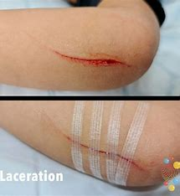
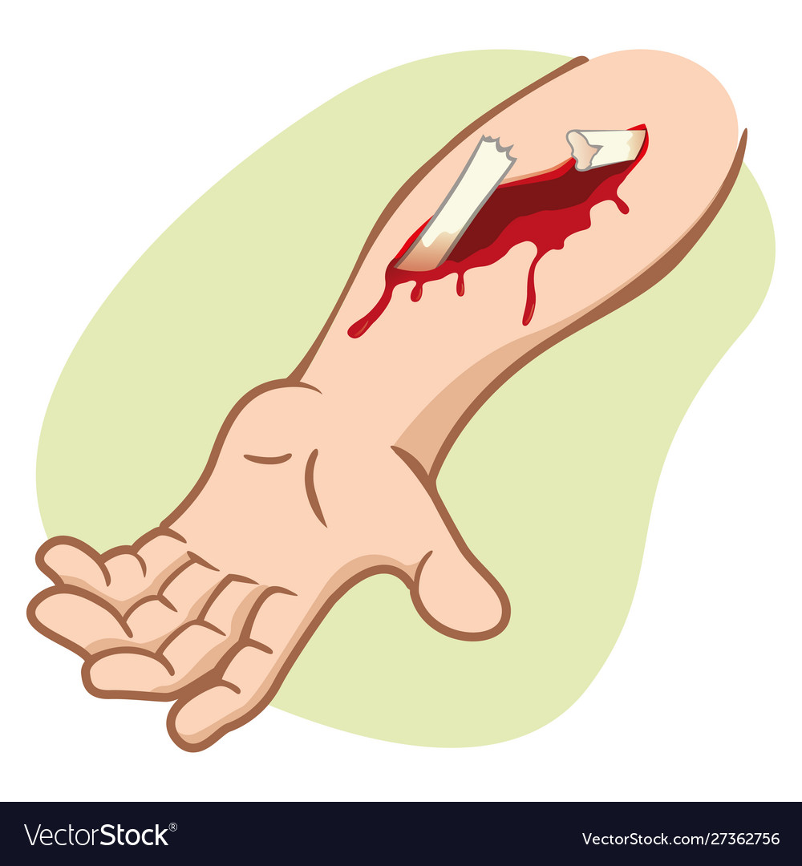
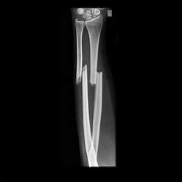
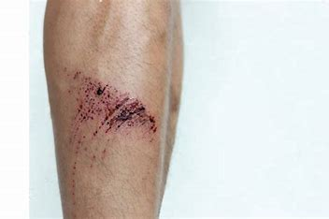
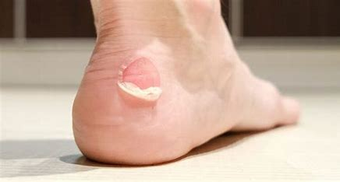
OCR Sports Science Knowledge Organiser R180 TA3 Different Types and causes of sports injuries
Acute injuries: result from sudden trauma – damage or harm to part of the body, causing immediate pain, swelling and loss of function.
Chronic injuries: Are caused by overuse of parts of the body through repetitive movement. They develop gradually over a long period of time.
Acute injuries- Hard tissue
Open Fracture: Also known as a compound fracture. It is a complicated break where the bone has broken through the skin, or the initial injury has exposed the broken bone Closed fracture (Acute) Also known as a simple fracture The fractured bone is not visible as the bone has broken but it has not pierced the skin. Stress fracture (Chronic) A stress fracture is a tiny crack in a bone caused by repetitive stress. Dislocations A dislocation is an injury that occurs a bone in the joint where the two bones meet is forced out of position.
Acute injuries- Hard tissue (Head injuries)
Concussion: Concussion is an acute injury where the brain has been shaken inside the cranium and can cause the performer to become unconscious!
Chronic Injuries
Tendonitis: A common injury, can effect different tendon through out the body, resulting in pain Epicondylitis Medial – GOLFERS ELBOW Lateral – TENNIS ELBOW Shin Splints: Usually occurs when a performer has been doing lots of running, its causes pain and tenderness in the tibia. Stress Fractures: Tiny cracks appear in a bone due to repeated stress.
PRICE Therapy
Used for the treatment of soft tissue injuries. PROTECTION REST ICE Compress Elevate
Acute Injuries: Soft tissue
Soft tissue injuries affect the soft tissue parts of the body – the muscles, tendons and ligaments. Soft tissue injuries include: Strains: When a performer tears a muscle or a tendon Sprains: When a performer tears a ligament
Acute Injuries - Skin Damage
Abraisions- Grazes Cuts –Lacerations Contusions- Bruises Blisters

Slide 8
OCR Sports Science Knowledge Organiser R180 TA3 Different Types and causes of sports injuries – Knowledge applied.
Extrinsic Factor | Risk of injury occurring
Type of activity | Acute injuries such as cuts or bruises in boxing and MMA Chronic injuries such as shin splints in marathon runners
Coaching, instructing and leading | Acute injuries such as fractures could be caused if players are encouraged to carry out two footed tackles. Chronic injuries such as medial epicondylitis (golfers elbow) can be caused if incorrect driving technique is taught.
Environmental Factors | Acute injuries such abrasions can be caused by falls on to hard surfaces. Chronic injuries such as shin splints are caused by repetitively running on hard surfaces.
Equipment | Acute injuries such as fractures from not wearing shin pads. Chronic injuries such as tendonitis from not taping or supporting weaker body parts.
Ways to reduce acute injuries
1. Warm up properly before exercise 2. Ensure that muscles, ligaments and tendons are strong and build up exercise gradually. 3. Maintain a healthy weight Avoid being underweight – malnutrition leads to reduced bone density. Being overweight increases pressure on the body
Ways to reduce chronic injuries
1. Avoid overtraining 2. Develop good techniques/ Avoid bad habits 3. Avoid training on hard surfaces where possible 4. Wear footwear that is appropriate for the sporting activity 5. Avoid returning to exercise too soon following injury.
Intrinsic Factor | Risk of injury occuring
Age | From the age of 35 the body loses bone density. As a person gets older, their bones become weaker. Older people and people on certain medications are more at risk of bruising. Skin also becomes more fragile increasing the risk of cuts.
Nutrition | A lack of calcium in the things we eat and drink can cause bones to become weaker and at greater risk of fracture.
Previous Injuries | Ligaments become weaker following a sprain or dislocation, increasing the risk of these injuries occurring again.
Sleep | If a person is tired due to a lack of sleep, they may lack in concentration therefore making a mistake which could lead to injury. Fatigue can lead to poor technique which could result in tendonitis

Slide 9
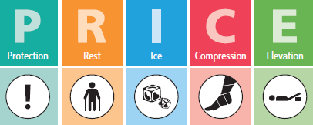
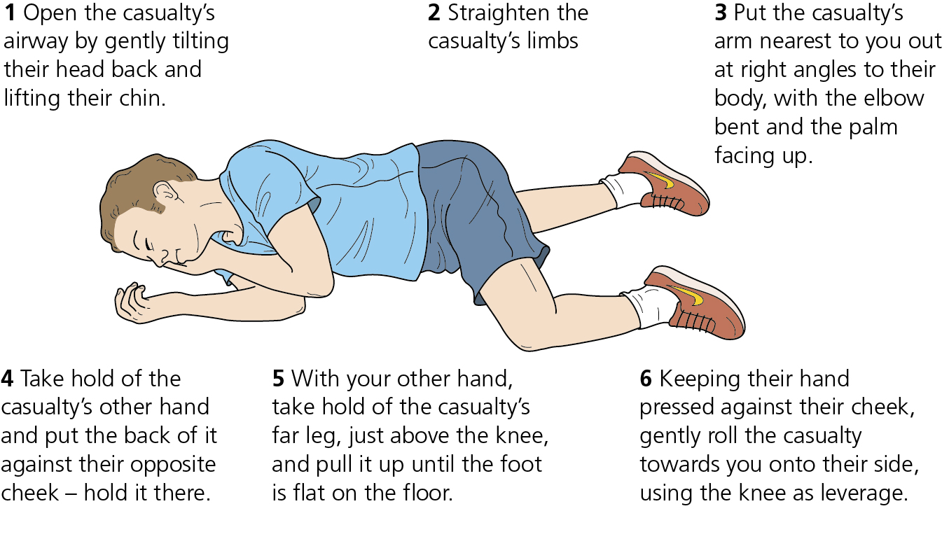
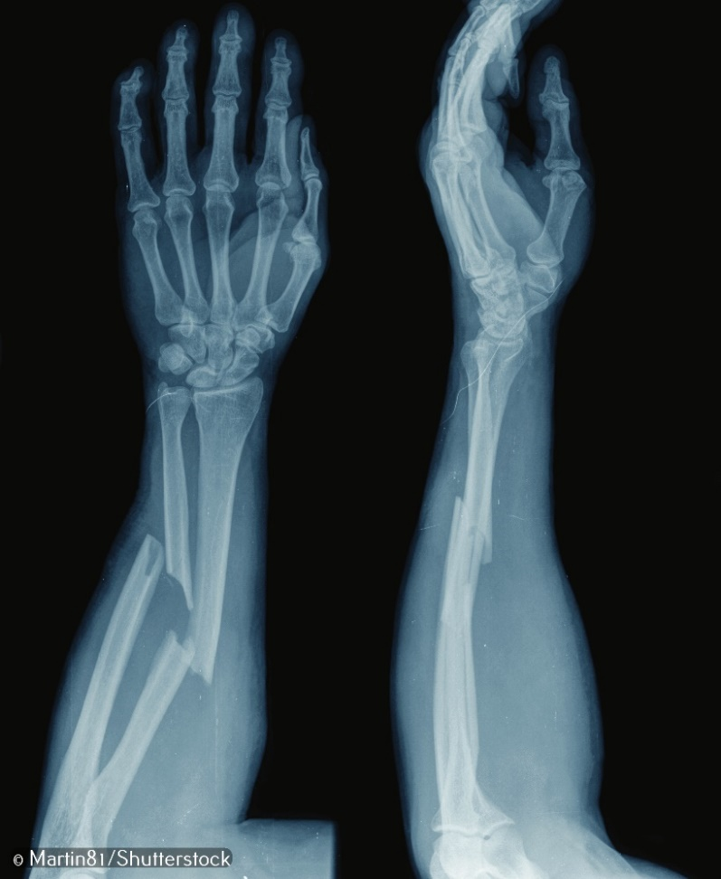
OCR Sports Science Knowledge Organiser R180 TA4: Reducing the risk, treatment of and rehabilitation of sports injuries and medical conditions
Safety Checks
Should be undertaken for all activities prior to and during participation. People involved in any sport or physical activity. – coaches, players and support staff, must be aware of the safety hazards and risks associated with that sport or physical activity. Playing surfaces and playing equipment are obvious potential safety hazards.
Stratergies to help reduce the risk of sports injuries and medical conditions
Risk Assessments: Inspections carried out to identify hazards and work out the level of risk so that control measures can be put in place to minimize the risk of injury. Medicals: An examination of a persons body to find out how healthy they are and their level of fitness. Screenings: Used to discover underlying health conditions that could effect performance. NGB Guidelines: National Governing Bodies create policies designed to ensure safety.
EAP- Emergency action plan
An Emergency Action Plan (EAP) Is a document that sets out the procedures to be followed when a sporting injury requires emergency treatment. It contains three parts: Emergency Personnel: DR, First Aider Emergency Equipment: First aid kit, wheel chair, defibrillator Emergency Contact details: 111, 999, Next of kin.
SALTAPS (On the field assessment routine.)
SALTAPS involves an assessment of whether an injured performer should be allowed to continue to play or train. Acronym – See, Ask, Look, Touch, Active, Passive and Strength. Undertaken by the most qualified and experienced individual in the vicinity of the injury. If the injury is serious – stop the SALTAPS process.
DRABC
A primary survey of an injury should be undertaken to see whether it is life threatening. Use the DRABC acronym for the primary survey: Danger, Response, Airway, Breathing and Circulation. Proceed with the survey in this order and treat anything that is not right.
Recovery position
The recovery position should be used wit an unconscious casualty. Place unresponsive performer who is breathing and has no other life-threatening conditions into the recovery position and call 999 for emergency help. Putting someone in the recovery position keeps their airway clear and open
PRICE THERAPY
Used for acute, but non-serious injuries to soft tissues, such as mild sprains and strains. Treatable at home for two or three days. Such injuries often involve inflammation, so the purpose of PRICE is to reduce swelling, ease pain and prevent further damage.
X- RAYS
X-rays can be used to detect: Fractures Dislocations damage to growth plates Arthritis bone cancer infections in bone foreign objects.

Slide 10
OCR Sports Science Knowledge Organiser R180 TA4: Reducing the risk, treatment of and rehabilitation of sports injuries and medical conditions
MASSAGE | ELECTROTHERAPY | CRYOTHERAPY | CONTRAST THERAPY | SUPPORT
Manipulation of soft tissues. Increases flow of blood to affected body part. Increases flexibility. Helps relax muscles and relieve tension. Can help manage pain and delayed onset muscle soreness (DOMS). | Electrotherapy is the use of electrical energy as a treatment – ultrasound can be included as a form of electrotherapy. Pulsed shortwave therapy (PST), a form of electrotherapy, can be used to reduce inflammation and speed up soft tissue repair. Transcutaneous electrical nerve stimulation (TENS) provides pain relief. | Cryotherapy is the use of cooling/ice to treat injuries. Used for contusions, abrasions and pain relief. Ice baths are used for recovery after exercise. Blood flows from the limbs towards the body core to keep the body warm and protect vital organs. On leaving the ice bath, blood returns to the limbs full of oxygen which helps to heal damaged muscles. | Use of hot and cold treatments – usually water. Heat reduces pain and stiffness. Decreases muscle spasm. Increases blood flow to the area which promotes healing. Heat lamps/heat packs and microwaveable gel packs can also be used to provide relief. | Tubular support bandages made of elasticated cotton – used for sprained joints and strained muscles. Bandaging provides support, helps prevent swelling/decreases blood flow and reduces pain. Variety of joint supports available – some are adjustable using straps or laces.
ULTRASOUND SCANS | HYDROTHERAPY | PAINKILLERS | Kinesiology tape/neoprene | IMMOBILISATION
Uses high-frequency sound waves to produce images of structures inside the body to diagnose injuries. Can be used as a treatment to reduce pain and inflammation – increases circulation and mobility of soft tissues Speeds up recovery and helps to heal injuries and wounds. Stimulates repair of proteins | Use of warm and/or high-pressure water for therapeutic purposes. Reduces muscle spasms. Relieves pain. Strengthens weak muscles. Improves the range of motion in joints. Improves poor circulation. Improves balance and co-ordination skills damaged after injury. | Painkillers such as paracetamol can be used to help ease the pain of injury. They work by blocking nerve signals Ibuprofen is used to ease pain and reduce inflammation. Ibuprofen is better, because injuries produce an inflammatory reaction resulting in pain, heat, swelling and a loss of function. | Provides support while allowing normal movement. When applied, it lifts skin away from underlying tissue which then fills with fluid. Tape can lessen pain, reduce swelling and helps bruises heal faster. Neoprene joint supports add extra compression, support and heat to relieve pain. | Immobilisation stabilises the injury by preventing movement. Casts are used to prevent broken bones from moving. Splints are used for acute fractures or sprains. They immobilise the injured limb, lessen pain and allow healing to occur. Slings are used for arm joint injuries to reduce swelling and relieve pain.

Slide 11
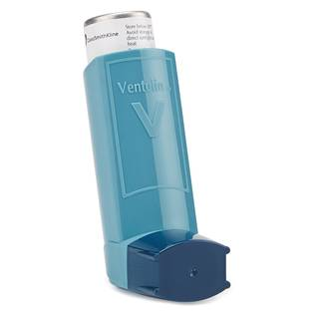
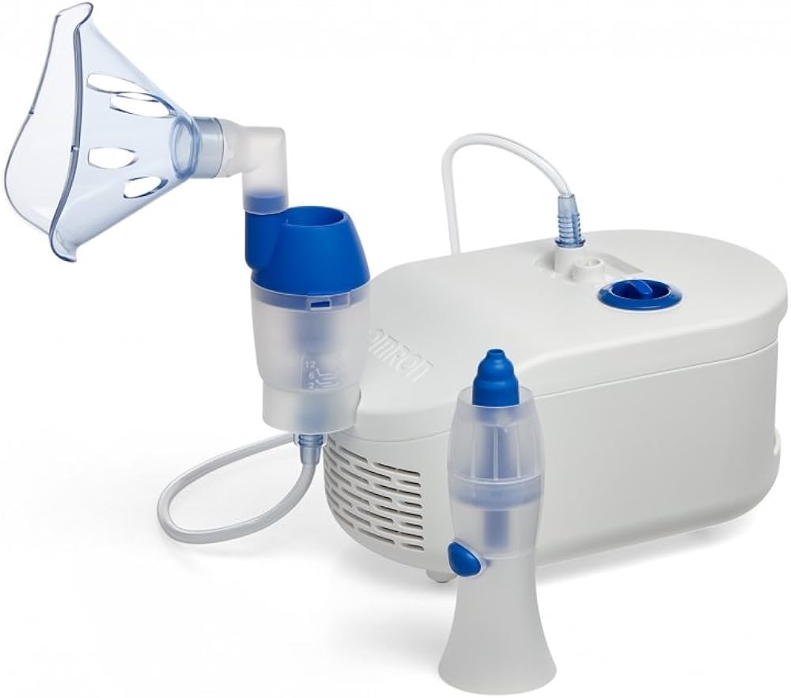
OCR Sports Science Knowledge Organiser R180 TA5: Reducing the risk, treatment of and rehabilitation of sports injuries and medical conditions
Asthma causes and symptoms | Asthma Treatments | Epilepsy causes and symptoms | Epilepsy Treatments | Hypothermia causes/ symptoms | Dehydration
Causes: Family History Allergies Pollution Smoking Intense exercise Symptoms: Coughing Wheezing Shortness of breath Tightness in chest | Reassurance Inhalers Nebulisers Steroid Tablets | Epilepsy is a serious medical condition that affects the way the brain functions. Sudden bursts of electrical activity in the brain results in seizures. Symptoms: Confusion Loss of consciousness Violent twitching | 1.Anti-epileptic drugs (AEDs) are the most common form of treatment used to control seizures. They work by changing the chemical levels in the brain. 2. Ketogenic diet: uses foods that are high in fat and low in carbohydrates and protein. | Cause: A dangerously low body temperature – below 35 degrees Symptoms: Tiredness, Confusion, Slurred speech, Blue lips and pale cold skin, Shivering, Breathing is slow. Treatment: 1. Move them out of the cold. 2. Remove any wet clothing 3. Give the person a warm drink if they are awake. 4. Keep the person awake by talking to them and asking them questions | Cause: Dehydration happens when the body loses more fluids than it takes in. Symptoms: Infrequent urination, dark yellow colour. Dry mouth/lips, Fatigue, Feeling thirsty, Sickness. Treatments: Drink plenty of fluids 2. Rehydration products available, e.g. gels, sachets, tablets. These contain salts, minerals and GLUCOSE
Diabetes causes/ symptoms | Diabetes-Treatment | SCA | SCA Treatments | Heat Exhaustian
2 types of diabetes: Type 1: The body is unable to produce insulin Type 2: The body does not produce enough insulin, or it makes does not work correctly. Symptoms: Extreme Tiredness Thirst Weight loss Blurred vision | MONITOR their glucose levels as this will tell them whether they need to take more medication such as insulin or something to eat. | Cause: Electrical problems in the heart stops the heart beating unexpectedly Symptoms: Unconscious Unresponsive Absent or abnormal breathing | Defibrillators can be used to restart the heart. They send an electronic shock to the heart. CPR: Cardio Pulmonary resuscitation Life Style Changes: | Causes: body temperature rises above 38 degrees. Usually occurs when sport performers do strenuous physical activity. Symptoms: dizziness, rapid pulse, breathing difficulties, feeling sick, being sick, thirsty, headaches. Treatment: Drink plenty of water and sports drinks, Move performer into the shade, Remove items of clothing to help cool down.

