Slide 1
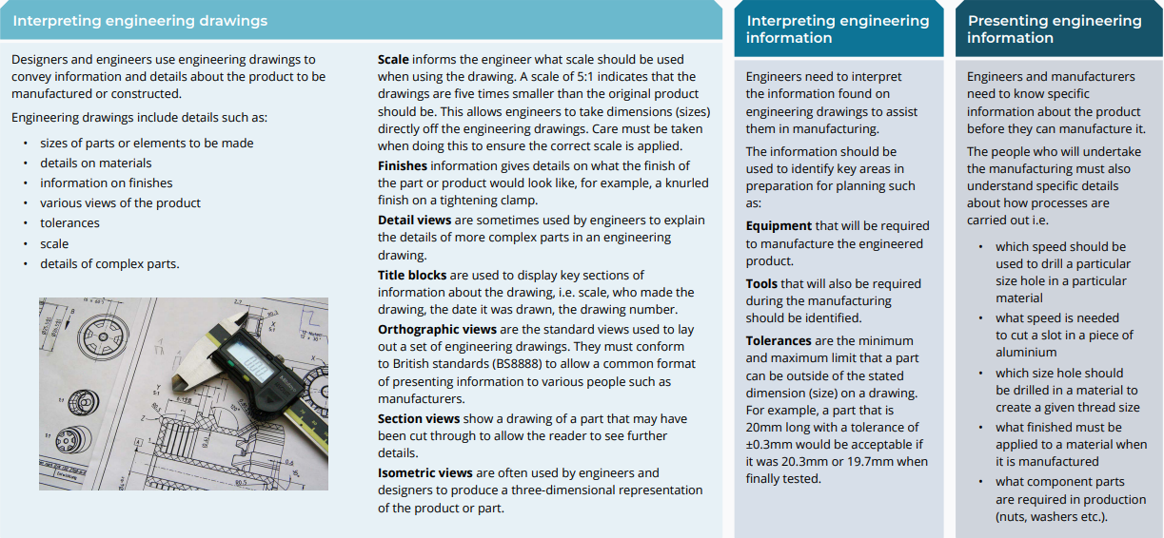
Unit 1: Understanding engineering drawings

Slide 2
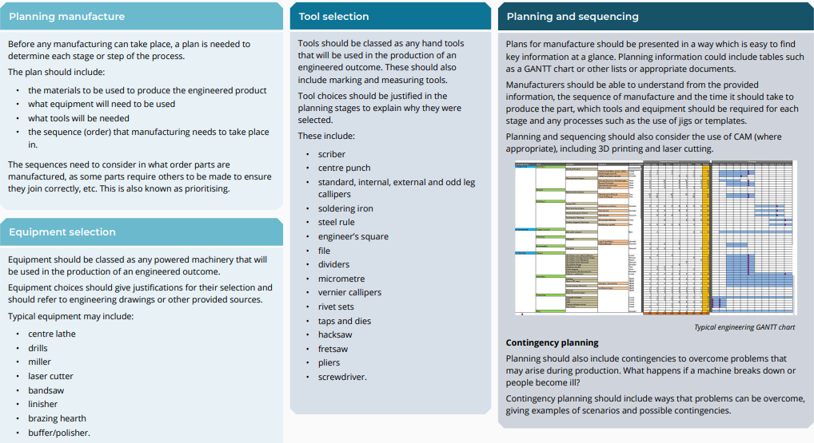
Unit 1: Planning manufacture

Slide 3
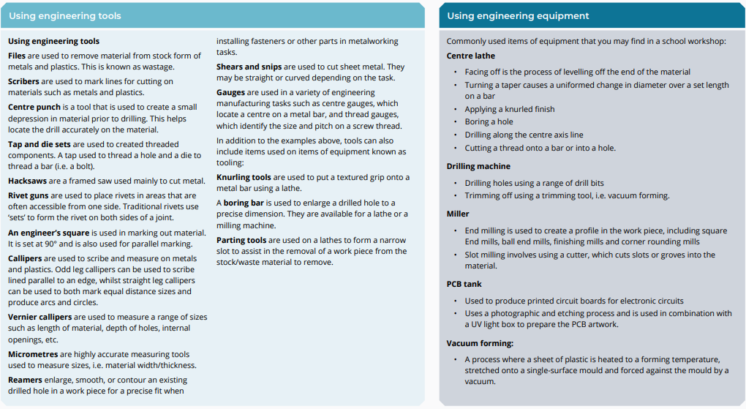
Unit 1: Using engineering tools and equipment

Slide 4
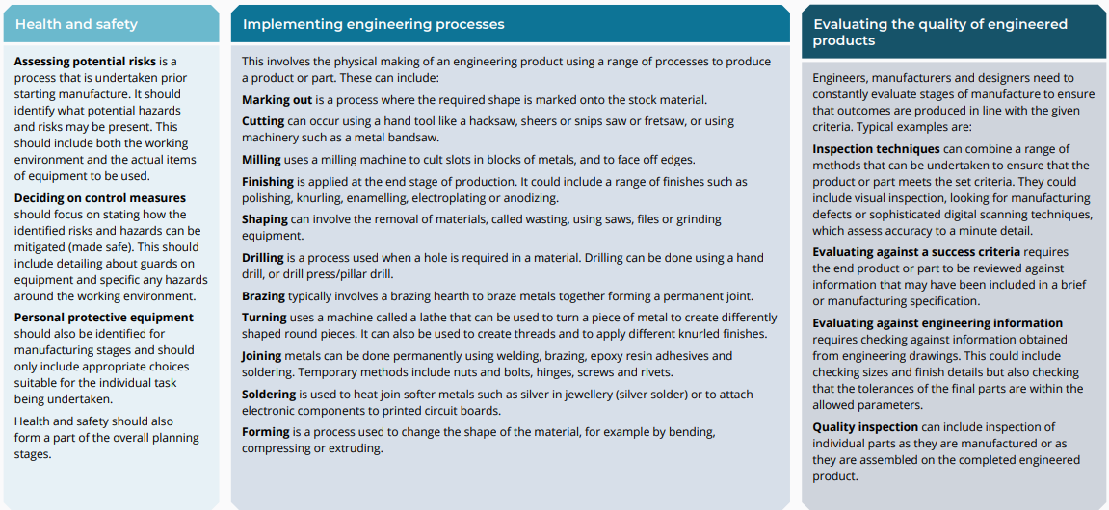
Unit 1: Health and safety, implementing engineering processes and evaluating quality

Slide 5
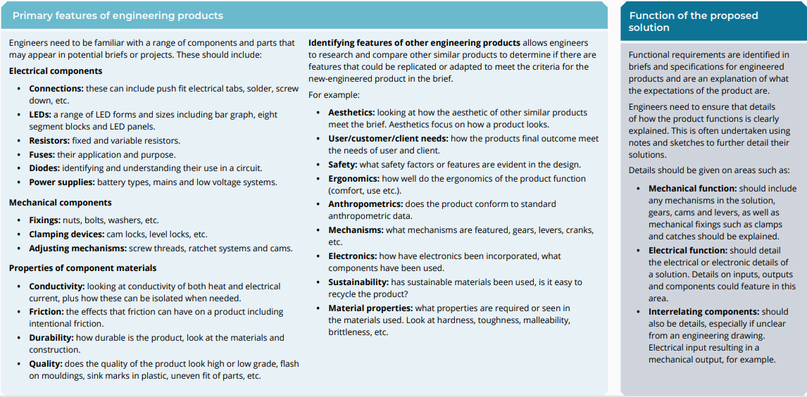
Unit 2: Understanding function and meeting requirements

Slide 6
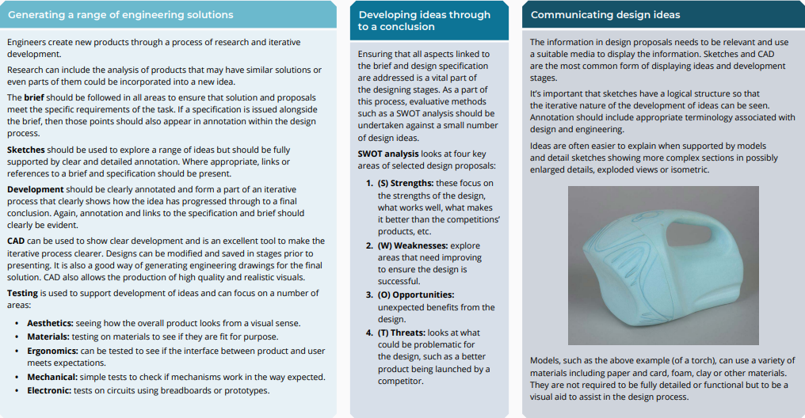
Unit 2: Proposing design ideas

Slide 7
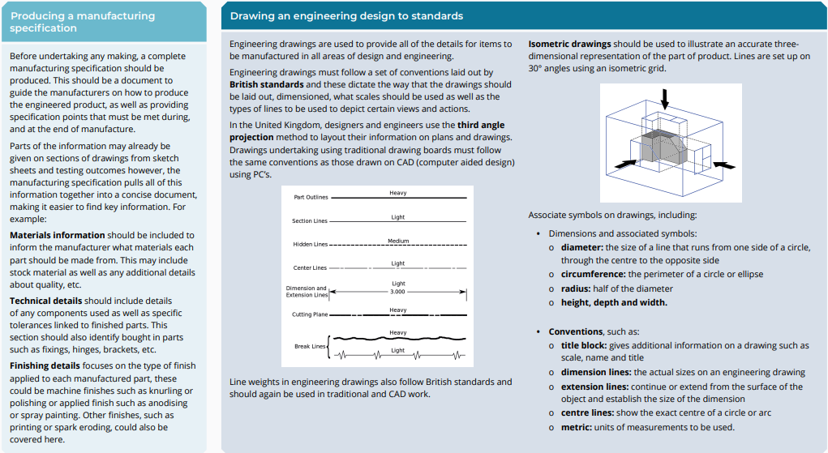
Unit 2: Communicating an engineering design solution

Slide 8
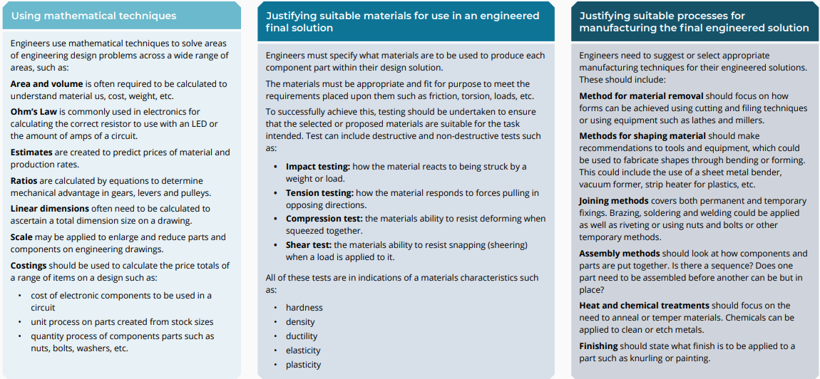
Unit 2: Understanding function and meeting requirements

Slide 9
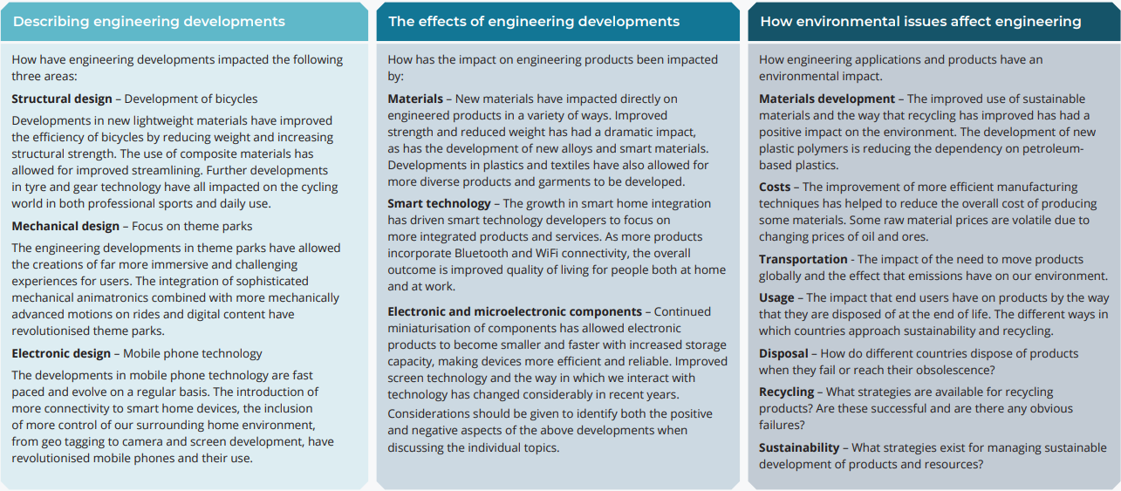
Unit 3: Understanding the effects of engineering achievements

Slide 10
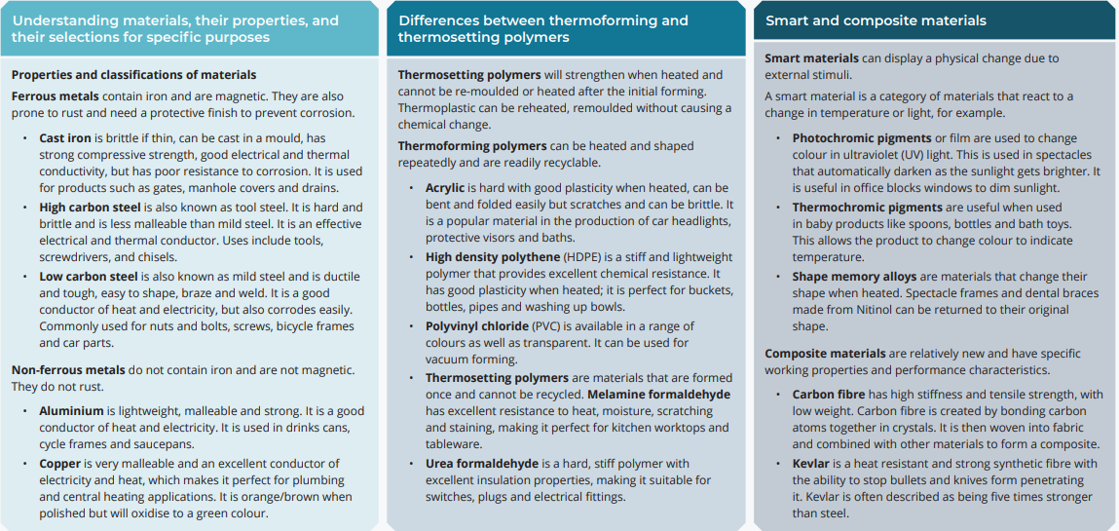
Unit 3: Understanding properties of engineering materials

Slide 11
Unit 3: Properties and testing materials

Slide 12
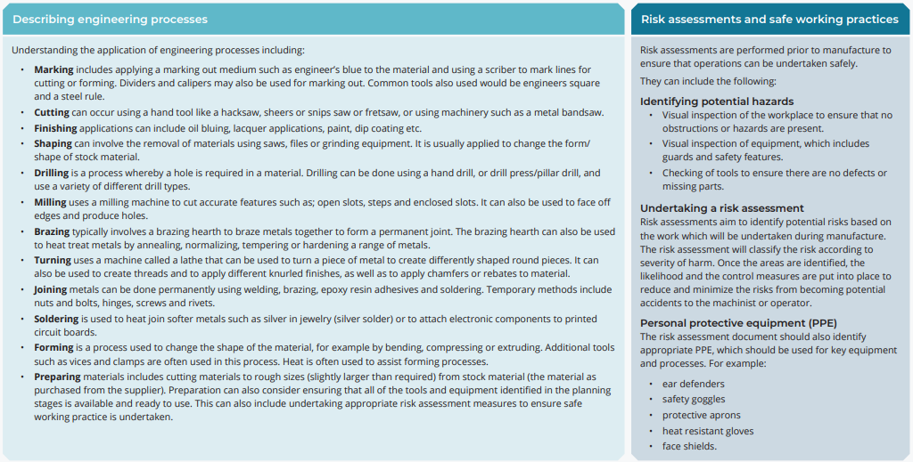
Unit 3: Preparation, forming joining and finishing of materials

Slide 13
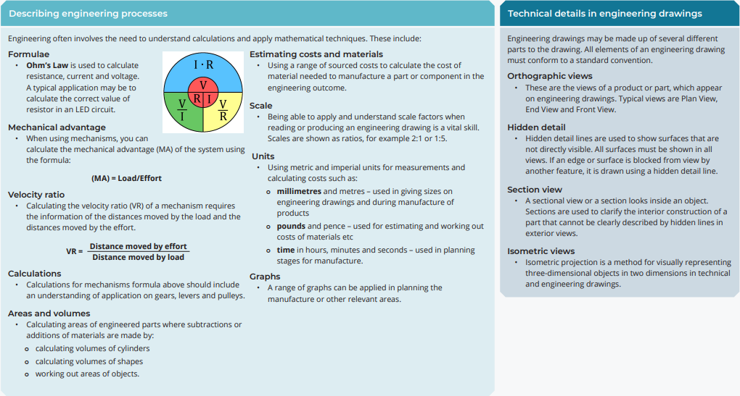
Unit 3: Solving engineering problems

