Slide 1

12 Days of Easter
GCSE PE Paper 1 Revision April 2025

Slide 2
12 Days of Easter Revision Plan
GCSE PE Easter Paper 1 Revision
Paper 1 Exam Date: Monday May 19 2025
You have 12 topics in paper 1 to work through. You have revision clocks, revision guide, online lecture and notes.
See the suggested plan below and the order of topics for you to work through. Tick off the topics as you go.
Evaluation of your recall of the topics: The topics that are note secure then highlight in RED, those that you know highlight in GREEN those that are ok in YELLOW.

Slide 3
Timetable and guidance…
Day | Topic
1 | Skeletal System and Joints
2 | Movement Analysis
3 | Muscles and muscle fibre types
4 | CV System
5 | Respiratory System
6 | Short Term or Immediate effects of exercise on the body systems
7 | Levers and Planes/Axes
8 | Health and PES
9 | COFS/MOTS and POTS
10 | Injuries and Injury Prevention
11 | PEDS
12 | Warm up and Cool Down
Take each topic and then split the 4 tasks into 2 sessions…no more than 20 mins each.
Part 1
Task 1 Complete the revision clock adding AO1 AO2 AO3 content from memory
Task 2 Now use you revision guide/notes and green pen your revision clock using your notes/revision guide…this is the content you now need to re learn/go over.
Part 2
Task 1 Ever Learner Lecture Watch the clip and annotate your notes in the booklet.
Task 2 Ever Learner topic test. 80% required!
Once completed…be proud and get busy doing something else before hitting the next topic!

Slide 4
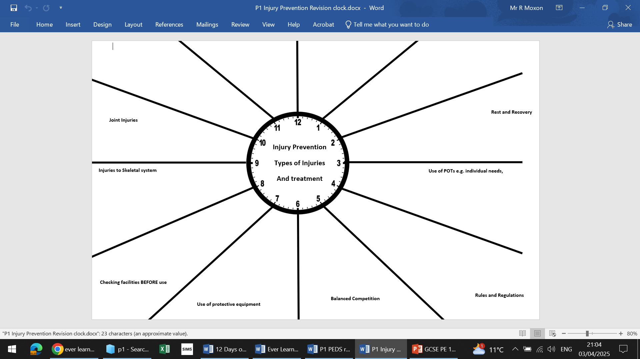
Revision Clock
Task 1 Complete the revision clock adding AO1 AO2 AO3 content from memory
Task 2 Now use you revision guide/notes and green pen your revision clock using your notes/revision guide…this is the content you now need to re learn/go over.

Slide 5
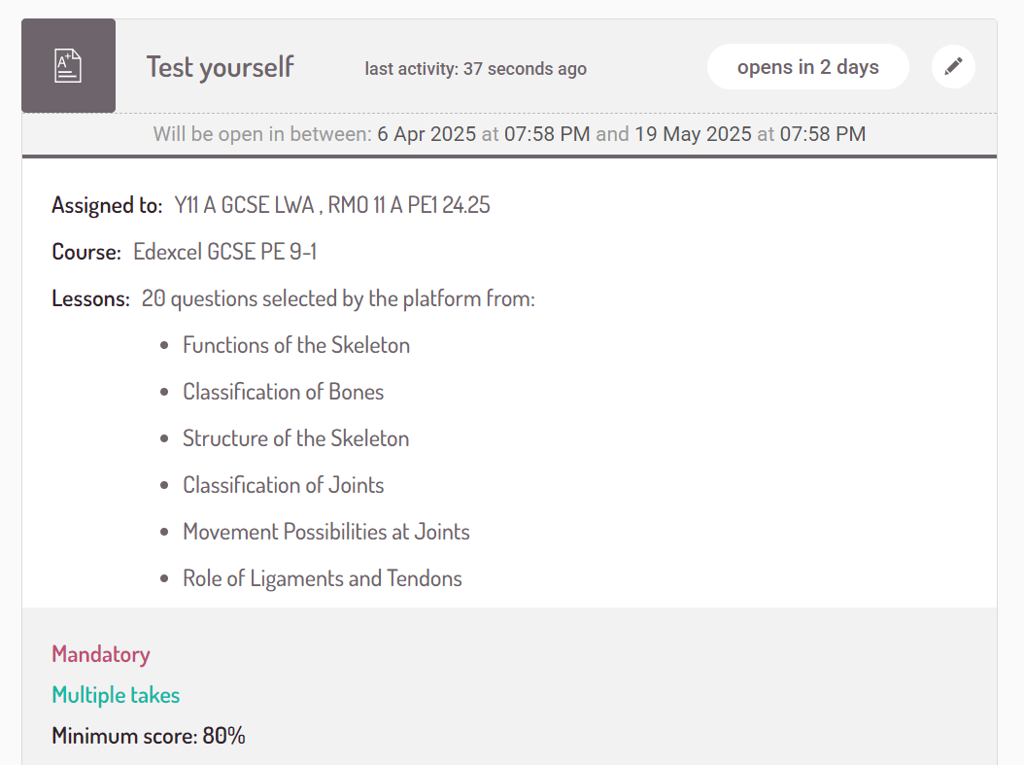


Slide 6
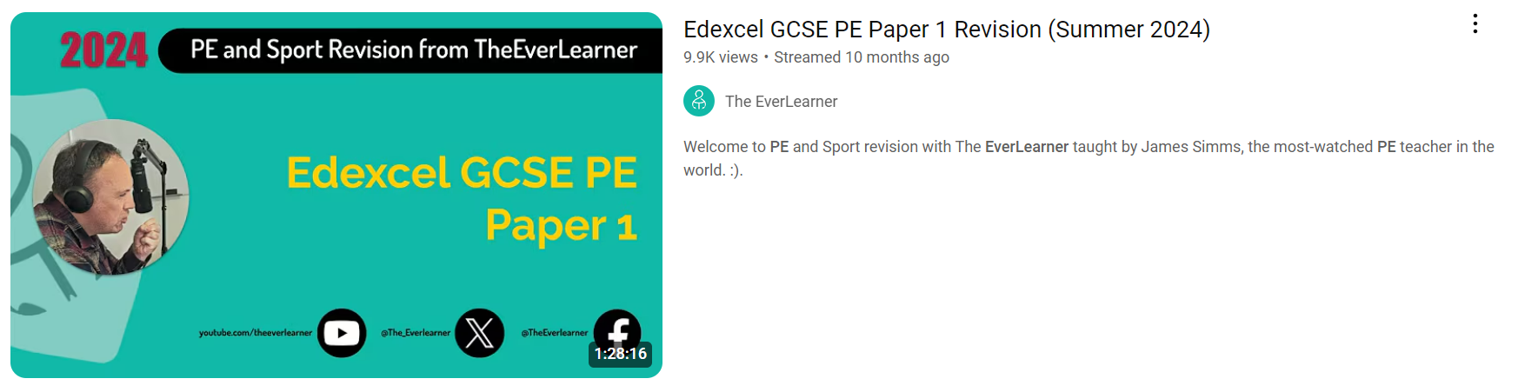
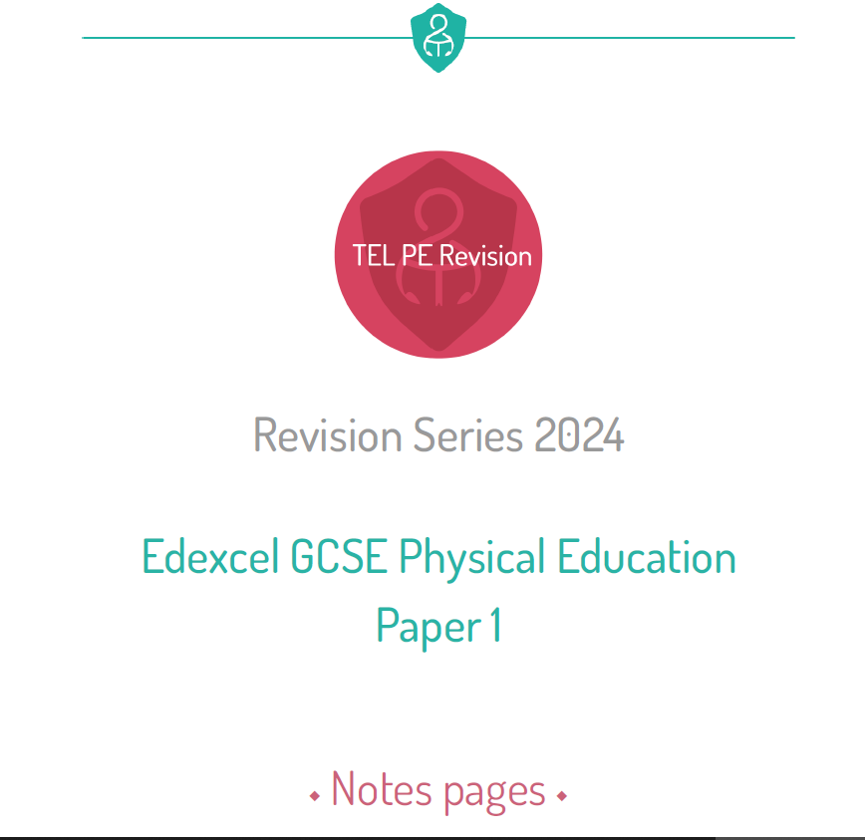
Guidance for the Ever Learner Lecture on Paper 1
Click on the image and it will direct you to the lecture.
Have your revision notes ready to work through.
Do not spend more than 15 minutes per session on this…make a note of the time you finished watching to quicken your next visit.

Slide 7
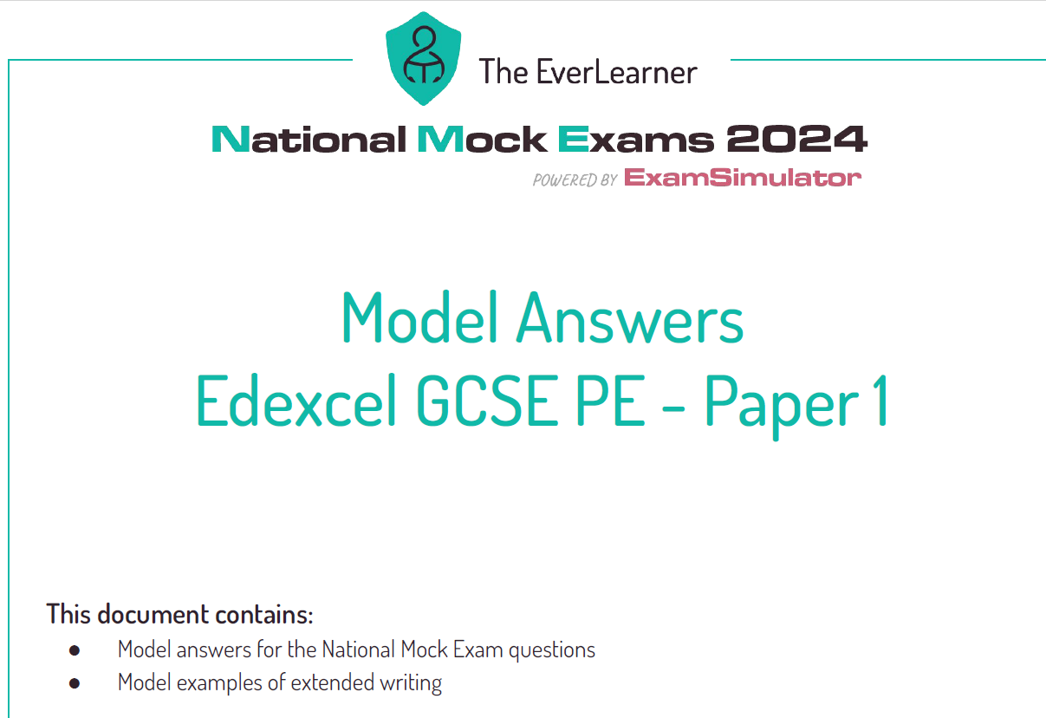
Mock Paper 1
Task
Once you have completed a topic then find the content in the paper and answer in order to check your understanding.
Use the model answers to check your understanding and to provide guidance.

