Slide 1




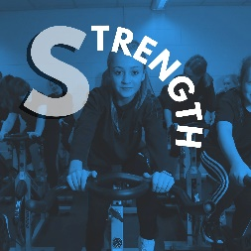
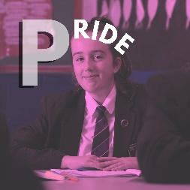
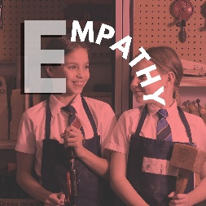

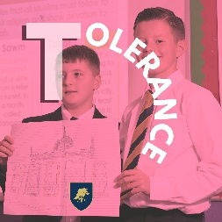
Schools Diversity Week
LGBT+
Sexual orientation and gender identity

Slide 2
Schools Diversity Week
Let's start with a few definitions

Slide 3
Schools Diversity Week
Match these words with their definition
Straight
A man who is attracted to women, or a woman who is attracted to men
This word is usually used to describe a man who is attracted to men. It can also be a general term for gay and lesbian people
Lesbian
When someone is attracted to more than one gender
Gay
A woman who is attracted to women
Bisexual

Slide 4
Schools Diversity Week
Match these words with their definition
Straight
A man who is attracted to women, or a woman who is attracted to men
This word is usually used to describe a man who is attracted to men. It can also be a general term for gay and lesbian people
Lesbian
When someone is attracted to more than one gender
Gay
A woman who is attracted to women
Bisexual

Slide 5
Schools Diversity Week
Match these words with their definition
Straight
A man who is attracted to women, or a woman who is attracted to men
This word is usually used to describe a man who is attracted to men. It can also be a general term for gay and lesbian people
Lesbian
When someone is attracted to more than one gender
Gay
A woman who is attracted to women
Bisexual

Slide 6
Schools Diversity Week
Match these words with their definition
Straight
A man who is attracted to women, or a woman who is attracted to men
This word is usually used to describe a man who is attracted to men. It can also be a general term for gay and lesbian people
Lesbian
When someone is attracted to more than one gender
Gay
A woman who is attracted to women
Bisexual

Slide 7
Schools Diversity Week
Match these words with their definition
Straight
A man who is attracted to women, or a woman who is attracted to men
This word is usually used to describe a man who is attracted to men. It can also be a general term for gay and lesbian people
Lesbian
When someone is attracted to more than one gender
Gay
A woman who is attracted to women
Bisexual

Slide 8
Schools Diversity Week
Match these words with their definition
Straight
A man who is attracted to women, or a woman who is attracted to men
This word is usually used to describe a man who is attracted to men. It can also be a general term for gay and lesbian people
Lesbian
When someone is attracted to more than one gender
Gay
What do all of these words have in common?
A woman who is attracted to women
Bisexual

Slide 9
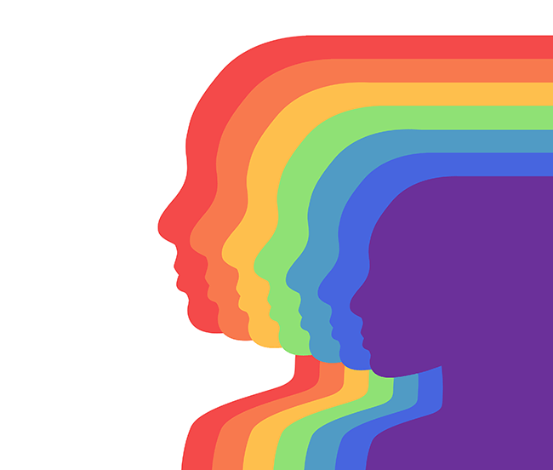
Schools Diversity Week
They all describe sexual orientations
Sexual orientation refers to a person’s sexual or romantic attraction to other people, or lack thereof.
Sexual orientation varies from person to person and is a very personal part of someone’s identity.
While these are terms you may be more familiar with, there are plenty of other terms people can use to describe their sexual orientation. Can you think of any others?

Slide 10
Schools Diversity Week
So what about gender identity?

Slide 11
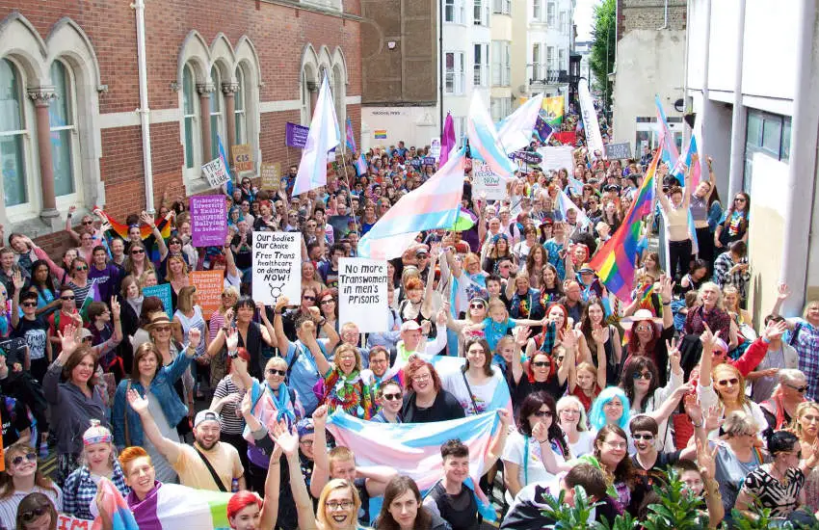
Schools Diversity Week
Gender identity is different to sexual orientation
While someone’s sexual orientation is about who they are attracted to, gender identity is about a person’s sense of their own gender, whether male, female or something else, which may or may not correspond to the sex assigned at birth.
Have a look at some of the key words on the next page and learn more about some of the key vocabulary used when talking about gender identity.
Trans Pride in Brighton

Slide 12
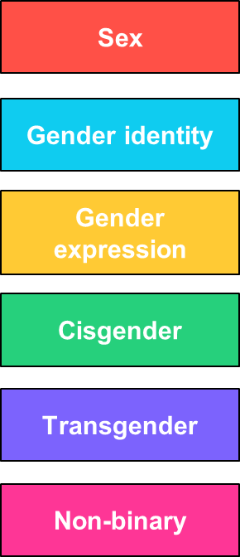
Schools Diversity Week
Match these words with their definition
Someone whose gender is not the same as, or does not match, the sex they were given at birth.
How a person sees their own gender. Gender identity relates to how you feel. It’s different from biological sex, or how you look or act.
People whose gender identity doesn’t match exactly with ‘man’ or ‘woman’. Some non-binary people identify with parts of being a “man” or “woman”, while others don’t at all.
Given to a person depending on their sex characteristics (genitalia and reproductive functions).
Sometimes people are born with differences in sex characteristics that means they don’t fit the typical definitions for male or female. This is called intersex.
This is how a person shows their gender identity to others. This might be through what they wear, how they act, their appearance, as well as many other ways.
Someone who is comfortable with the sex they were given at birth. A cisgender person is not transgender.

Slide 13
Schools Diversity Week
Match these words with their definition
Someone whose gender is not the same as, or does not match, the sex they were given at birth.
How a person sees their own gender. Gender identity relates to how you feel. It’s different from biological sex, or how you look or act.
People whose gender identity doesn’t match exactly with ‘man’ or ‘woman’. Some non-binary people identify with parts of being a “man” or “woman”, while others don’t at all.
Given to a person depending on their sex characteristics (genitalia and reproductive functions).
Sometimes people are born with differences in sex characteristics that means they don’t fit the typical definitions for male or female. This is called intersex.
This is how a person shows their gender identity to others. This might be through what they wear, how they act, their appearance, as well as many other ways.
Someone who is comfortable with the sex they were given at birth. A cisgender person is not transgender.

Slide 14
Schools Diversity Week
Match these words with their definition
Someone whose gender is not the same as, or does not match, the sex they were given at birth.
How a person sees their own gender. Gender identity relates to how you feel. It’s different from biological sex, or how you look or act.
People whose gender identity doesn’t match exactly with ‘man’ or ‘woman’. Some non-binary people identify with parts of being a “man” or “woman”, while others don’t at all.
Given to a person depending on their sex characteristics (genitalia and reproductive functions).
Sometimes people are born with differences in sex characteristics that means they don’t fit the typical definitions for male or female. This is called intersex.
This is how a person shows their gender identity to others. This might be through what they wear, how they act, their appearance, as well as many other ways.
Someone who is comfortable with the sex they were given at birth. A cisgender person is not transgender.

Slide 15
Schools Diversity Week
Match these words with their definition
Someone whose gender is not the same as, or does not match, the sex they were given at birth.
How a person sees their own gender. Gender identity relates to how you feel. It’s different from biological sex, or how you look or act.
People whose gender identity doesn’t match exactly with ‘man’ or ‘woman’. Some non-binary people identify with parts of being a “man” or “woman”, while others don’t at all.
Given to a person depending on their sex characteristics (genitalia and reproductive functions).
Sometimes people are born with differences in sex characteristics that means they don’t fit the typical definitions for male or female. This is called intersex.
This is how a person shows their gender identity to others. This might be through what they wear, how they act, their appearance, as well as many other ways.
Someone who is comfortable with the sex they were given at birth. A cisgender person is not transgender.

Slide 16
Schools Diversity Week
Match these words with their definition
Someone whose gender is not the same as, or does not match, the sex they were given at birth.
How a person sees their own gender. Gender identity relates to how you feel. It’s different from biological sex, or how you look or act.
People whose gender identity doesn’t match exactly with ‘man’ or ‘woman’. Some non-binary people identify with parts of being a “man” or “woman”, while others don’t at all.
Given to a person depending on their sex characteristics (genitalia and reproductive functions).
Sometimes people are born with differences in sex characteristics that means they don’t fit the typical definitions for male or female. This is called intersex.
This is how a person shows their gender identity to others. This might be through what they wear, how they act, their appearance, as well as many other ways.
Someone who is comfortable with the sex they were given at birth. A cisgender person is not transgender.

Slide 17
Schools Diversity Week
Match these words with their definition
Someone whose gender is not the same as, or does not match, the sex they were given at birth.
How a person sees their own gender. Gender identity relates to how you feel. It’s different from biological sex, or how you look or act.
People whose gender identity doesn’t match exactly with ‘man’ or ‘woman’. Some non-binary people identify with parts of being a “man” or “woman”, while others don’t at all.
Given to a person depending on their sex characteristics (genitalia and reproductive functions).
Sometimes people are born with differences in sex characteristics that means they don’t fit the typical definitions for male or female. This is called intersex.
This is how a person shows their gender identity to others. This might be through what they wear, how they act, their appearance, as well as many other ways.
Someone who is comfortable with the sex they were given at birth. A cisgender person is not transgender.

Slide 18
Schools Diversity Week
Match these words with their definition
Someone whose gender is not the same as, or does not match, the sex they were given at birth.
How a person sees their own gender. Gender identity relates to how you feel. It’s different from biological sex, or how you look or act.
People whose gender identity doesn’t match exactly with ‘man’ or ‘woman’. Some non-binary people identify with parts of being a “man” or “woman”, while others don’t at all.
Given to a person depending on their sex characteristics (genitalia and reproductive functions).
Sometimes people are born with differences in sex characteristics that means they don’t fit the typical definitions for male or female. This is called intersex.
This is how a person shows their gender identity to others. This might be through what they wear, how they act, their appearance, as well as many other ways.
Someone who is comfortable with the sex they were given at birth. A cisgender person is not transgender.

Slide 19
Schools Diversity Week
Closing thoughts

Slide 20
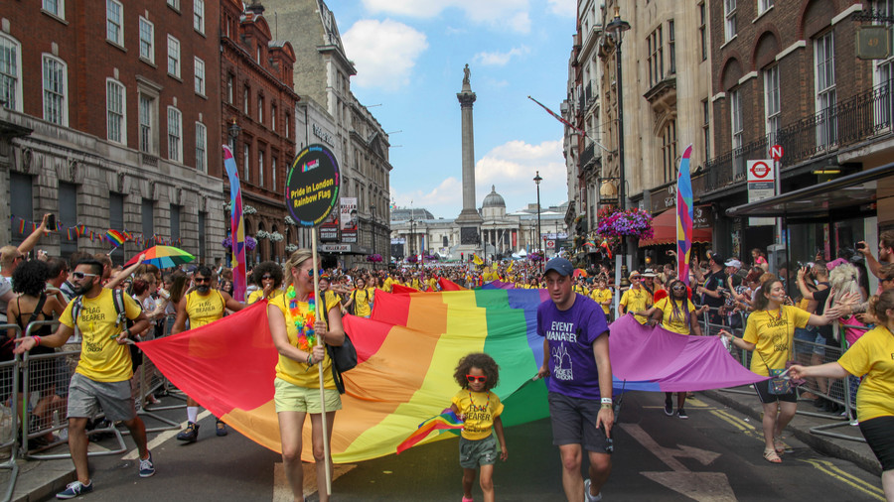
Schools Diversity Week
Sexual orientation and gender identity are very personal
It’s OK to not fully remember or understand every term you have seen today.
Talking to people and asking respectful questions about their identity is a great way to learn more about each other and understand more about the differences between us that make us unique.
However it is important to remember that both sexual orientation and gender identity are very personal parts of someone’s identity.

Slide 21
Schools Diversity Week
Dos and don’ts
Aim: Understand how to sensitively respond to someone coming out as LGBT+.
Task: Highlight the do’s and don’ts in different colours.
Notes:
The session begins by discussing what it means to ‘come out’. It will be important to underline how valuable it is just to listen to someone, and also to keep in mind that everyone’s situation is unique, and coming out as a particular sexual orientation isn’t the same as gender identity - each will have quite distinct considerations. The session ends on a ‘dos and don’ts’ sorting activity, offering pupils straightforward guidance. See support guide in folder for teachers to help discussions.

