Slide 1


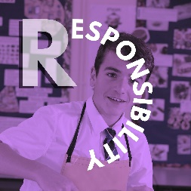

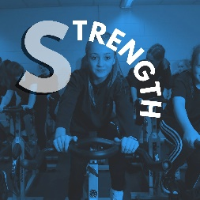
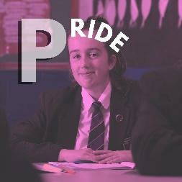


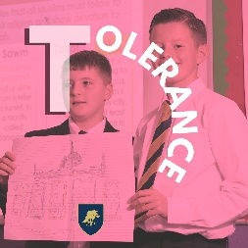
Life Skills & Wellbeing
Growing up LGBT+ today

Slide 2
Life Skills & Wellbeing
Aims for today’s session:
Gain insight into the experience of growing up as an LGBT+ person today
Think about how I can show acceptance in my own life

Slide 3
Life Skills & Wellbeing
Meeting the ‘Just Like Us’ ambassadors

Slide 4
Life Skills & Wellbeing
The videos on the next few slides feature several Just Like Us ambassadors, speaking about their experiences as LGBT+ people
We asked them to focus on the issues which were most significant to them
Their stories provide a window into the lived experiences of LGBT+ people in today’s society
Each video is accompanied by three areas on which to take notes, which can form the basis of a class discussion
We hope the videos will encourage young people to empathise with our ambassadors, potentially find comfort in their stories, or to better appreciate things their peers may be going through

Slide 5
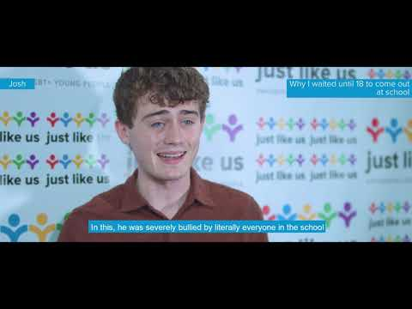
Life Skills & Wellbeing
Josh’s story
06.30 - 07.51
Josh identifies as a gay man
Notes:
http://www.youtube.com/watch?v=wgVpxw8UZpw

Slide 6
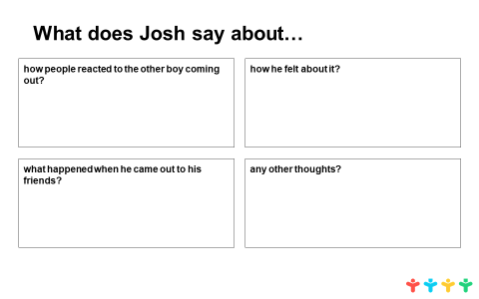
Life Skills & Wellbeing
Josh’s story
06.30 - 07.51
Josh identifies as a gay man

Slide 7
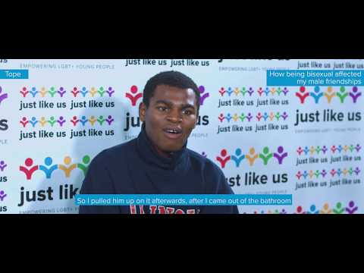
Life Skills & Wellbeing
Tope’s story
07.00 - 09.44
Tope identifies as a bisexual man
Notes:
http://www.youtube.com/watch?v=6N1NMgW51uw

Slide 8
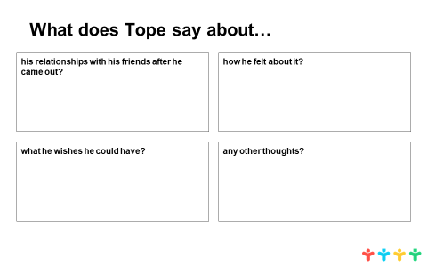
Life Skills & Wellbeing
Tope’s story
07.00 - 09.44
Tope identifies as a bisexual man

Slide 9
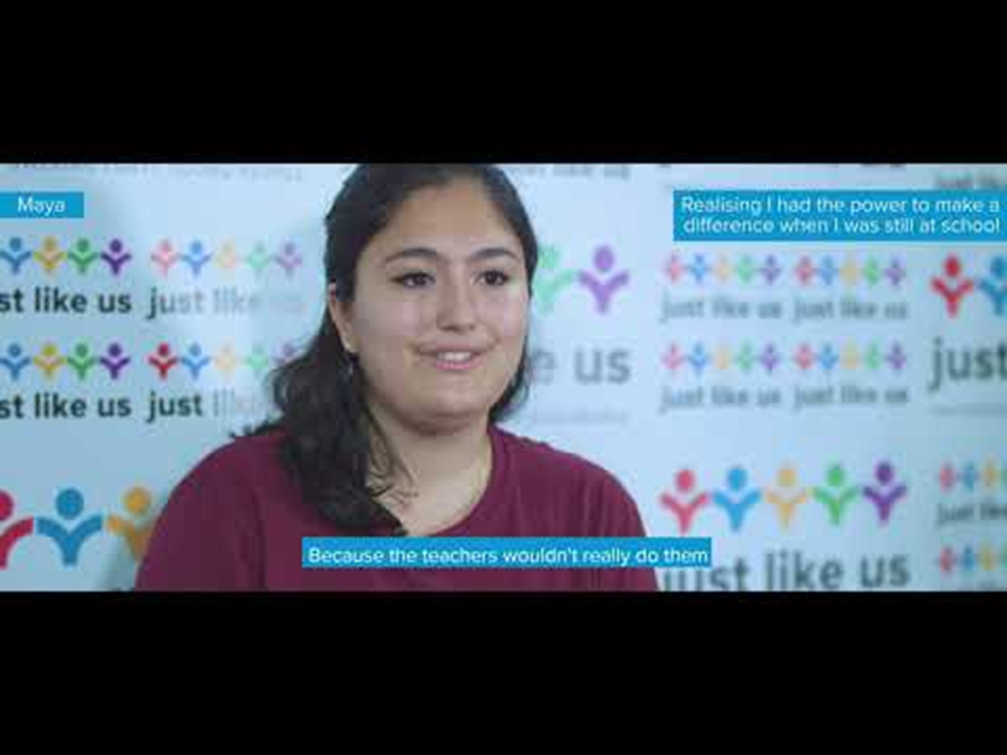
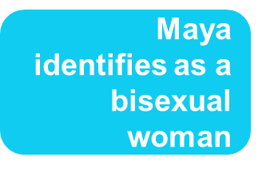
Life Skills & Wellbeing
Maya’s story
full clip
Notes:
http://www.youtube.com/watch?v=oWqtbLi__pQ

Slide 10
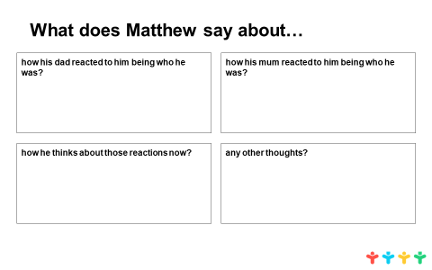
Life Skills & Wellbeing
Maya’s story
full clip

Slide 11
Life Skills & Wellbeing
Now reduce that to 5 key words
5-5-1 review
Write 5 sentences summarising what you will take away from today’s lesson
And finally to one word

Slide 12
Life Skills & Wellbeing
If you know you’re not LGBT+
Sexuality and gender are essential parts of all of us
Imagine growing up feeling like an outsider
Anti-LGBT+ bullying is as destructive as other bullying
YOU can make a huge difference

Slide 13
Life Skills & Wellbeing
If you know you’re LGBT+
If you’re having a rough time now, things get better
There’s no one way of being LGBT+
It won’t hold you back from having an awesome life
You are not alone – reach out for support at school and/or from helplines

Slide 14




Life Skills & Wellbeing
Switchboard LGBT+ helpline Childline
Brook help and advice The Mix help and advice
Who can I talk to?

Slide 15
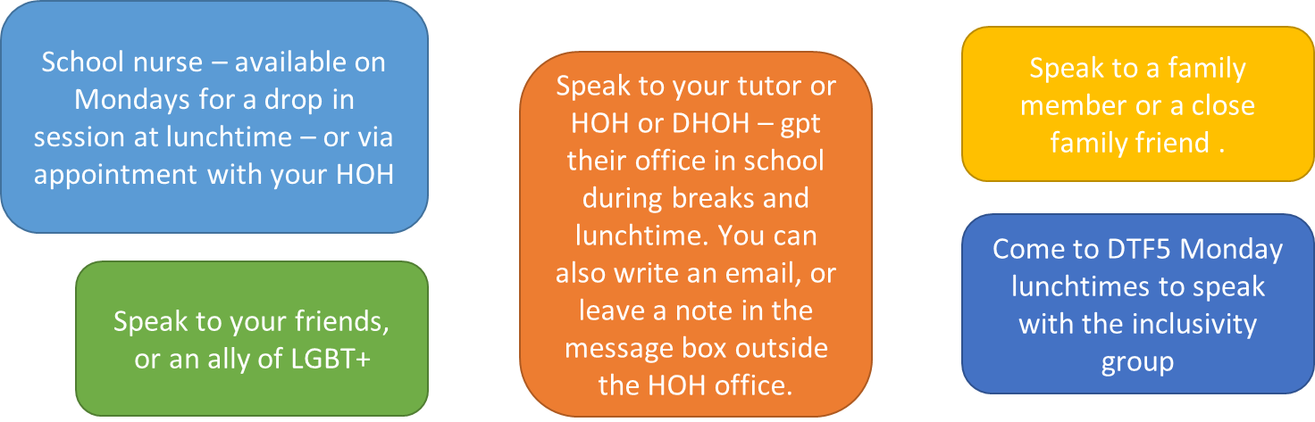
Life Skills & Wellbeing
Who can I talk to?

Slide 16

Life Skills & Wellbeing
What would you like our school to do for LGBT+ pupils?

