Slide 1



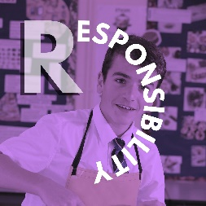

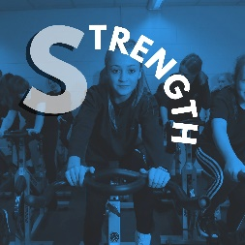
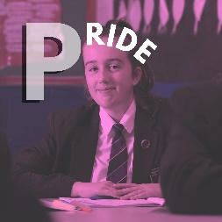


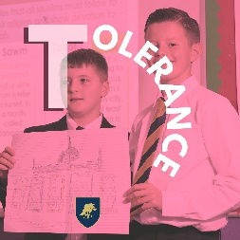
Schools Diversity Week

Slide 2

Schools Diversity Week
Prioritising wellbeing and mental health
As the statistics show, wellbeing and mental health should be a priority for young people everywhere, but particularly for LGBT+ young people.
Loneliness and isolation can have a big impact on wellbeing, when in reality, building connections and talking to those around you can be one of the easiest ways to reduce these feelings.

Slide 3

Schools Diversity Week
Discussion time!
What helps you to feel more relaxed in your day-to-day life?
What is one thing you achieved in the last week that made you feel happy?
What is one thing you could do today that might improve someone else’s day?
What one positive change would you like to see in your school that might reduce feelings of loneliness or isolation?

Slide 4

Schools Diversity Week
What is an ally?
An ally is someone who supports people who may face discrimination that they themselves will most likely not experience.
LGBT+ allies are typically straight, cisgender people who support the rights of LGBT+ people and play an important role in improving the lives of LGBT+ people in the UK.
Speak to your friends, or an ally of LGBT+
The LGBT+ ally flag

Slide 5
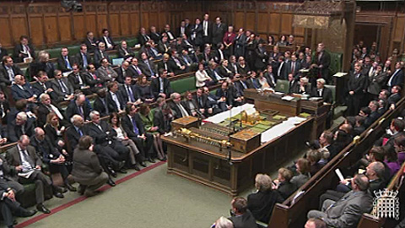
Schools Diversity Week
Why is being an ally important?
Being an ally is important as it shows empathy for the lives of those around you and the challenges they face.
Allies are important for supporting the causes of minority groups in many ways, and can help change the opinions of others around them, or even help vote through changes in the law.
The House of Commons during the debate that legalised equal marriage by a vote of 400 - 175 in 2013.

Slide 6
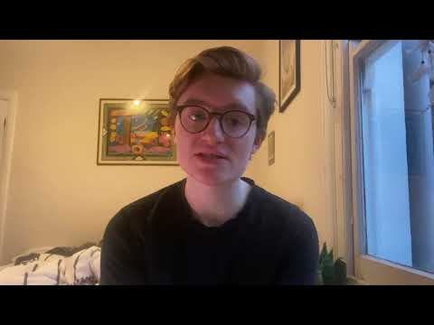
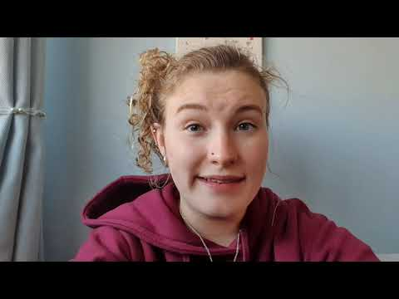
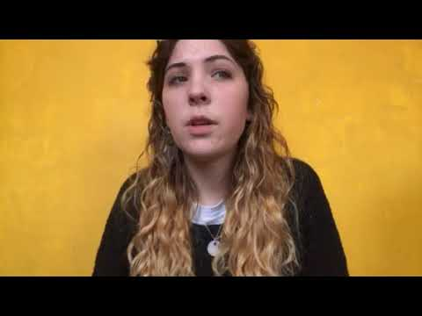
Schools Diversity Week
How have people been good allies to Elliott, Aoife and Georgie?
Elliott (he/him, they/them)
Aoife (she/her)
Georgie (she/her)
Notes:
The media clips are in the file for Wednesday

Slide 7
Schools Diversity Week
Legal
What are the arguments for being a good ally?
Moral
Psychological
Personal
Societal
Notes:
The media clips are in the file for Wednesday

Slide 8
Schools Diversity Week
Legal
Forms of discrimination, abuse and prejudice are against the law
Psychological
Being kind and helping others improves your own wellbeing
Moral
Believing it’s the right thing to do
What are the arguments for being a good ally?
Personal
Being informed about others, and the world you live in
Being empathetic
Being kind
Societal
Wanting to live in a more connected, more considerate world
Notes:
The media clips are in the file for Wednesday

Slide 9
Schools Diversity Week
How can someone be a good ally?
You have 2 minutes to write down as many ideas as possible.
IMPORTANT: write each idea on a separate post-it.
One idea to one post-it.
You have 3 minutes to group the ideas, before we feedback.
Notes:
What LGBT+ authors, actors or musicians can you name?
What content could you read, listen to or watch to learn more about LGBT+ people and their lives?

Slide 10
Schools Diversity Week
Did we find these categories?
Being informed
Understand your own privilege
Not being a bystander
Being visibly supportive
Listening
Letting people speak about their own experiences (when they’re comfortable to)
Volunteering
Fundraising
Sharing knowledge about helpful people, organisations or other resources
Notes:
What LGBT+ authors, actors or musicians can you name?
What content could you read, listen to or watch to learn more about LGBT+ people and their lives?

Slide 11
Schools Diversity Week
How can you be an ally?
The first step of being a good ally to someone else is learning more about people who are different from you and how their lives might be different.
This could include watching TV shows, listening to music, reading books or following social media accounts made by people from different backgrounds to you.
Notes:
What LGBT+ authors, actors or musicians can you name?
What content could you read, listen to or watch to learn more about LGBT+ people and their lives?

Slide 12
Schools Diversity Week
How can you be an ally?
The second step to being a good ally is to be respectful to those around you.
It is important to listen to people when they are telling you how they feel, which is even more important when they may be talking about things you have never experienced. Being respectful in the language you and those around you use is also important to making people feel safe, welcome and comfortable
Notes:
One of your friends is talking about an situation that made them feel really uncomfortable, but you don’t quite understand why – how could you respond?
Imagine someone uses a word in conversation you know would be offensive to one of your friends who isn’t there – how could you respond?

Slide 13
Schools Diversity Week
How can you be an ally?
The third step to being a good ally is to stand up for rights of people around you, whether you will benefit directly from it or not.
Staying up to date with events in the UK and around the world and talking to those around you can help you understand more about issues others find important, and highlight ways you might be able to show support for those causes yourself.
Notes:
What big issues have you heard about, either in the UK or around the world that you’ve tried to learn more about or tried to support?

Slide 14
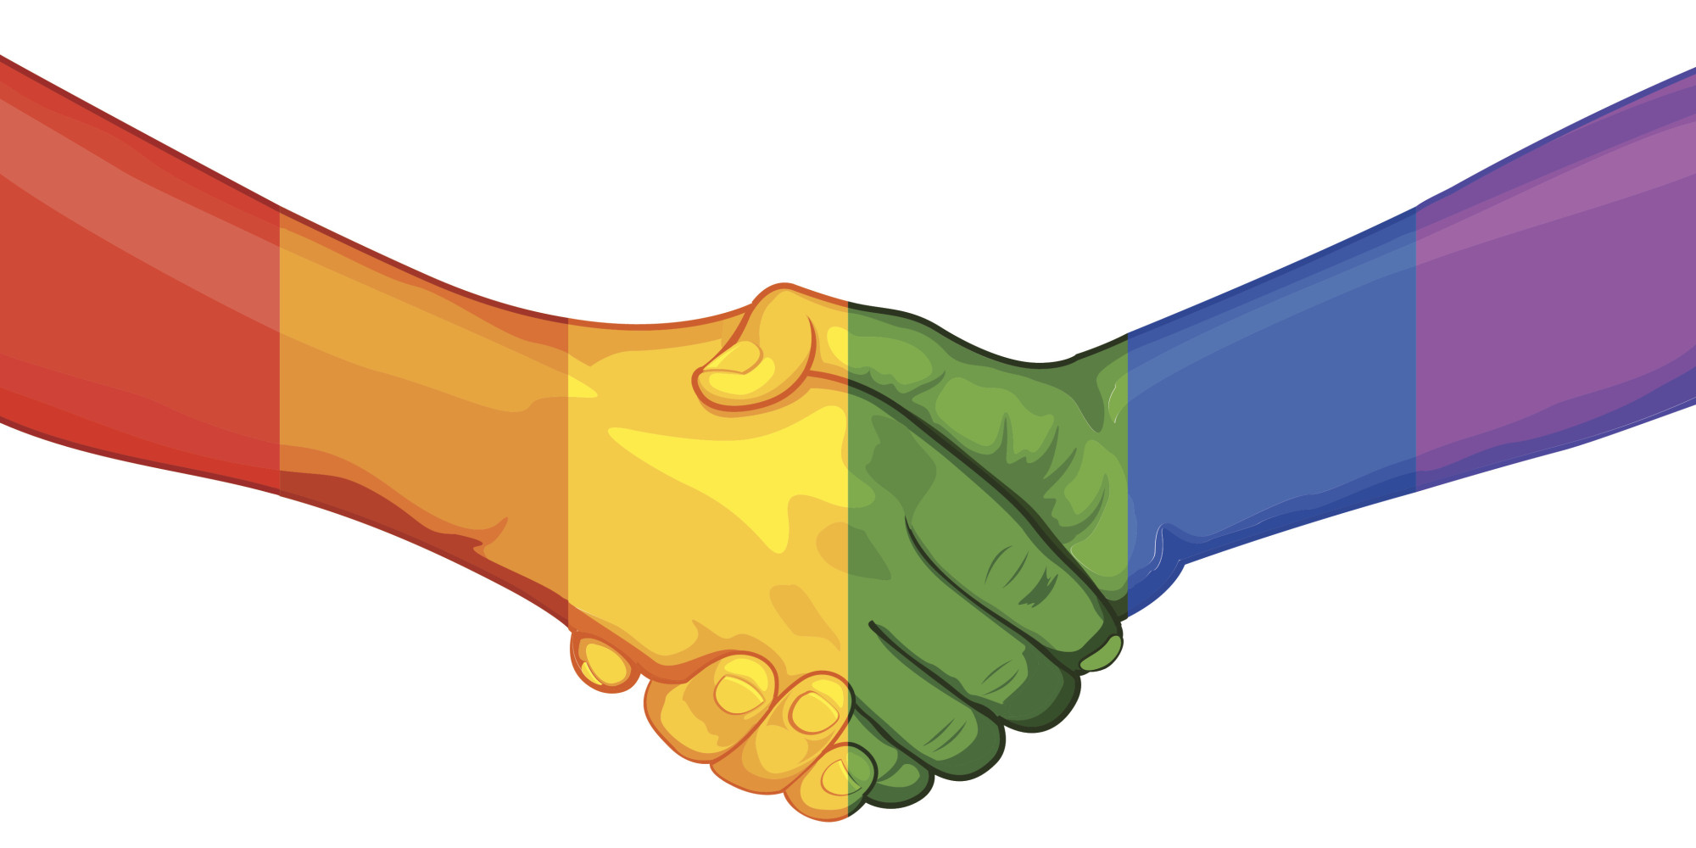
Schools Diversity Week
Bringing it all together

Slide 15
Schools Diversity Week
What to remember when being an ally
Educate yourself about people from all walks of life, not just your own
Listen to and respect the views and experiences of those around you
Stand up for the rights of others, even when you might not gain anything from it yourself

Slide 16
Schools Diversity Week
What can I do?
Write down 5 things you can do to be a better ally. Make them as specific as possible, without referring to individuals: actions you can take within the next weeks or months.
Use the ideas you generated earlier in the lesson for inspiration.
Example: add my pronouns to my social media profile.

Slide 17
Schools Diversity Week
Where can you get support and how can you access it?
School nurse – available on Mondays for a drop in session at lunchtime – or via appointment with your HOH
Speak to a family member or a close family friend .
Speak to your tutor or HOH or DHOH – gpt their office in school during breaks and lunchtime. You can also write an email, or leave a note in the message box outside the HOH office.
Come to DTF5 Monday lunchtimes to speak with the inclusivity group
Speak to your friends, or an ally of LGBT+

Slide 18

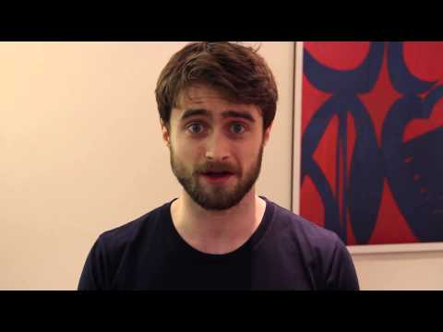
Schools Diversity Week
The British LGBT Awards - Daniel Radcliffe's Acceptance Video for Celebrity Straight Ally – YouTube
Daniel Radcliffe
Actor
Notes:
The British LGBT Awards - Daniel Radcliffe's Acceptance Video for Celebrity Straight Ally – YouTube

