Slide 1
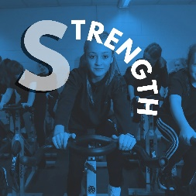
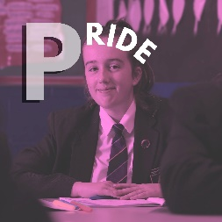
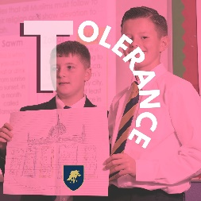
Schools Diversity Week
What is School Diversity Week?

Slide 2
Schools Diversity Week
What is School Diversity Week?
How would you define diversity?

Slide 3
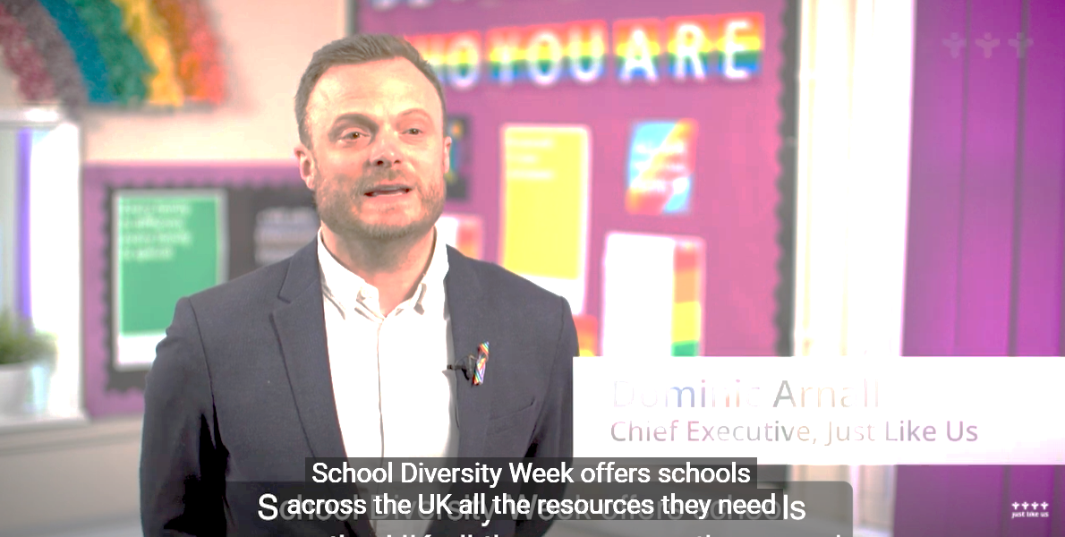
Schools Diversity Week
School Diversity Week is the UK-wide celebration of LGBT+ equality in primary and secondary schools.
School Diversity Week 2022 | Just Like Us – YouTube
Notes:
School Diversity Week 2022 | Just Like Us – YouTube

Slide 4
Schools Diversity Week
Young people across the UK show their support for LGBT+ equality.
They want to celebrate every single person in their school community, no matter their sexual orientation or gender identity.
In 2022, more than 5,000 schools are signed up to take part!

Slide 5
Schools Diversity Week
What is LGBT+?
Lesbian
Gay
Bisexual
Transgender
A woman who is attracted to women
This word is usually used to describe a man who is attracted to men. It can also be a general term for gay and lesbian people
When someone is attracted to more than one gender
Someone whose gender is not the same as, or does not match, the sex they were given at birth

Slide 6
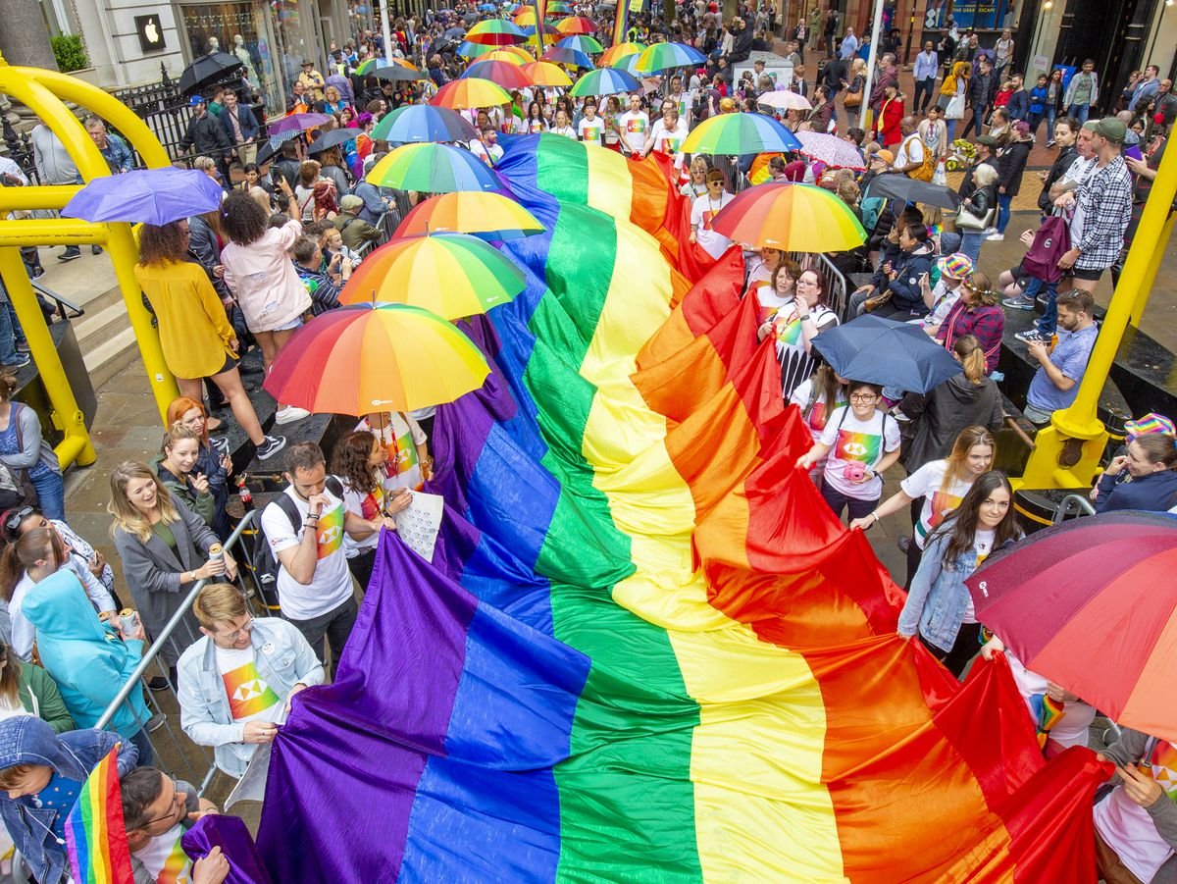
Schools Diversity Week
Happy Pride Month!
June is Pride month, a month dedicated to celebrating the LGBT+ communities around the world.
Pride is usually celebrated with parades and marches, and sometimes when people use the term ‘Pride’, they are referring to one of these events.
June is the month chosen to celebrate Pride as it was the month of the Stonewall riots - more on these later.
Notes:
Pride month takes place every June and is a dedicated to celebrating LGBT+ communities around the world. Pride marches happen in most large towns and cities across the UK, with some of the largest in London, Brighton and Manchester bringing together hundreds of thousands of LGBT+ people and allies every year. Pride is a chance for every part of the LGBT+ community to come together to celebrate each other, have fun and work together to improve lives for LGBT+ people across their towns, cities and the UK as a whole.

Slide 7
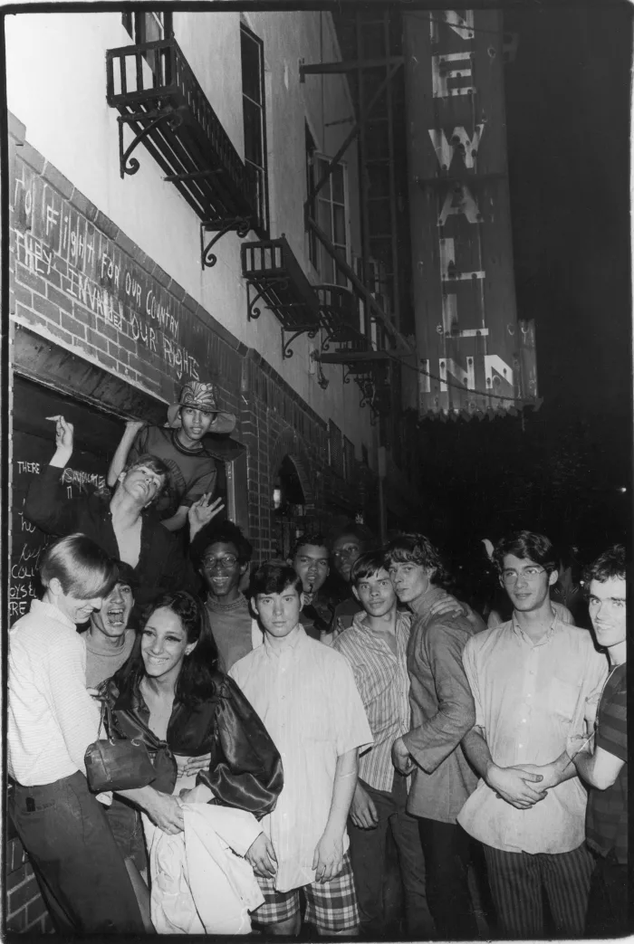
Schools Diversity Week
How did Pride start?
The Stonewall Inn in 1969
Pride has a long history, rooted in the political activism of LGBT+ communities around the world.
Through the 1950s & 60s, LGBT+ people faced legal discrimation and were sometimes raided by police in their community spaces.
For example in the UK male same-sex affection was illegal until 1967 and could have resulted in arrest and imprisonment.
Notes:
The Stonewall riots, LGBT+ groups had been organising to challenge legal discrimination they faced around the world. Before this, LGBT+ people faced daily discrimination and could be questioned or arrested by police for wearing clothes that did not match their assigned gender, for publicly showing same-sex affection, or even be targetted for raids in private community spaces by police where they were informed LGBT+ people might be meeting.

Slide 8
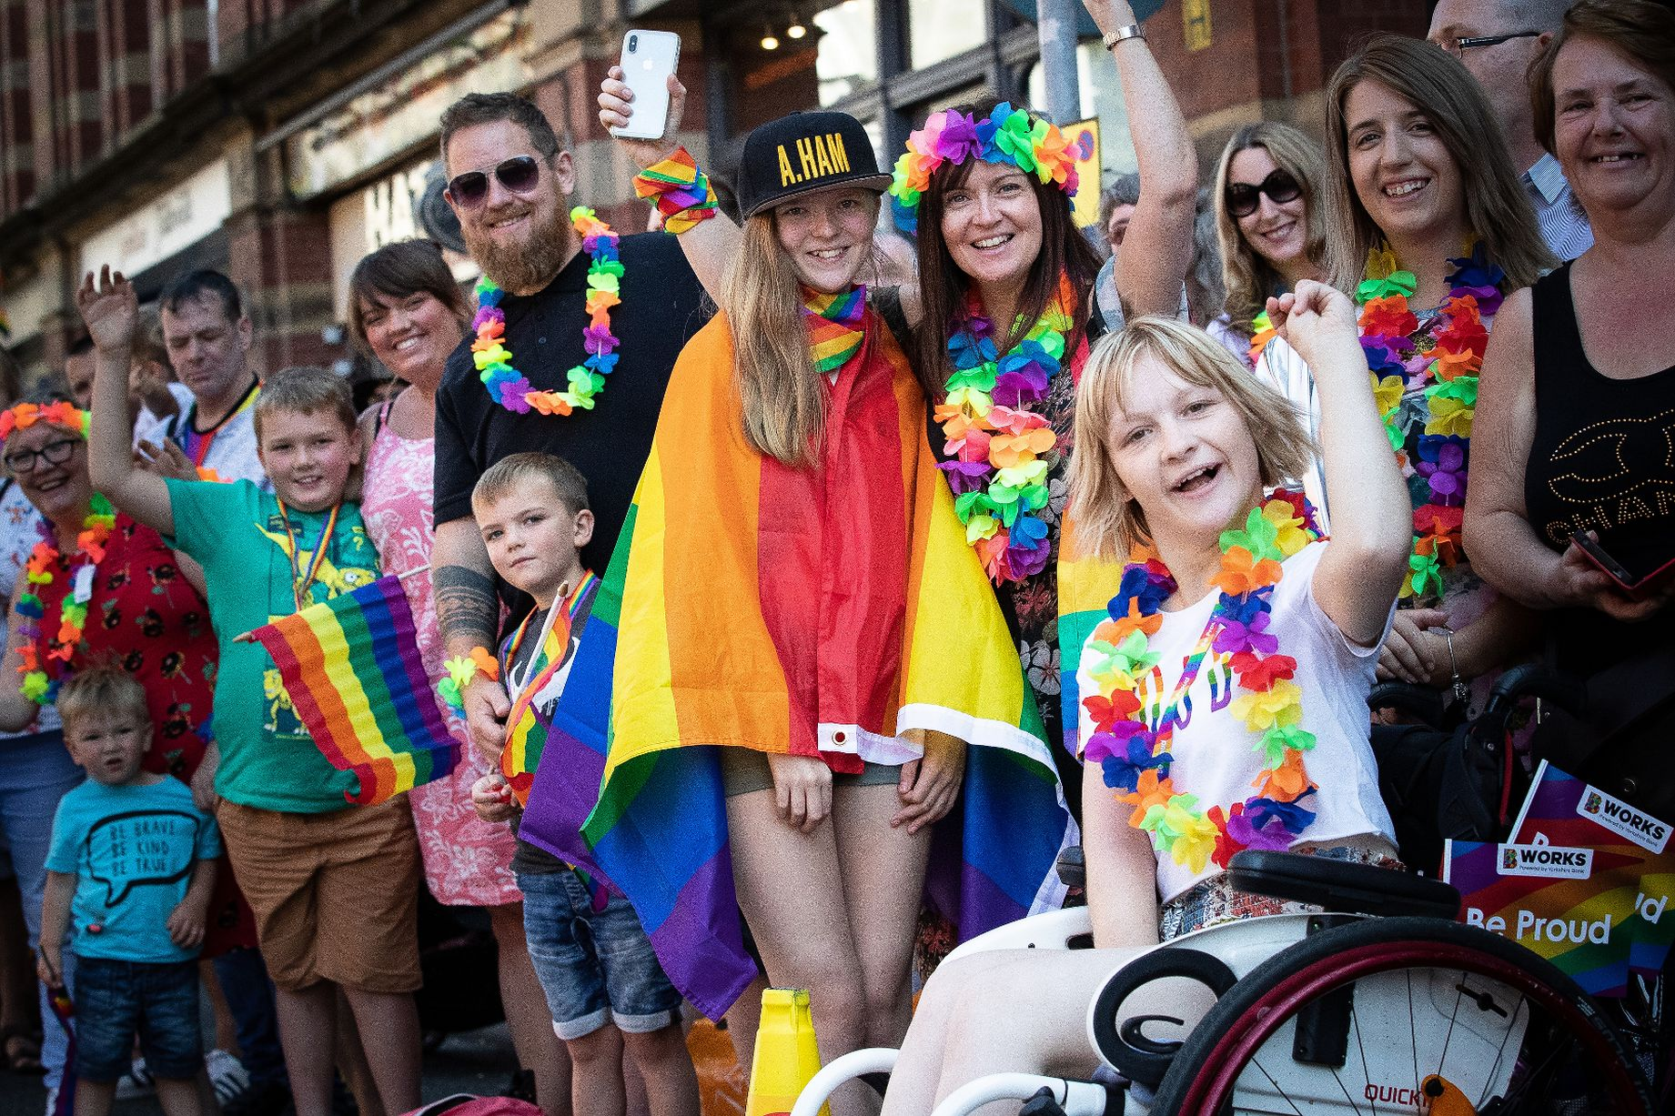
Schools Diversity Week
Pride in the UK today
As rights and freedoms for LGBT+ people have improved over time, Pride has increasingly become about celebrating the LGBT+ community, their lives and their achievements.
Alongside this, Pride is also a key time for local LGBT+ communities and organisations to come together and push for further change to improve the lives of LGBT+ people in the UK.
Notes:
Pride in the UK today reflects the improved rights and freedoms of LGBT+ people and while it still retains its political roots, the focus of Pride is now about celebrating the lives and achievements of LGBT+ people in an inclusive atmosphere with friends and family. Music and entertainment sit alongside community groups and activists to create a atmosphere that promotes the positive contributions of LGBT+ people to life in the UK, while still building on past successes at combating discrimination and improving the lives of people from every part of the LGBT+ community.

Slide 9
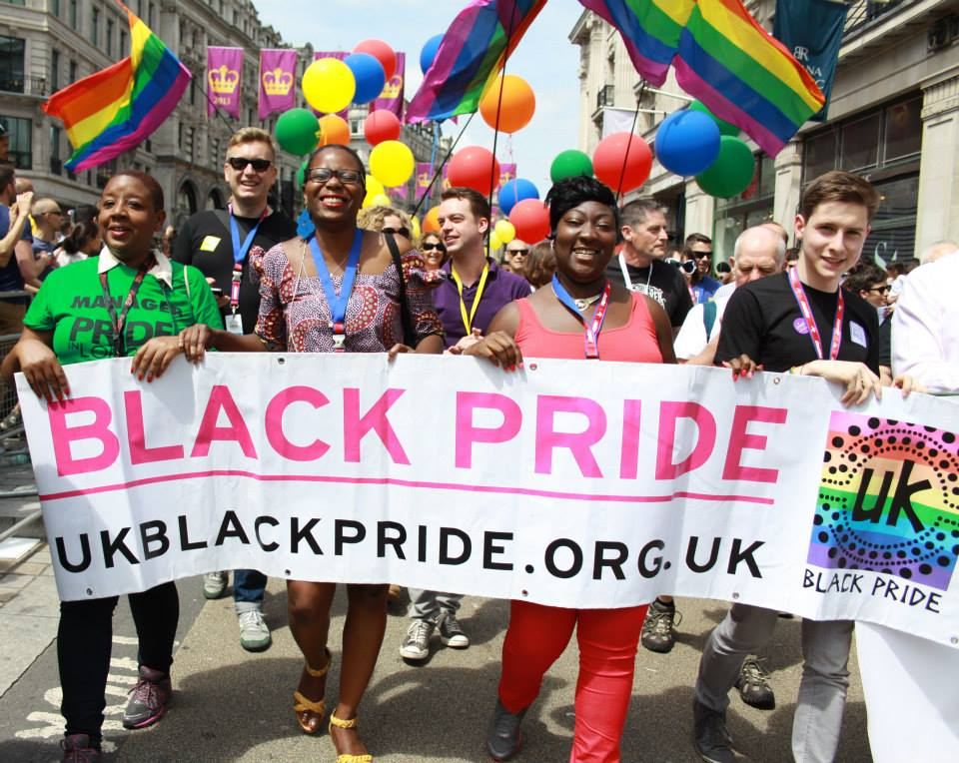
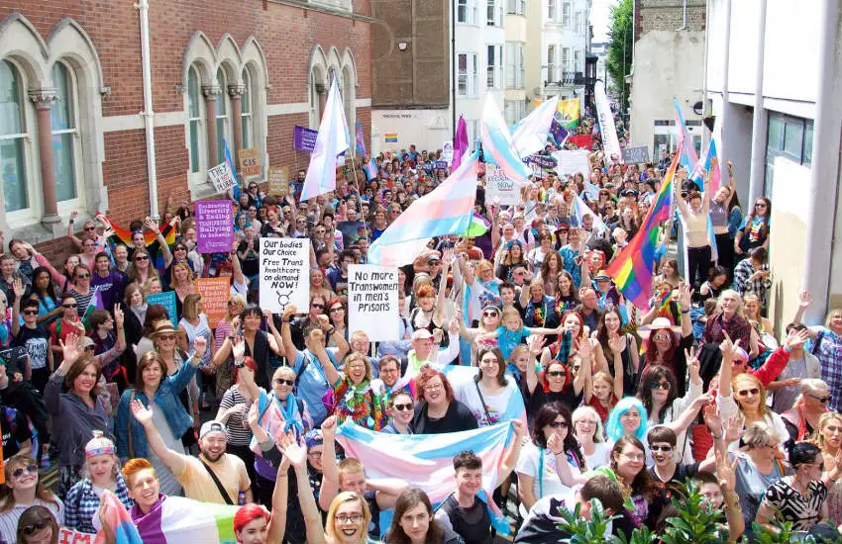
Schools Diversity Week
Pride in the UK today
Pride in the UK today still has its political roots and Pride parades with floats, music and entertainment are still often organised around contemporary LGBT+ issues.
UK Black Pride (top right) and Trans Pride in Brighton (bottom right) foreground the issues that face parts of the LGBT+ community while creating safe, inclusive spaces for everyone to celebrate Pride.
Notes:
Pride is still political. From our research

Slide 10
Schools Diversity Week
Head to your local Pride event!
Get involved and celebrate Pride month this year!
Notes:
https://www.chesterfieldpride.co.uk/

Slide 11
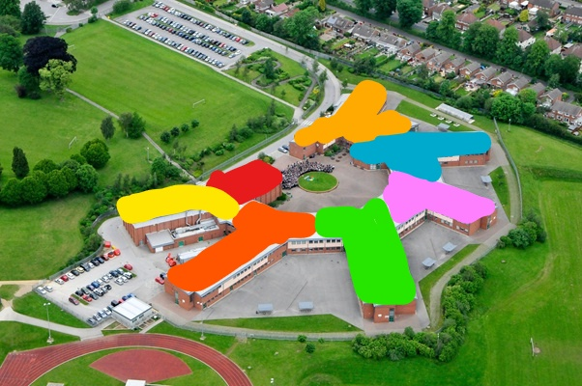
Schools Diversity Week
We can show we’re an accepting school community
We believe that no one should face discrimination because they are different to others
It’s important to do this because life can still be really difficult for LGBT+ people around the world
LGBT+ young people are still twice as likely to be bullied and struggle with mental health
Notes:
Why do we have School Diversity Week?

Slide 12
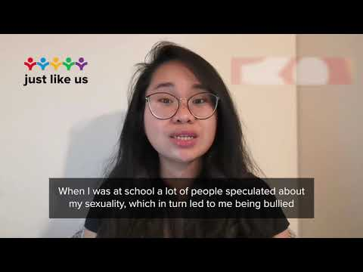
Schools Diversity Week
School Diversity Week 2021 – YouTube
Notes:
School Diversity Week 2021 – YouTube

Slide 13
Schools Diversity Week
What are our plans?
New posters, displays and features around school
Themed lessons within subjects, celebrating differences
This week we’ll...
Tupton Hall School Diversity Week
Diversity themed quiz, prepared by students
Bake off ‘Diversity Cake’ competition
Themed Diversity Week tutor times, every day – celebrating differences
Students encourages to wear a rainbow ribbon or badge
Be inclusive to all others

Slide 14
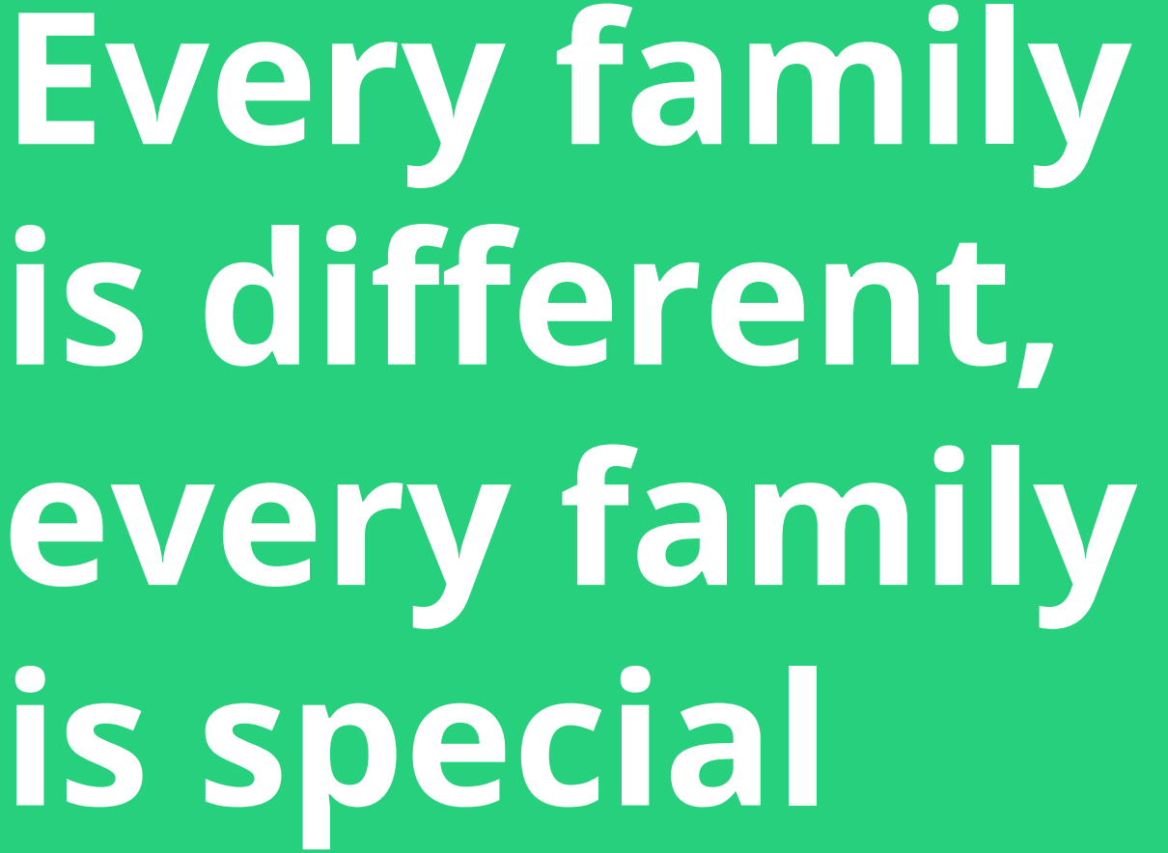
Schools Diversity Week
Thoughts for the week ahead

